Slide 1
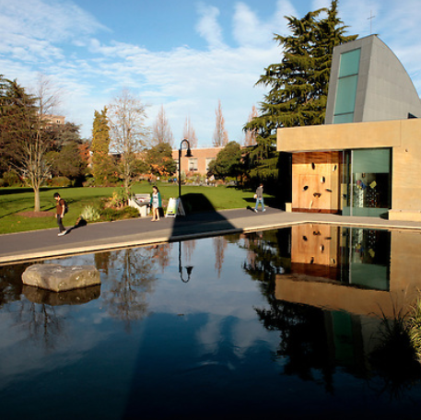
Re-imagining What Counts for Faculty Advancement: Cultivating a Culture of Valuing Comprehensive, Inclusive Faculty Careers
An Experience Report Presented by:
Jodi O’Brien, Jenny Loertscher, & Colette Taylor
Notes:
Colette 1-3

Slide 2
Goals of SU ADVANCE: Reimagining the Professoriate
Critically examine taken-for-granted ideals regarding faculty careers and what counts.
Alignment of our educational mission with the realities of what is actually happening, and the recognition systems that are used to evaluate faculty.
Reimagined professoriate in which the diversity of contributions are valued, welcomed, and celebrated for what they are—necessary for success, satisfaction, and sustainability of the university.
Through restructuring our promotion guidelines, and through the mentoring program, we will be able to effect the cultural transformation that is necessary if we are to truly be a diverse campus.

Slide 3
Seattle University ADVANCE-IT Experience Report: How to Effect the Cultural Changes Necessary to Support and Sustain Institutional Transformation
Critical examination of cultural barriers to advancement
Unexamined faculty beliefs and ideals
Participatory action research as a cultural change method
In-depth interviews
Cultivating a critical mass of faculty change agents
Consciousness raising
Signs of deep change
Focus groups
Multi-level engagement
Reframing entrenched ideals
One size fits all promotion criteria
Insufficient methods for evaluating a comprehensive range of faculty activities
Emergent and iterative learning
Engaging with resistance
SU ADVANCE institutionalized as the faculty development philosophy for
University 5-year strategic plan
2023 NSF ADVANCE Partnership:
Multi-dimensional faculty
evaluation metrics
Prior to 2021
0-2 promotions
annually
2021
7 promotions
2022
9 promotions
2023
11 promotions
Evidence of multi-level change
and institutional literacy
Reframing the
external evaluation
process for promotion
FOC affinity mentoring
&
Mentoring the mentors
Notes:
Emphasis in this presentation. Is cultural change

Slide 4
Philosophy
Recognize and reward an inclusive, comprehensive range of faculty activities that constitute the basis of higher education:
Student success
University community and governance
University reputation and rankings
Public engagement (democracy).

Slide 5
Faculty Activities Inventory
Consider some of the activities that you engage in as a faculty member that you are good at and enjoy beyond traditional research.
1) Do these activities contribute to:
-Student success?
-University functioning?
-University reputation and mission?
-Broader communities?
-Public interest?
2) Do they count toward tenure and promotion?
3) Where do you put them on your CV?
Notes:
Title slide for this and next one: crtically re-examining ….

Slide 6
Under-Valued Faculty Activities:
Undervalued scholarship: applied, public-focused; teaching-related
Community engaged research
Faculty administrative leadership (institution building)
Diversity and inclusion work
Women faculty and faculty of color are over-represented in all of these activities.
Notes:
Compare with UCCS notes and. Discuss both unexamined beliefs and process of engaging.

Slide 7
Exercise
Participatory Research Action (PAR) –
Critical Examination
What beliefs and practices get in the way of recognizing and valuing an inclusive, comprehensive range of faculty activities?

Slide 8
Seattle University took on a culture of resistance and successfully revised its promotion guidelines to count undervalued faculty contributions
Holistic faculty careers support a diverse, equitable, vibrant university
Community-engaged scholarship
Student-faculty research
Institution building; administrative work
Applied Research
Diversity and inclusion work
I love the university mission, but it's killing me
Traditional metrics for advancement neither recognize nor accurately evaluate these activities
We value these activities, we just don't know how to count them
Women and faculty of color are more likely to be engaged in
these activities
We value diversity work, just not as a path to promotion. Those faculty should get a plaque or something
If you want to do community or applied research, go for it, but don't expect to get promoted
Notes:
Engaged this culture of resistance. - pivots around hfd

Slide 9
What is Holistic Faculty Development?
INTENT
Post-tenure systematic focus and planning for integrated professional development and intentional contribution in specified domains.
Encourage formative conversations between faculty, chairs, and deans.
Establish a specified reference basis for annual performance evaluations.

Slide 10
Holistic Faculty Development Plan as Leverage for Change
Is initiated in the first year post-tenure.
Is intended to be a dynamic, work-in-progress (propose, practice, reflection, revise).
Includes consideration and systematic development around:
Faculty passions/expertise.
Identified communities of practice.
Alignment with institutional mission.

Slide 11
Professional Identity I am a ___________?
In a few words or a phrase, how would you describe your professional identity?
(be creative, have fun with this)
Notes:
Flipped emphasis from what. Journal next to professional identity. Development and communities of practice.

Slide 12
Reflection:
What is the impact you intended to make when you entered the profession?
What have you learned from going through the tenure process about yourself?
What are you passionate about in context of your professional identity?
How would you describe your specific forms of expertise?
How does this expertise show up in your professional life?
How does this expertise show up in your university engagements?
What are the unifying themes of your professional life?
How does your professional identity and journey to professor align with your institution’s mission?

Slide 13
Identifying “Communities of Practice”:
Who/what are the professional audiences in your head?
Where/how do you aspire to have impact? How would you demonstrate that impact?
What contributions are you already making that you think don’t count; how might you develop these?
Notes:
Need a conclusion slide following this one and. Tie-in to partnership

Slide 14
Take-aways
Cultural Transformation
Experiment-in-process
Engage Resistance in Critical Examination
Communication across multiple levels
PAR and Iterative Learning
Indicators of Deep Cultural Shift
Strategic Directions
Surge in faculty morale
# of petitions for promotion
Generous faculty support
Notes:
Jodi conclusion

