Slide 1

The 2021
Harriet Stephenson
Business Plan Competition
Wednesday Workshop 4: Legal & Financial Basics

Slide 2
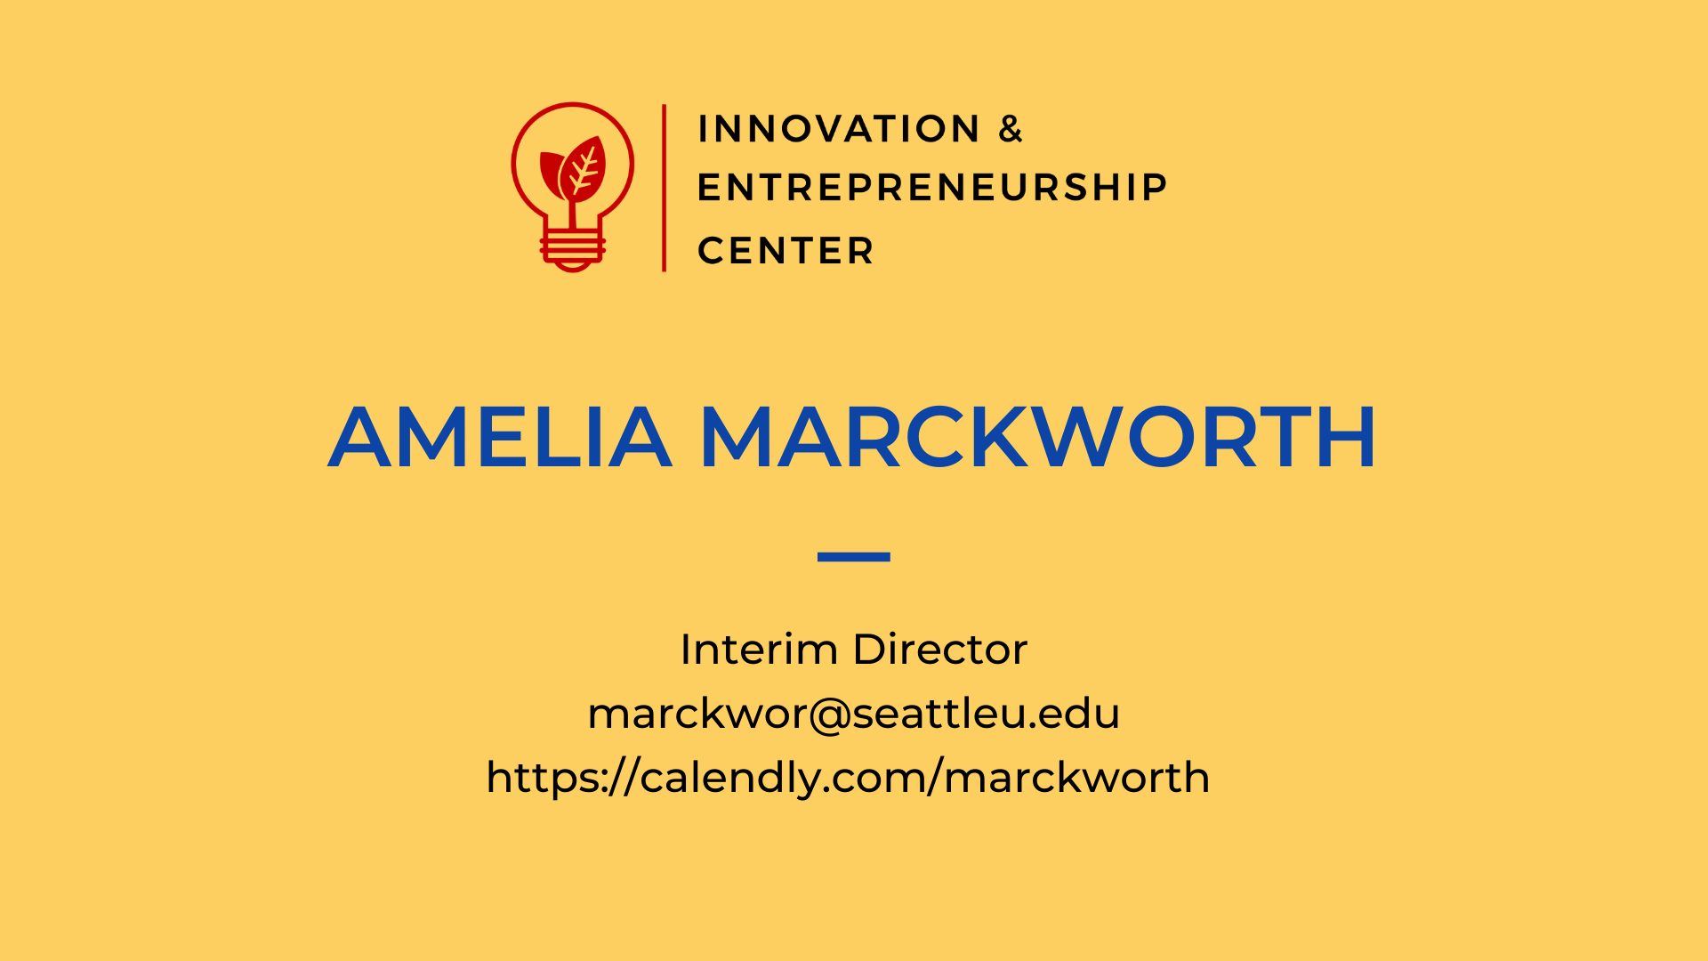

Slide 3
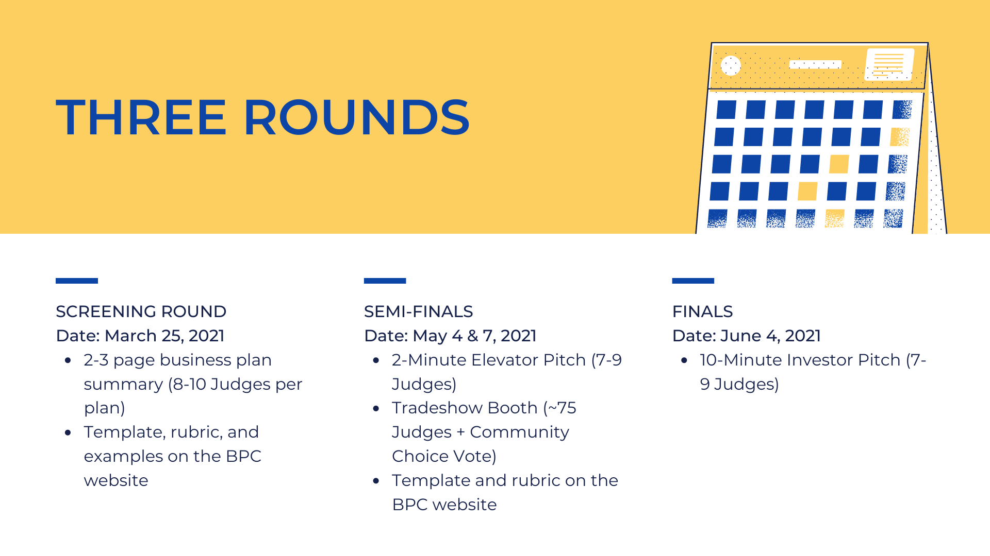

Slide 4
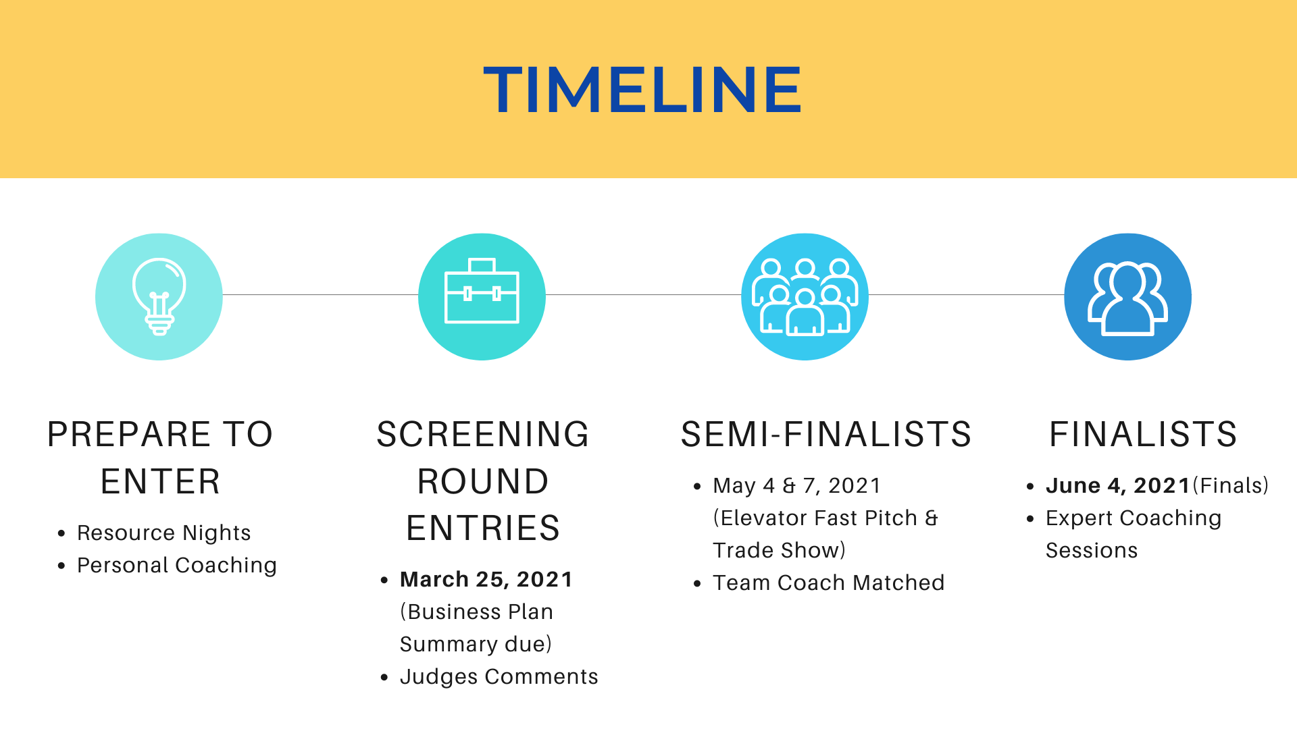
TIMELINE
Screening Round Entries (~35)
Semi-Finalists (20-25)
April 7 BOOTCAMP
Finalists (4)
May 31 FINALS
March 24 BUSINESS PLAN SUMMARY
Judges Comments
May 7 PITCH COMPETITION & TRADESHOW
Team Coach Matched
Expert Coaching Sessions
Prepare to Enter
RESOURCE NIGHTS
Personal Coaching

Slide 5
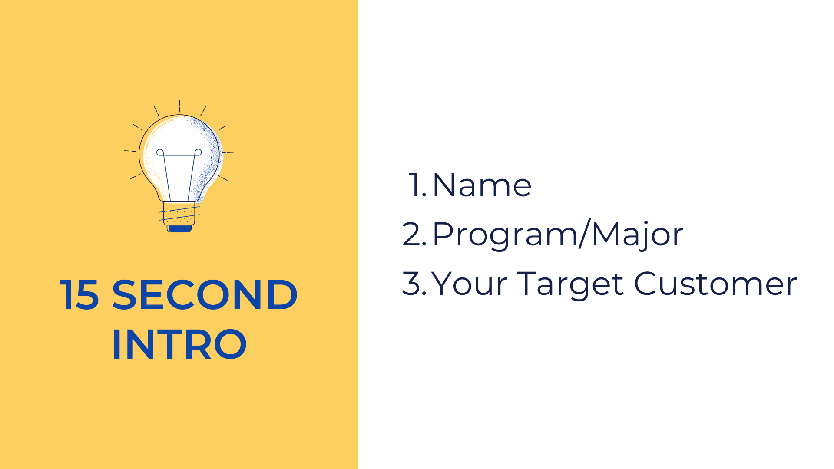
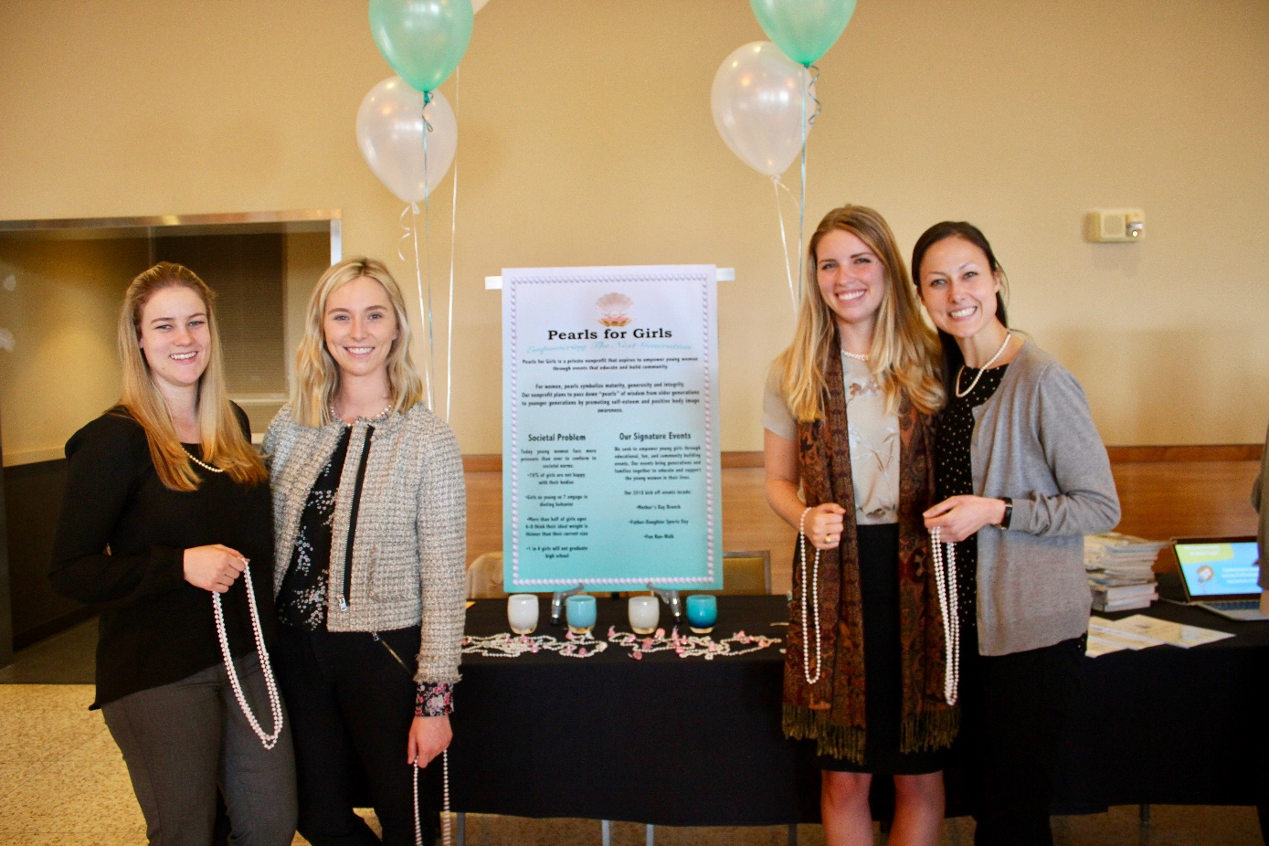
30 Second Intro
Name
Program/Major
Your Product/Service

Slide 6
Legal Structures – Sole Proprietorship
Pros
Most common
Easy, low cost
Complete managerial control
Expenses & income on your personal tax return
Cons
You’re liable for financial debt.
So, your personal assets are at risk.
Consider When You
Have no/few employees (solopreneurs)
Have few personal assets
Can protect your business with insurance
Want to test a concept

Slide 7
Legal Structures – Partnerships
General: All partners are fully liable
Limited: Only general partner is fully liable
Limited Liability: No partners are fully liable
Pros
Relatively easy, low cost
Some tax advantages for reporting your share of income/losses
Cons
General partners have unlimited liability
Consider When You
Plan to have several partners
Common with real estate

Slide 8
Legal Structures – Corporation
S-Corp’s most common; C-Corporation for high-growth ventures
Pros
Independent legal entity
Owners’ assets (beyond investment) aren’t at risk
Cons
More expensive, complex, board of directors
More accounting, tax-prep, double-taxation (C-Corp)
S-Corp. limited to 100 shareholders
Consider When You
Need liability protection
Want flexibility to grow
Common for manufacturers, restaurants, high-growth companies

Slide 9
Legal Structures – Limited Liability Corporation
Pros
Limited protection as with corporation
No double taxation/earnings & losses on personal tax return
Less expensive than corporation to set up
Cons
More complex than sole proprietorship
May have to pay self-employment tax on earnings
Consider When You
Need some liability protection
Want flexibility to grow
Are starting out and not sure how you’ll grow

Slide 10
Legal Structures – Non-Profit Corporation
Pros
Limited protection as a corporation
Can accept tax-deductible donations
Not beholden to shareholders
Cons
More complex accounting, reporting, board of directors
Must file for IRS tax-exempt status to receive donations
Not profit-focused
Consider When You
Don’t want a high-growth or “lifestyle” company
501c3: religious, educational, charitable
501c4: social/advocacy

Slide 11
Protecting your Intellectual Property
Trade Secrets: "information, including a formula, pattern, compilation, program, device, method, technique, or process that:
  Derives independent economic value, actual or potential, from not being generally known to, and not being readily ascertainable by proper means by, other persons who can obtain economic value from its disclosure or use; and
  Is the subject of efforts that are reasonable under the circumstances to maintain its secrecy.
Trademarks: A trademark is any word, name, symbol, or design, or any combination thereof, used in commerce to identify and distinguish the goods of one manufacturer or seller from those of another and to indicate the source of the goods.
Copyrights: The exclusive legal right to reproduce, publish, sell, or distribute the matter and form of something
Patents: The five primary requirements for patentability are: (1) patentable subject matter, (2) utility, (3) novelty, (4) nonobviousness, and (5) enablement.
https://www.law.cornell.edu/wex

Slide 12
Patents
A patent grants the patent holder the exclusive right to exclude others from making, using, importing, and selling the patented innovation for a limited period of time.
Utility Patent
  Issued for the invention of a new and useful process, machine, manufacture, or composition of matter, or a new and useful improvement thereof, it generally permits its owner to exclude others from using, or selling the invention for a period of up to twenty years from the date of patent application filing, subject to the payment of maintenance fees. Approximately 90% of the patent documents issued by the in recent years have been utility patents, also referred to as "patents for invention".
Design Patent
  Issued for a new, original, and ornamental design embodied in or applied to an article of manufacture, it permits its owner to exclude others from making, using, or selling the design. Design patents issued from applications filed on or after May 13, 2015 shall be granted for the term of fifteen years from the date of grant. Design patents issued from applications filed before May 13, 2015 shall be granted for the term of fourteen years from the date of grant. Design patents are not subject to the payment of maintenance fees.
Plant Patent
Reissue Patent
Statutory Invention Registration (SIR)
https://www.law.cornell.edu/wex

Slide 13
Start a Business in Washington
File your formation document with the Secretary of State.
Wait for processing and your UBI number.
Submit your master Business License Application.
Apply for other licenses and permits.
File your Initial Report.
Obtain a Federal Tax ID Number (EIN).
Pay taxes to the Department of Revenue.
Get Workers’ Compensation and Unemployment Insurance
Keep in compliance.
https://www.washingtonregisteredagent.net/how-to-start-a-business-in-washington-state.html

Slide 14
What Licenses Do You Need?
File with WA Office of the Secretary of State (for corporations, nonprofits, LLCs, and limited partnerships, $50 - $200)
Get WA State Business License (WA Dept. of Revenue, $19 application fee, UBI number, renew annually if LLC or Corp.)
Get Specialty License, as needed (WA Dept. of Revenue)
Get Seattle Business License Tax Certificate ($110 annually/$55 for small business)

Slide 15
Business Resources
Seattle Public Library Business Section
Seattle Office of Economic Development
Small Business Administration (SBA)
WA State Dept. of Revenue
WA Business Hub: http://business.wa.gov/
Small Business Development Centers
Women’s Business Centers
SCORE mentors
Veteran Business Opportunity Centers

Slide 16
Legal Structures – Factors to Consider
How much control do you want?
How much growth do you expect/want?
How much flexibility?
What’s your exit strategy, if any?
How much time & money do you want to expend?
How much risk/liability are you willing to assume?

Slide 17
Business Model
Describe how you will make money, in the short- and long-term.
Is your offering to business to consumer (B to C), business to business (B to B), or both?
What are your key revenue streams?
  How viable and sustainable are these revenues? How have you tested this?
What’s your proposed pricing strategy?
What are your startup expenses and ongoing expenses? What are the key drivers of your expenses?
What are your average revenues, expenses, and gross profits per client, product, store, etc?
How will you provide customer and partner support?

Slide 18
Company Financials & Funding
What are your 3-5 year financial projections for revenues, expenditures, and profit?
What is your break-even level of revenues and when does it occur?
What are your key assumptions and how have you tested them?
What, if any startup funding have you had so far? How have you used the funds?
What startup or other funding do you need going forward? How much and what will you use it for?
How much outside funds do you want, if any, and how will you use them? What will investors get in return, including equity ownership?

Slide 19
Create a Compelling Financial Story
2 - Know and size your market
3 - Select revenue model(s)
4 - Estimate revenues
5 - Estimate startup costs
6 - Estimate ongoing operating expenses
7 - Create your financials
8 - Consider Triple Bottom Line
1 - Understand your audience

Slide 20
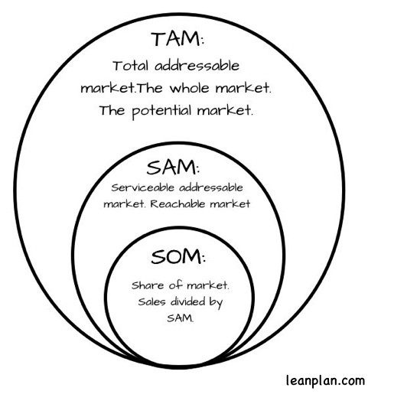
Size Your Market
2 - Know and size your market

Slide 21

Types of Revenue Models
3 - Select revenue model(s)
Unit Sales – Plum Restaurant
Advertising - Google
Data - Facebook
Intermediation/Broker – Real Estate
Licensing – SalesForce
Subscription – News/Media
Franchising - McDonalds
Professional Services - Consulting
Utility/Usage – Rental Car
Freemium - LinkedIn

Slide 22
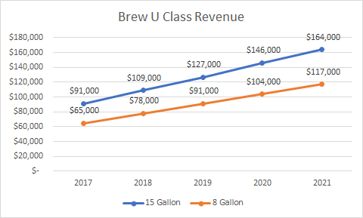
Revenue Streams - BrewU
4 - Estimate revenues
Price Per Class
8 Gallon Class = $250
15 Gallon Class =$350

Slide 23
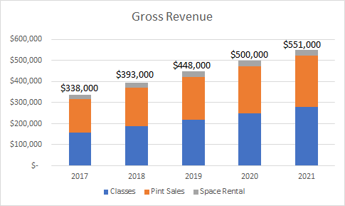
Revenue - BrewU
4 - Estimate revenues

Slide 24
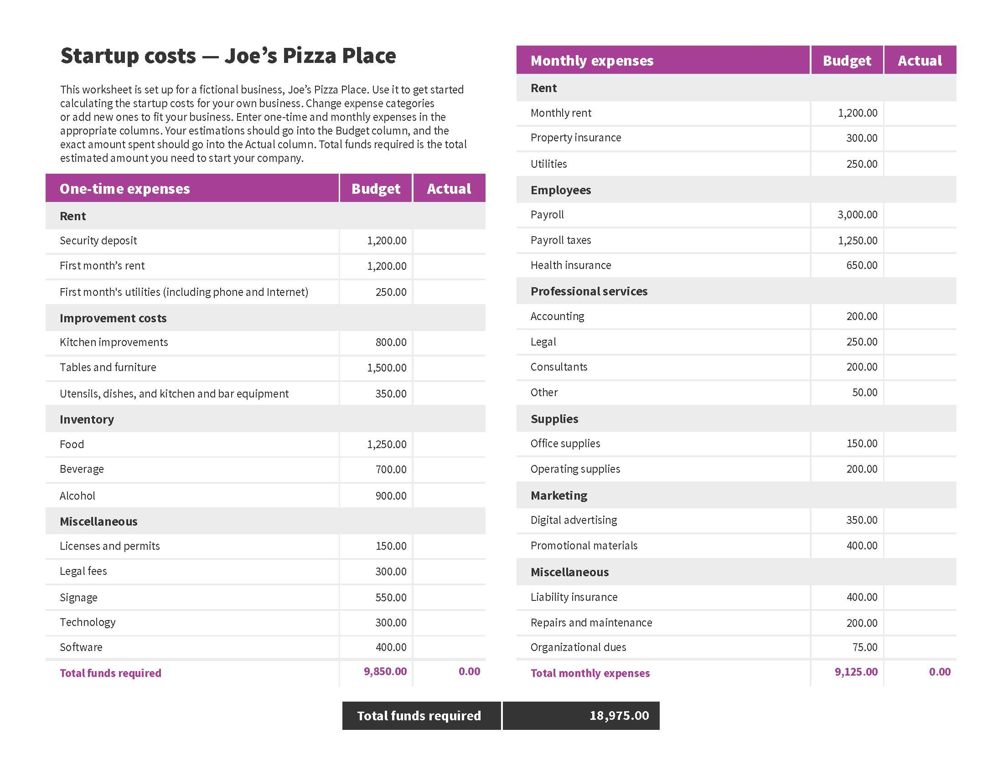
6 - Estimate ongoing operating expenses

Slide 25
PROJECTIONS (000s)
7 - Create your financials
 | 2018 | 2019 | 2020 | 2021 | 2022
TOTAL REVENUE | $88 | $1,374 | $3,830 | $12,026 | $17,200
MARKETING & TECHNOLOGY | $259 | $375 | $1,153 | $1,804 | $2,580
COGS | $201 | $1,289 | $1,959 | $5,908 | $6,022
TOTAL EXPENSES | $460 | $1,664 | $3,112 | $7,712 | $8,602
EBITA | ($372) | ($290) | $718 | $4,314 | $8,598
Margin | (424%) | (21%) | 19% | 36% | 50%

Slide 26

Triple Bottom Line
8 - Consider Triple Bottom Line
Sustainable Cash Flow
  Break even in Year 1, with increased cash reserves each subsequent year to reinvest into the school
People
  Provide an opportunity for economically challenged families to obtain educational services not previously available
Planet
  Minimize carbon footprint – all services will be under one roof

Slide 27
Create a Compelling Financial Story
2 - Know and size your market
3 - Select revenue model(s)
4 - Estimate revenues
5 - Estimate startup costs
6 - Estimate ongoing operating expenses
7 - Create your financials
8 - Consider Triple Bottom Line
1 - Understand your audience

Slide 28
Plan Submission Requirements
Business Model
Financials & Funding
Describe how you will make money, in the short- and long-term.
Is your offering to business to consumer (B to C), business to business (B to B), or both?
What are your key revenue streams? How viable and sustainable are these revenues? How have you tested this?
What’s your proposed pricing strategy?
What are your startup expenses and ongoing expenses? What are the key drivers of your expenses?
What are your average revenues, expenses, and gross profits per client, product, store, etc?
How will you provide customer and partner support?
What are your 3-5 year financial projections for revenues, expenditures, and profit?
What is your break-even level of revenues and when does it occur?
What are your key assumptions and how have you tested them?
What, if any startup funding have you had so far? How have you used the funds?
What startup or other funding do you need going forward? How much and what will you use it for?
How much outside funds do you want, if any, and how will you use them? What will investors get in return, including equity ownership?

Slide 29

Plan Submission Requirements
Business Model
Financials & Funding
Describe how you will make money, in the short- and long-term.
Is your offering to business to consumer (B to C), business to business (B to B), or both?
What are your key revenue streams? How viable and sustainable are these revenues? How have you tested this?
What’s your proposed pricing strategy?
What are your startup expenses and ongoing expenses? What are the key drivers of your expenses?
What are your average revenues, expenses, and gross profits per client, product, store, etc?
How will you provide customer and partner support?
What are your 3-5 year financial projections for revenues, expenditures, and profit?
What is your break-even level of revenues and when does it occur?
What are your key assumptions and how have you tested them?
What, if any startup funding have you had so far? How have you used the funds?
What startup or other funding do you need going forward? How much and what will you use it for?
How much outside funds do you want, if any, and how will you use them? What will investors get in return, including equity ownership?

