Slide 1

The 2021
Harriet Stephenson
Business Plan Competition
Wednesday Workshop 5: The Pitch Deck Formula

Slide 2


Slide 3
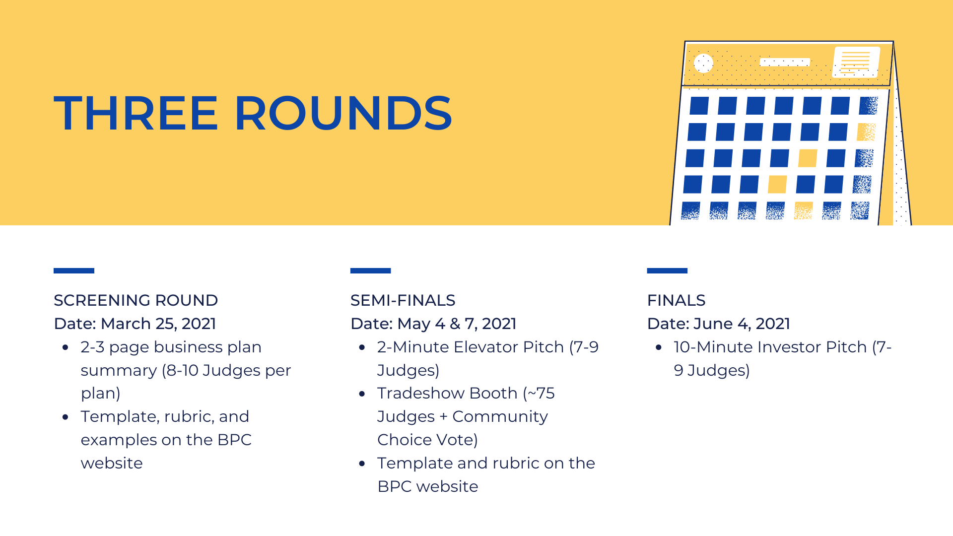

Slide 4
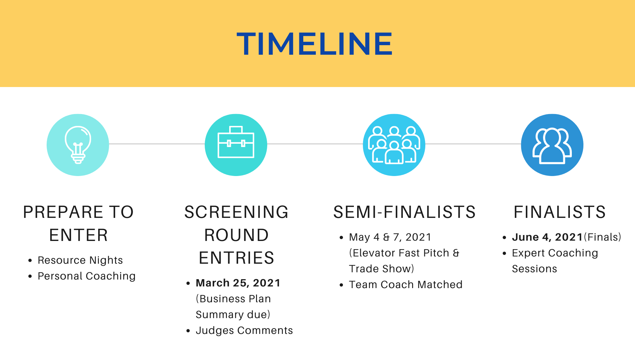
TIMELINE
Screening Round Entries (~35)
Semi-Finalists (20-25)
April 7 BOOTCAMP
Finalists (4)
May 31 FINALS
March 24 BUSINESS PLAN SUMMARY
Judges Comments
May 7 PITCH COMPETITION & TRADESHOW
Team Coach Matched
Expert Coaching Sessions
Prepare to Enter
RESOURCE NIGHTS
Personal Coaching

Slide 5
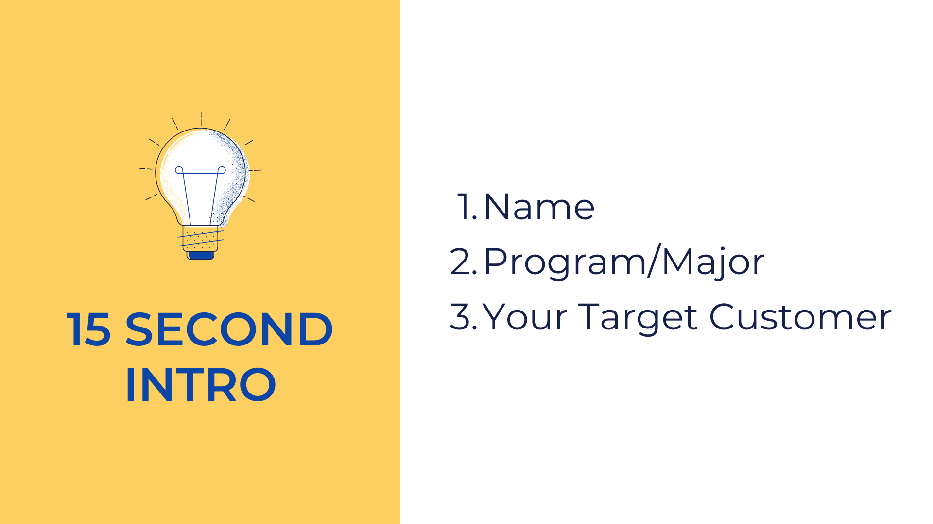

30 Second Intro
Name
Program/Major
Your Product/Service

Slide 6
Pitches
OFFER
What you HAVE
Pitch
ASK
What you NEED

Slide 7
Investment Pitches
ASK: $ (now)
Investment
OFFER: $$$$$ (later)
Return on Investment (ROI)

Slide 8
10/20/30 Rule
10 Slides
20 Minutes
30 Pt. Font
https://guykawasaki.com/the-only-10-slides-you-need-in-your-pitch

Slide 9
Investment Pitches
10-15 min
Pitch
5-10 min
Q&A

Slide 10
Investment Pitches
1. Team
2. Team
3. Team
Convince them to bet on you!
Best predictor of future action is past action

Slide 11
Investment Pitches
1. Team
2. Traction
3. Timing
Convince them to bet on you!
Best predictor of future action is past action

Slide 12

The Formula
Hook
Problem/Customer
Value Proposition
Product/Service, Price
Market & Launch
Competition
Roadmap
Traction
Team
Financial Projections
Ask/Offer
Title
Problem/Opp.
Value Prop.
Underlying Magic
Business Model
Go-To-Market
Competition
Management Team
Financials & Metrics
Traction, Roadmap, Use of Funds
Name/Purpose
Problem
Solution/Value Prop.
Why Now
Market
Customers
Competition
Milestones
Financials &
Team
Use of Funds/Ask
Amelia Marckworth; https://guykawasaki.com/the-only-10-slides-you-need-in-your-pitch; M. Neck, P. Neck, and Murray, Entrepreneurship: The Practice and Mindset, 2e, SAGE Publications, 2020.

Slide 13
Business Plan Template – ROUND 1
Summary/Brief
Market Opportunity
Target Customers
Market Problem and Current Solutions
Your Product/Service Solution
Competitors/Other Solutions
Competitive Advantages
Business Model
Sales & Marketing Strategy
Traction/Performance/Awards
Financial Projections
Funding Needed & Use of Funds
Team & Advisors

Slide 14


Slide 15

Plan Submission Requirements
Business Model
Financials & Funding
Describe how you will make money, in the short- and long-term.
Is your offering to business to consumer (B to C), business to business (B to B), or both?
What are your key revenue streams? How viable and sustainable are these revenues? How have you tested this?
What’s your proposed pricing strategy?
What are your startup expenses and ongoing expenses? What are the key drivers of your expenses?
What are your average revenues, expenses, and gross profits per client, product, store, etc?
How will you provide customer and partner support?
What are your 3-5 year financial projections for revenues, expenditures, and profit?
What is your break-even level of revenues and when does it occur?
What are your key assumptions and how have you tested them?
What, if any startup funding have you had so far? How have you used the funds?
What startup or other funding do you need going forward? How much and what will you use it for?
How much outside funds do you want, if any, and how will you use them? What will investors get in return, including equity ownership?

