Slide 1
Farm Workers, Sus Ag
& Democracy
Carol Dansereau, J.D.
Food & Sustainability Panel, August 8, 2016
Seattle University Just Sustainability Conference 2016

Slide 2
Farm worker families & pesticides
How are we doing?
What blocks our way forward?
III: What next?
IV: Perspectives on non-profits and careers.

Slide 3
PART I
Farm Worker Families
& Pesticides

Slide 4
Quintessential Environmental Injustice
Race
Poverty
Language
Immigration Status

Slide 5
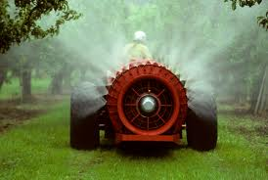
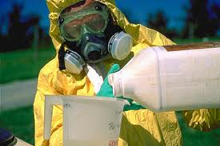
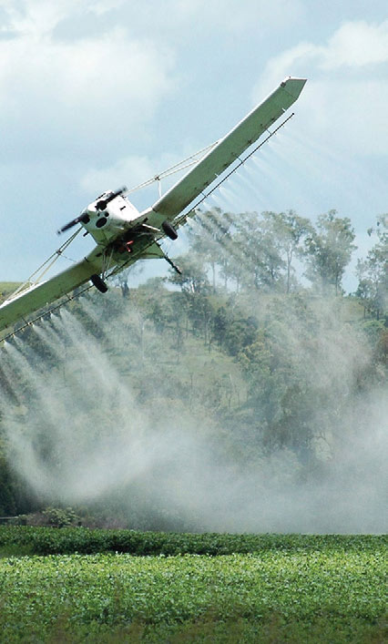
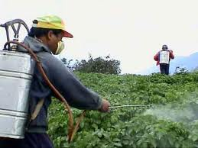
Pesticide Handlers
Mixing, loading & applying pesticides

Slide 6
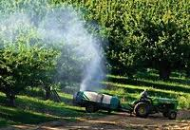
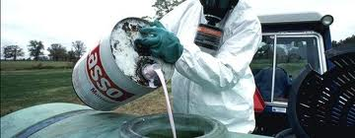
Spills & splashes
Drift

Slide 7
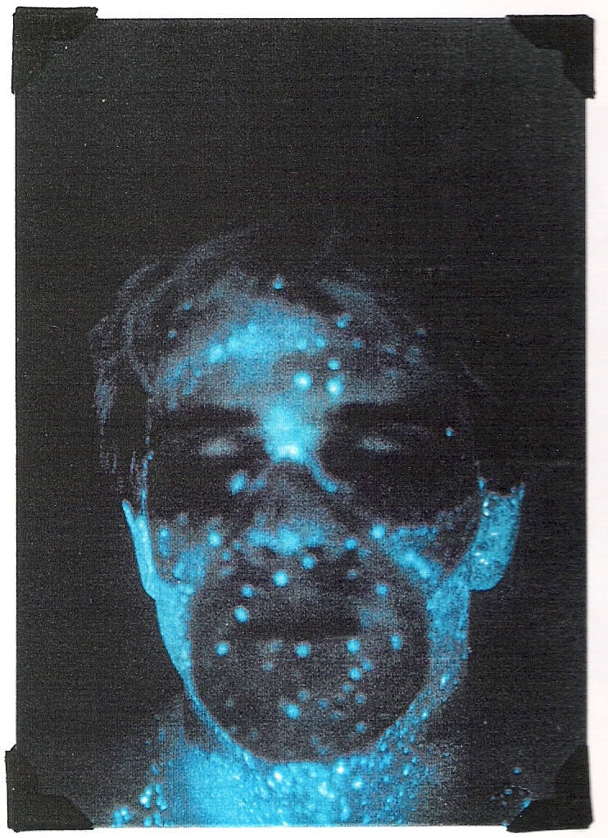
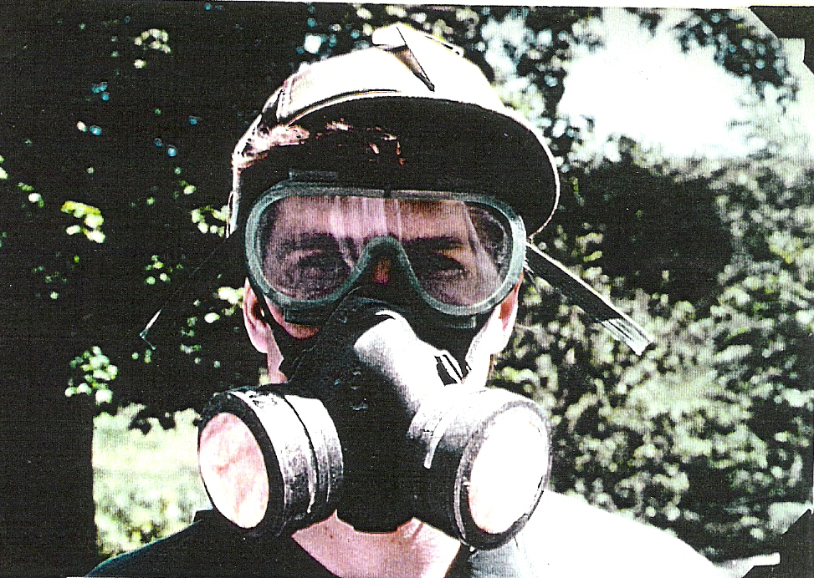
Notes:
Chemicals called “fluorescent tracers” can be mixed with pesticides to show where pesticides end up. On the left is an airblast applicator with his respirator and goggles. After he applied pesticides for 90 minutes, scientists shined a special “black light” on him in a dark room. In the photo on the right, you can see where the pesticides came in contact with his body. That’s where it is blue.

Slide 8
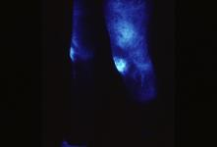
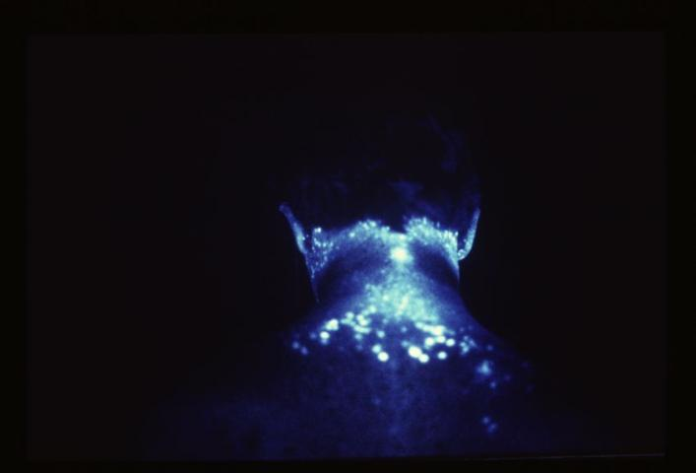
Notes:
Here are some other examples of photos taken by scientists of pesticide handlers. The applicator on the left wore “chemical resistant” coveralls, but contact with foliage for an hour deposited pesticides on his knees and thighs. The worker on the right wore cotton overalls, but pesticides accumulated not only on the uncovered part of his neck but also beneath the overalls on his shoulder blades. (Right photo.) T

Slide 9
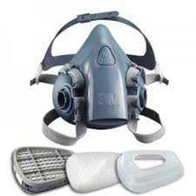
In Real Life….
Equipment can fail.
There may be pressure to work now despite risks.
Notes:
For example, in a case in Washington State in 2005 a worker noticed the respirator was defective and told his supervisor. He was told he would lose his job if he did not spray then, and he was poisoned. After he filed a complaint and the employer was fined, the worker was fired. He was evicted from his house which was owned by the employer. This happened after had worked for that employer for 12 years.

Slide 10
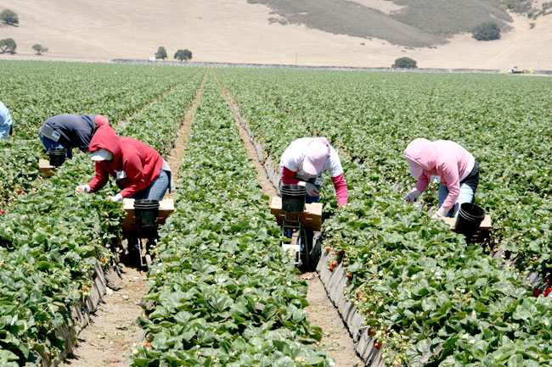
Field workers are exposed too.

Slide 11
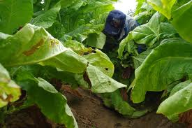
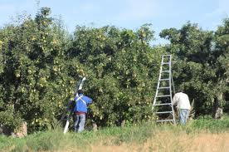
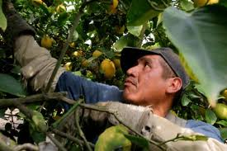
Pesticide residues
Notes:
Pesticides can be present on the crops and soil that workers touch.

Slide 12
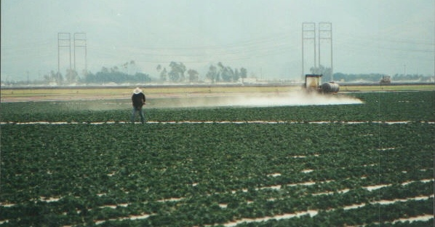
Drift
Notes:
Drift can come from a worker’s own employer, or from someone spraying on a neighbor’s land.

Slide 13
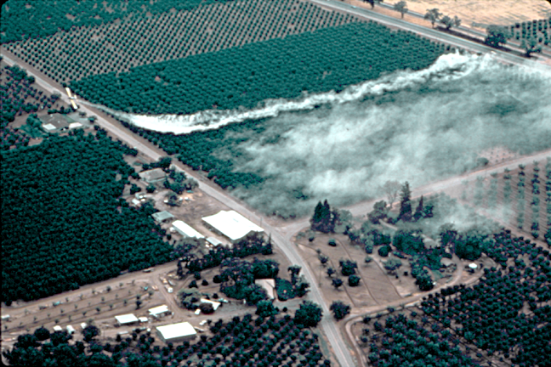
Drift doesn’t just happen during or right after applications.
Notes:
There are two types of drift. “Spray drift” is droplets or dust that drift during or just after an application. “Post-application drift” can happen days after applications end. Pesticides “volatilize” – in other words they rise up into the air as the temperature gets warmer – or they are present on dust particles which get blown by the wind.

Slide 14

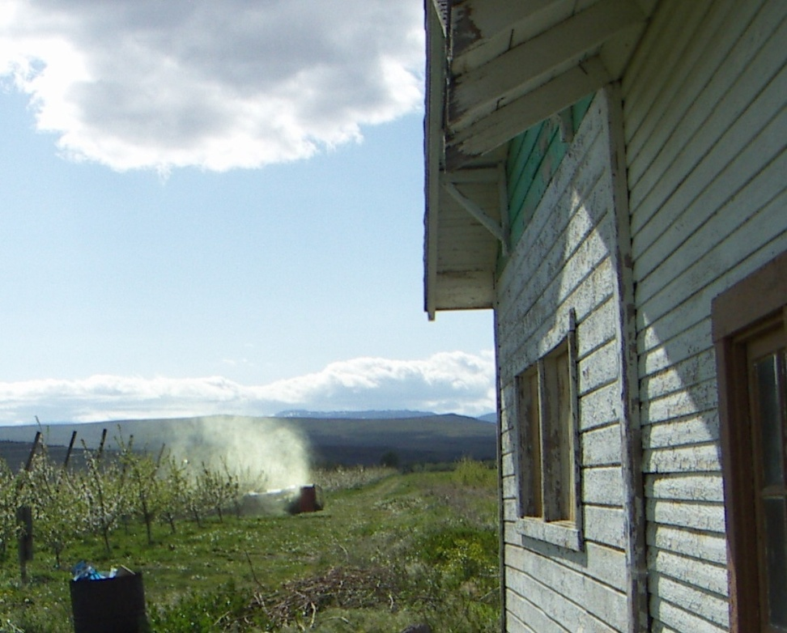
Farm worker families are exposed too.
Drift
The take-home pathway

Slide 15
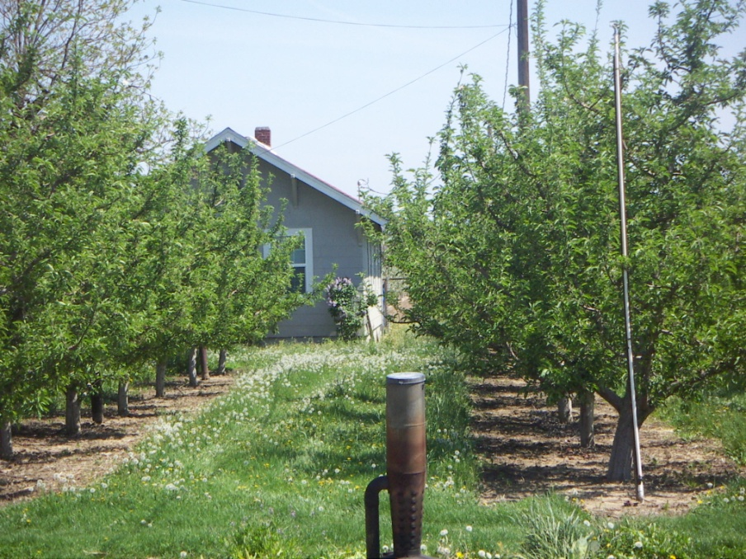
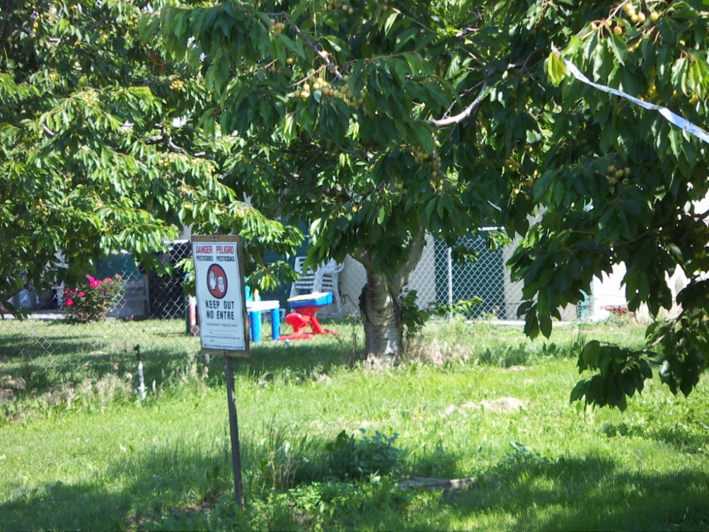
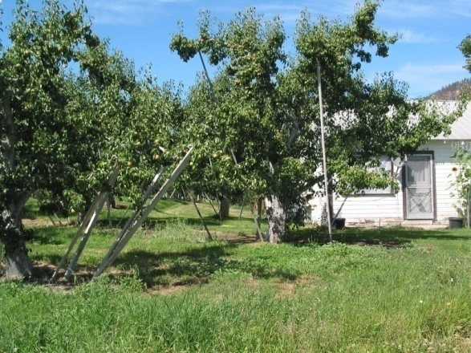
Many homes are located very close to farmlands
Notes:
California community members also tested for residues of chlorpyrifos in their urine. Elevent of the 12 had above average levels of the primary chemical that chlorpyrifos breaks down into in the body. Seven of the 8 women tested above “acceptable” leves for pregnant and nursing women calculated from US EPA information

Slide 16
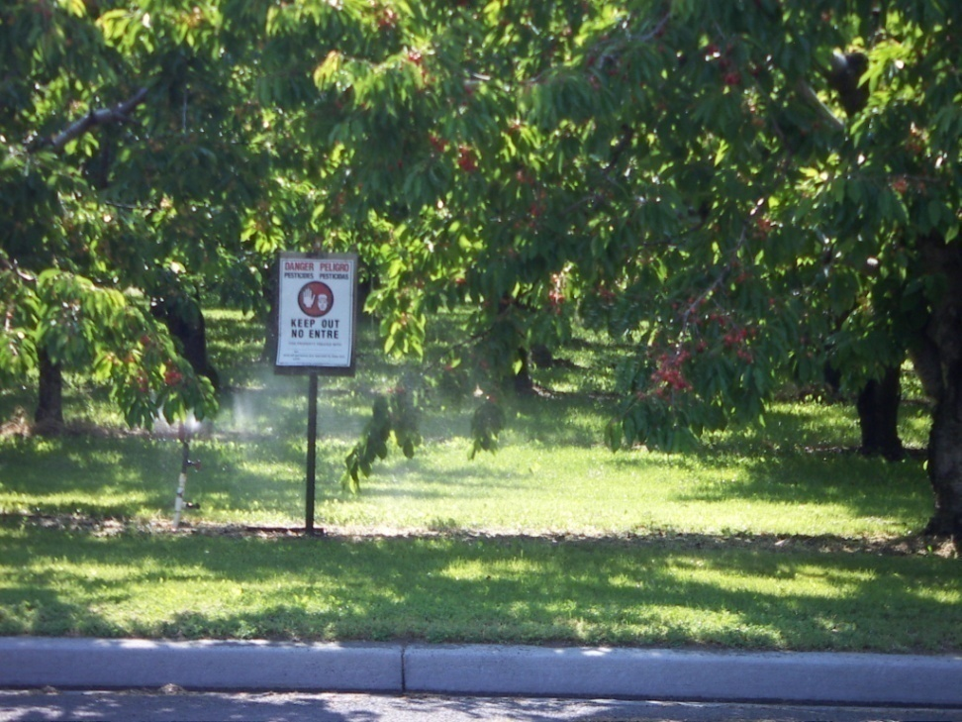
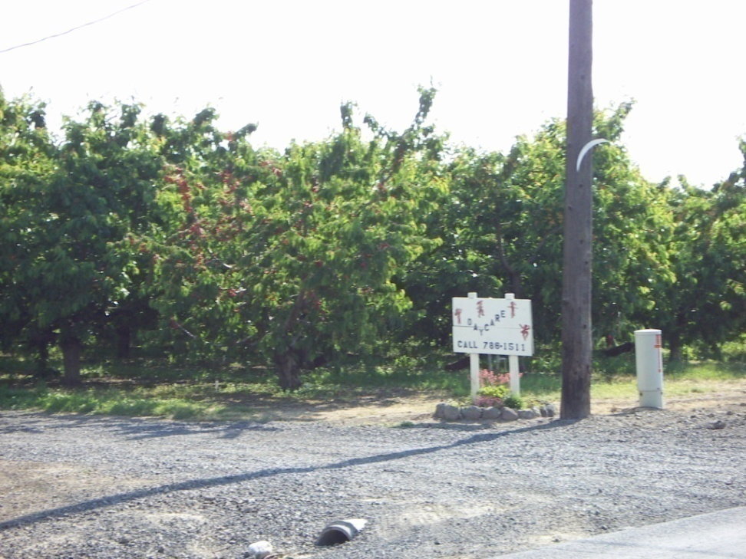
Many daycares are located close to the orchards
Notes:
The daycare on the left is literally in the middle of an orchard.
The orchard posted with a Do Not Enter sign on the right is just across the street from a daycare center.

Slide 17

Exposures through food.
Notes:
Studies in the Seattle area have shown that when children eat foods grown with organophosphate pesticides, levels of chemicals associated with those go up in their urine. When they eat organic foods they go down.
The scientists tested samples of the children’s food which parents had bought at local stores and washed as part of preparing them. 21% of the food samples contained organophosphate pesticides, often more than one kind. Overall 11 different organophosphates showed up in the food the children were eating.

Slide 18
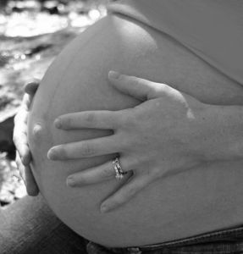
Children are exposed prenatally.
And through breastmilk
Notes:
When a pregnant woman is exposed to pesticides so is her unborn child. Breastfeeding also delivers pesticides to children, but has important benefits compared to feeding babies formula. (Formula may also be contaminated with pesticides or other chemicals.)
Children are very vulnerable in these early stages of life.

Slide 19
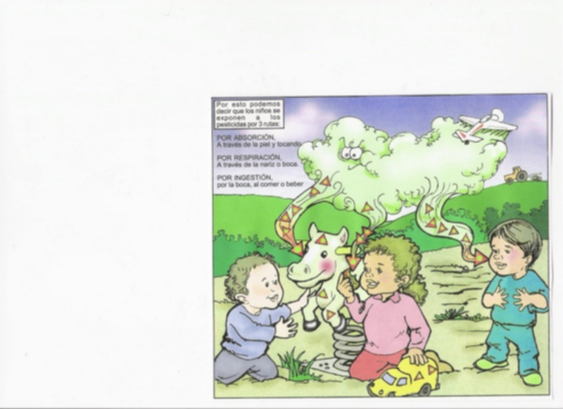
How Pesticides Enter Children
Inhalation
Contact with Skin and Eyes
Ingestion
Notes:
Here is a picture from a book for farm workers showing drift hitting children. That is an important way children are exposed.

Slide 20
Notes:
A lot of funding has gone to programs to teach farm worker families to reduce exposures to pesticides at home. We are told to take off shoes before entering the home, delay hugging our children, wash work clothes separately, etc.
Studies indicate that these measures may be helpful, but are by no means the solution. A review of 4 years of programs teaching farm workers certain measures to take in Washington State concluded that the levels of pesticides in people’s bodies were higher at the end of the 4 years. The contamination in the houses of those who were taught were at the same levels as those who were not. Relying on these programs also raises civil rights issues which will be discussed later.

Slide 21
*

Slide 22
HEALTH EFFECTS

Slide 23
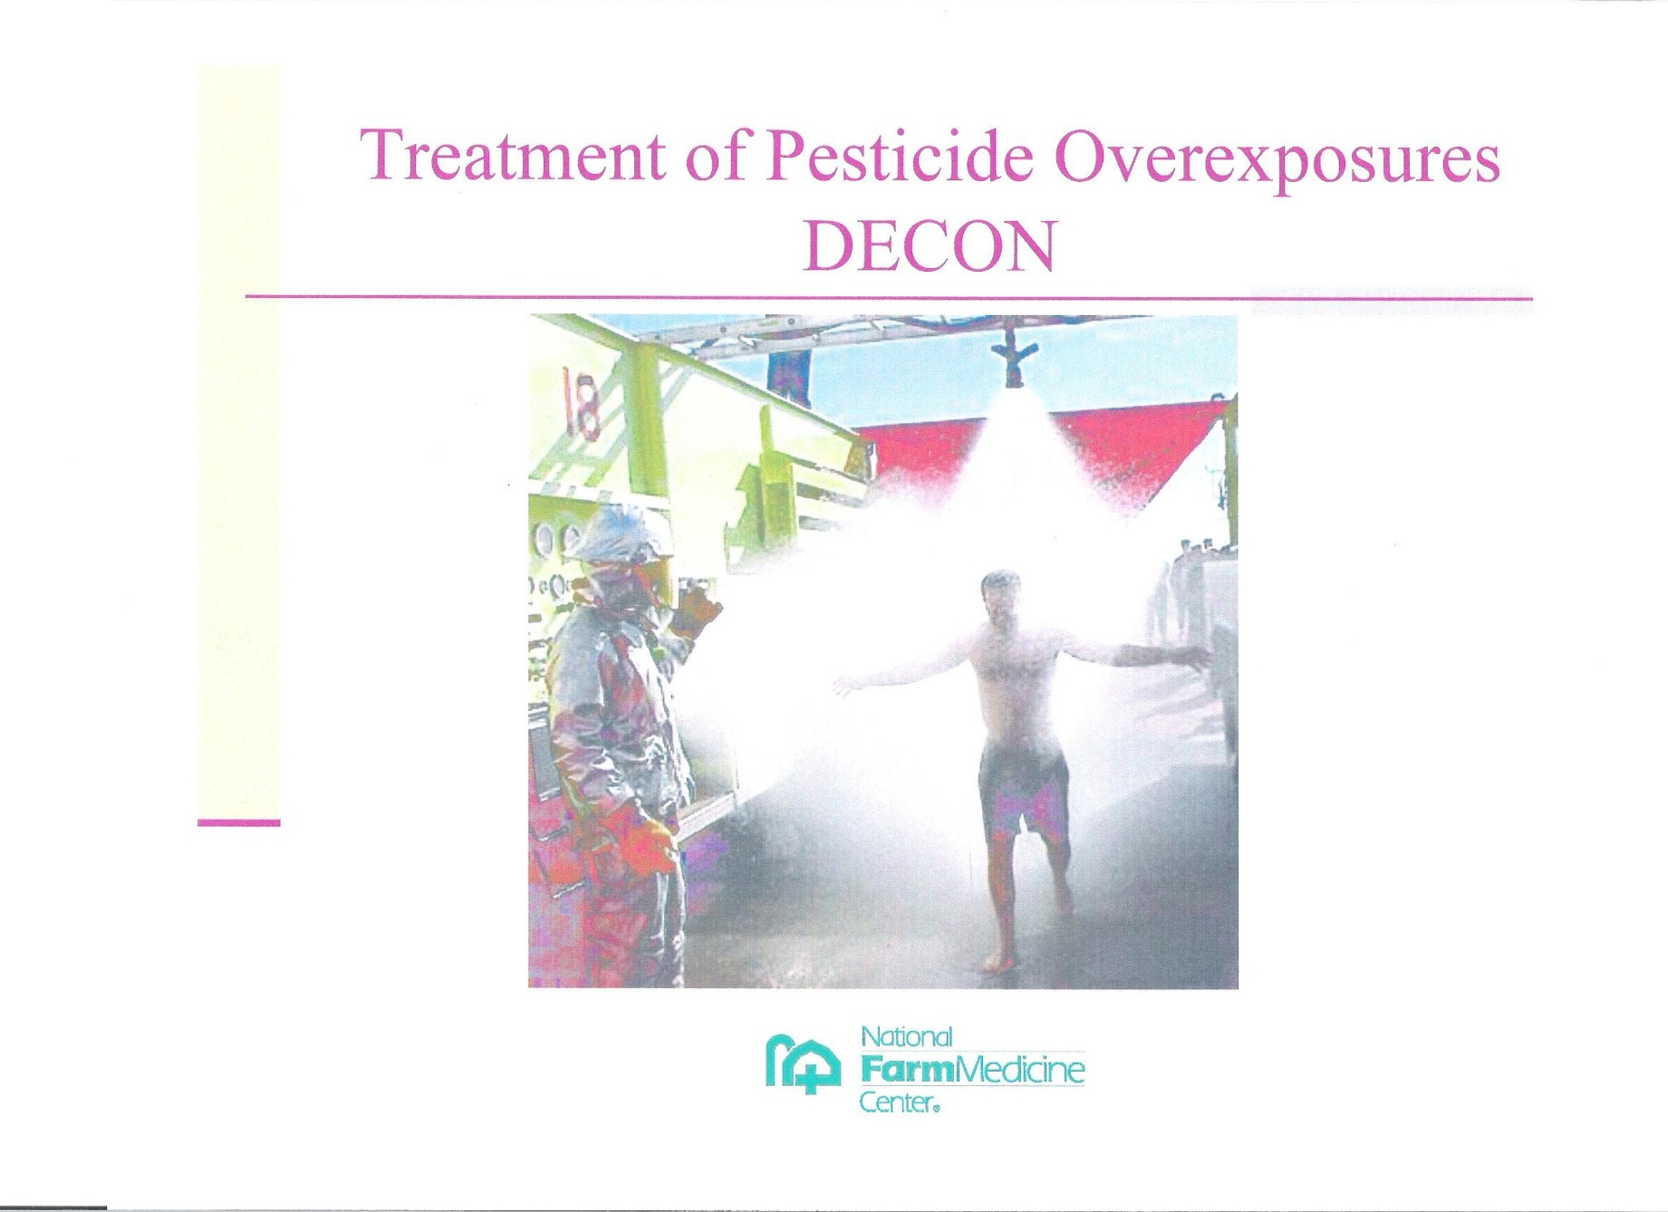
ACUTE POISONINGS

Slide 24
Farm Pesticide-Induced Illness Cases in Washington State, 2003-2008
(Documented by State Department of Health)
351 workers
- 167 pesticide handlers
- 184 field workers
Drift cases – 166 people
-108 workers
- 58 others

Slide 25
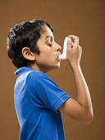
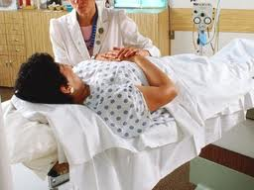
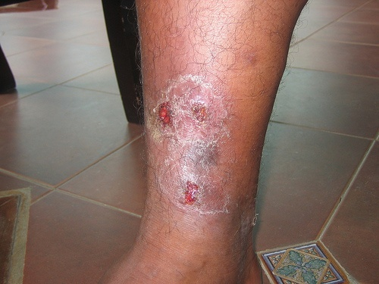
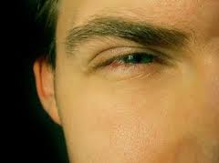
Other Health Effects
Cancer
asthma
Skin problems
Reproductive problems
Retinal degeneration
Notes:
Commonly used pesticides to which farm workers and families are exposed are associated with all sorts of other health problems besides acute poisoning. Studies have found higher rates of these sorts of problems among farm workers and others exposed to agricultural pesticides.

Slide 26
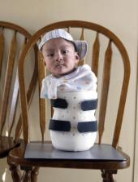
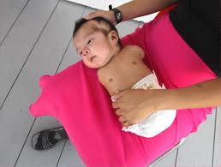
Carlitos, Florida
Notes:
Some pesticides are known or suspected to cause birth defects.
These are photos of Carlitos, a boy born without arms and legs in 2004 in Florida to farm worker parents who worked in Florida and North Carolina. Two other children with serious birth defects were born about the same time in the area. North Carolina health officials determined that Carlitos’ mother may have been exposed to birth-defect-causing pesticides during her pregnancy, and that plausibly these could have caused Carlito’s’ problems.

Slide 27
Pesticides Carlito’s
Mother Was Exposed To
Methamidophos:
* WA State study documented children’s exposure to this pesticide here.
* In 2000 at least 15 children and 9 teachers were poisoned by this pesticide at a school in Mattawa, Washington.
Mancozeb:
* Many products registered for use.
* In Washington State, 67% of fall potato acres in 2005 were sprayed with this pesticide.
Notes:
These are two examples of pesticides that can cause birth defects to which Carlitos’ mother was exposed. How many children around the United States are exposed to these before birth, or afterwards?

Slide 28
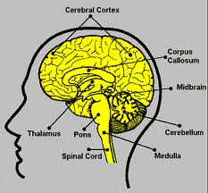
Neurological Effects
Notes:
Commonly used pesticides can damage the development of the brain and nervous system (a birth defect) and how well these function.

Slide 29
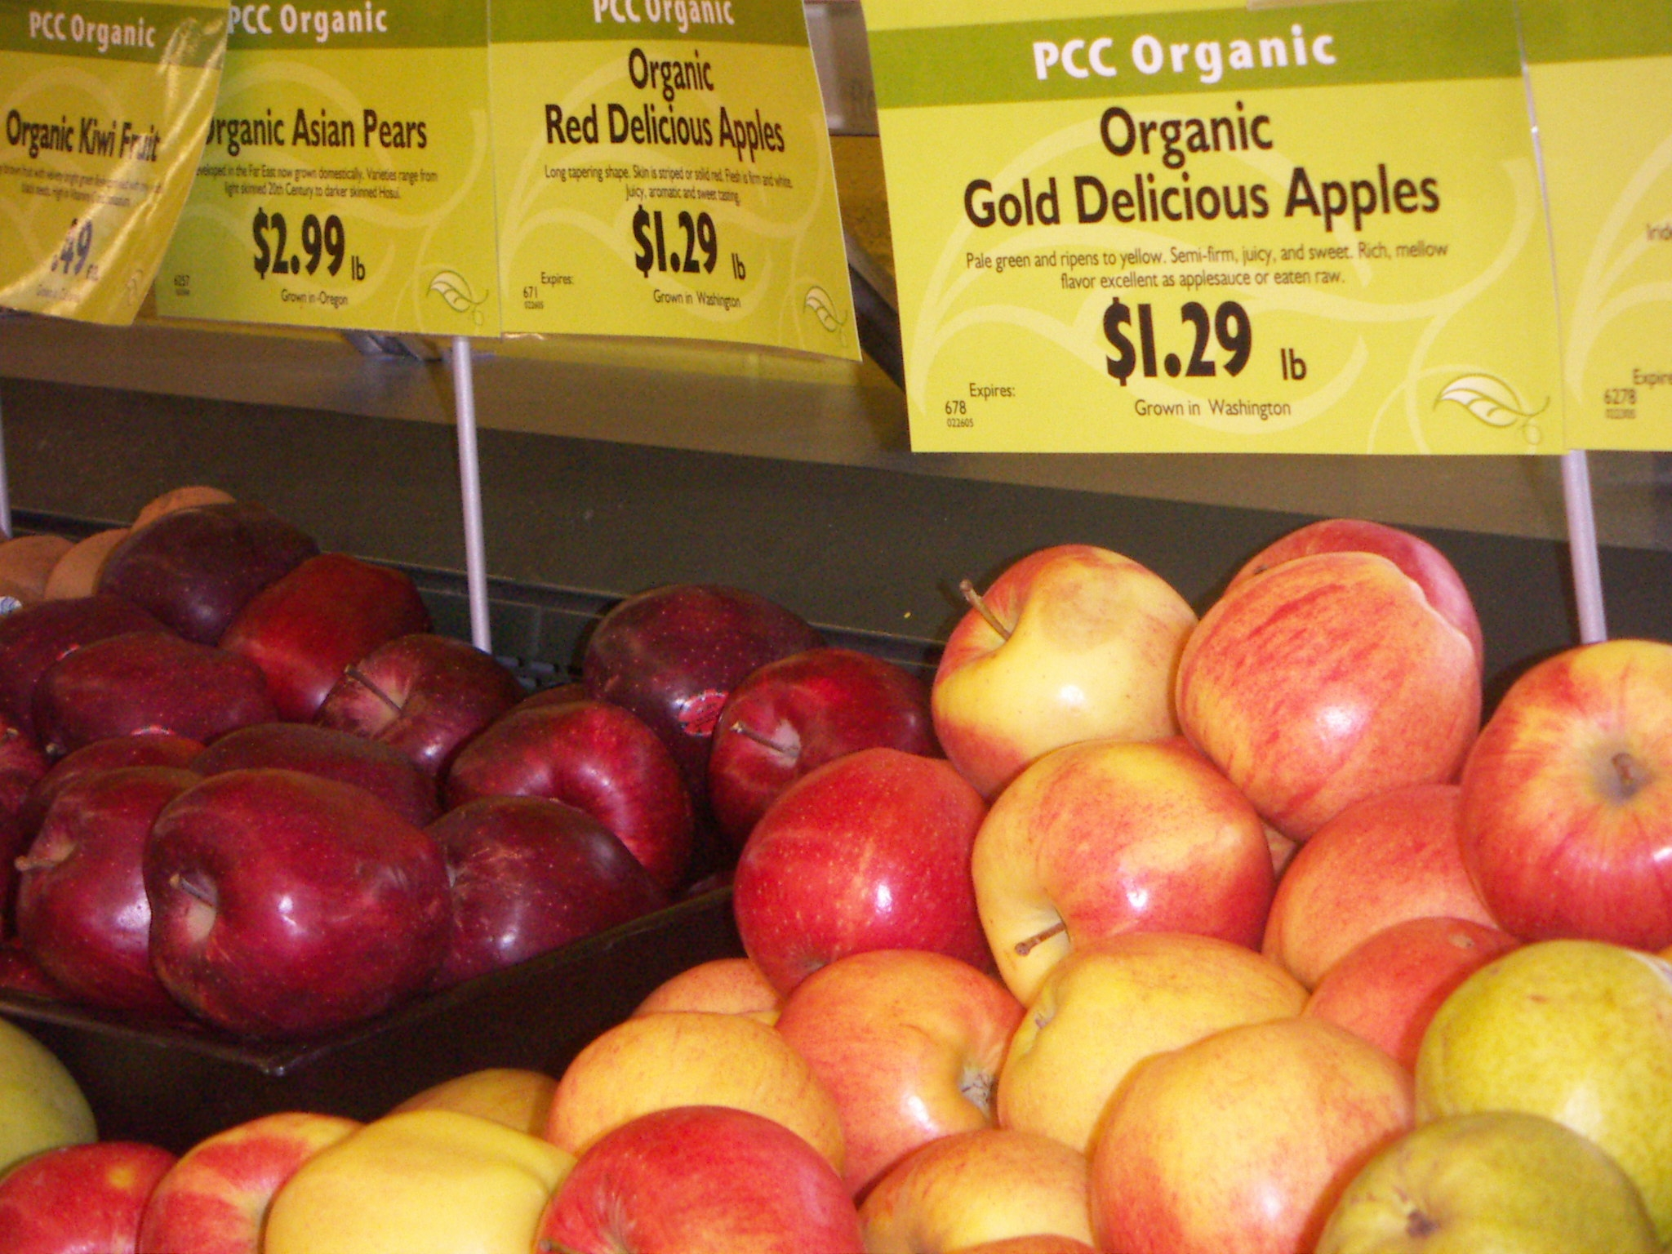
Alternatives Exist
Notes:
Safe alternatives to dangerous pesticides exist for every crop, and indeed there are farmers using them.
Organic farming involves thinking about the whole ecosystem of a farm, and working with biology. Helping beneficial insects and getting rid of habitat for bad insects are two examples.

Slide 30
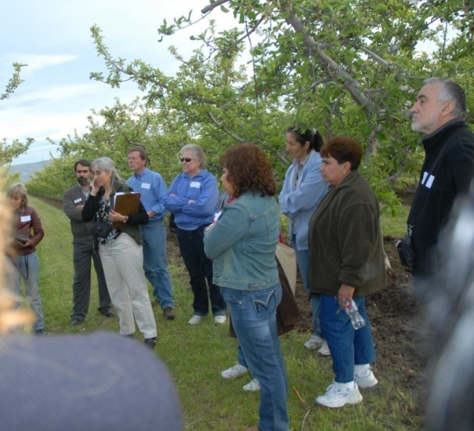
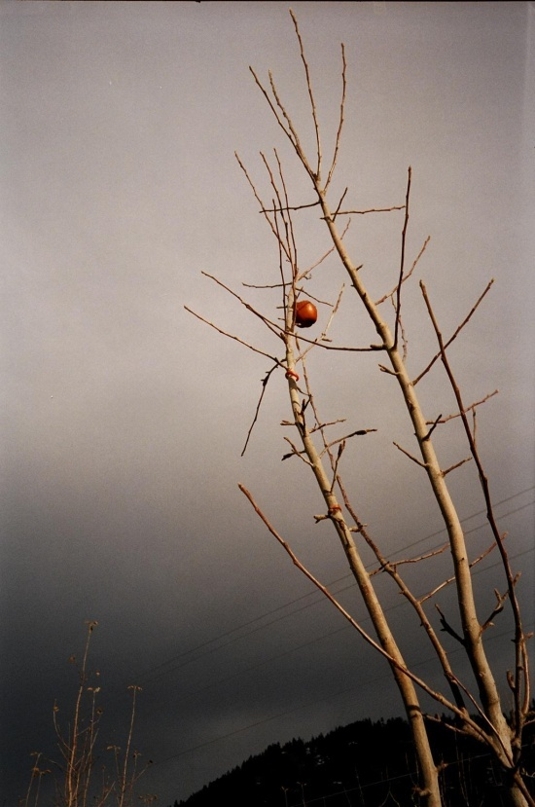
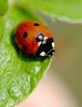
Pheremone mating disruption wire
Tour at an organic orchard
Notes:
In the photo on the left, people listen as an organic grower describes how he grows fruit organically. In the photo on the right a small red wire containing pheremones confuses male moths preventing mating.
Organic growers and farm workers think about the whole ecossytem of plants, insects and other animals on the land and how they interact with one another.

Slide 31
PART II
How are we doing?

Slide 32
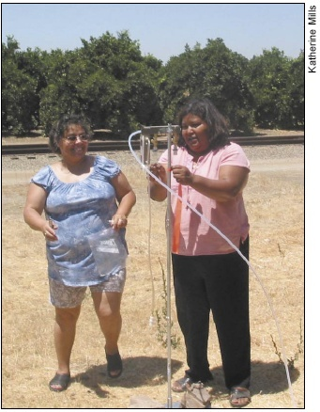
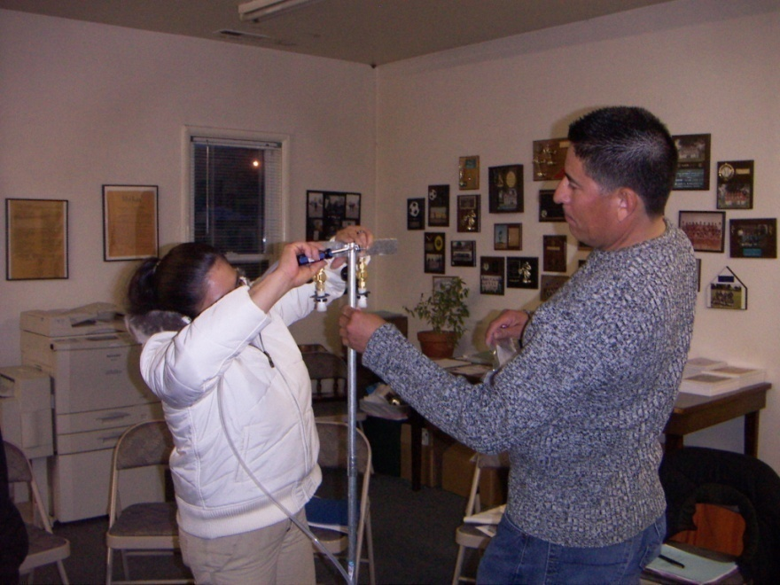
Community Drift Catching
Notes:
In the photo on the left California farm worker community members set up an air monitor, known as a “Drift Catcher” in their community. On the right farm worker community members in Washington State learn how to set up Drift Catchers at a training workshop.

Slide 33
Political Pressure
Against Enforcement
The Farm Bureau and legislators they contacted objected to Inspector David Zamora’s enforcmeent activities.
Zamora was removed and enforcement actions plummeted.
Notes:
David Zamora was an inspector for the Washington State Department of Agriculture who enforced against drift and other pesticide violations. Growers contacted the Farm Bureau which enlisted state legislators to pressure the Director of WSDA. She removed Zamora. An investigation by the Wenatchee World newspaper a few years later showed that numbers of enforcements went down dramatically after Zamora was removed.

Slide 34
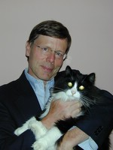
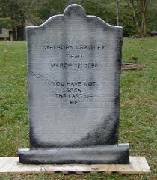
Retaliation against reform leaders
PIRT Panel
Pesticide Incident Reporting
& Tracking Panel (WA)
1989-2010
Dr. Steven Gilbert
Not reappointed.
Notes:
Under the leadership of neuro-toxicologist Dr. Steven Gilbert, the Pesticide Incident Reporting & Tracking (PIRT) Panel of Washington State voted to recommend that the State monitor the air in agricultural areas for pesticides. Groups and lobbyists affiliated with pesticide manufacturers and growers who oppose further restrictions on pesticides pressured the Governor to not reappoint Gilbert. She complied, appointing a scientist who worked for Dow Chemical in the past, and still receives funding from them for research instead. Public pressure forced the new scientist’s resignation. The Governor then urged the elimination of PIRT altogether under the guise of the budget crisis, despite the fact that convening the Panel cost very little money. The legislature eliminated PIRT in 2010.

Slide 35
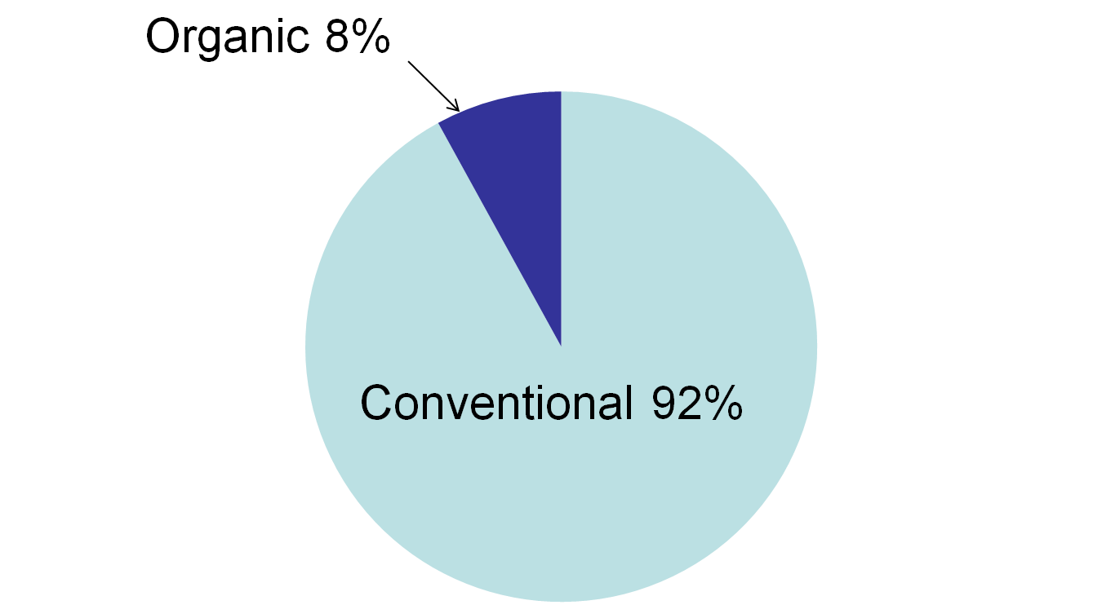
Apple Orchard Acres
(Washington State, 2008)
Notes:
But overall the percentages are still low.

Slide 36
Organic: still limited
WA 2011: 1.9% of farms, 0.7% farmland, 1.5% harvested cropland organic.
U.S. 2012: 13,000 of 2 million farms organic
Worldwide 2013: 43.1 million hectares organic cultivation, 0.98% of all ag land.

Slide 37
In 2012, 4.2% of U.S.
food sales were organic.

Slide 38
Sometimes we win. Or do we?
Organochlorines
Organophosphates
Neonics

Slide 39
PART III
What blocks our way forward?

Slide 40
The deck is stacked against.

Slide 41
Big Money in Elections
Agribusiness donors gave Obama > $2.5 million in 2008 and > $2 million in 2012.
Agribusiness donors gave $27 million to members of U.S. House and Senate Ag committees in decade leading up to 2011:
American Crystal Sugar Co $984,998
Dairy Farmers of America $550,100
National Cotton Council $332,718
Dow gave Democrats $250,000 and Republicans $100,000 for their 2008 Conventions.

Slide 42
Big Money Lobbying
Federal examples, 2012
Dow: $11,570,000
Croplife: . $2.4 million
Dow:
  * 49 lobbyists
  * 37 were “revolvers”.
Chemical industry as whole:
* 549 lobbyists
* 340 were “revolvers”

Slide 43

Big Money affecting implementation
Corporations dominate rulemakings.
It’s hard for us to make regulatory gains.
Maintaining gains requires constant vigilance. (e.g. organic standards.)

Slide 44
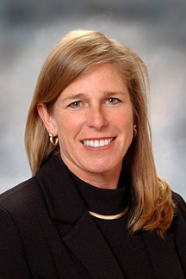
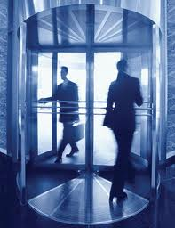
The Revolving Door
EPA
Pesticide
Industry
Elin Miller, former executive at Dow and other chemical companies, who was the head of EPA Region 10.
Notes:
These are just some examples of the “Revolving Door”. This is the term used to describe how people go back and forth between EPA and the industries it is supposed to protect us from.

Slide 45
Manipulable Frameworks
Risk assessment
Collaboration, partnership, consensus

Slide 46
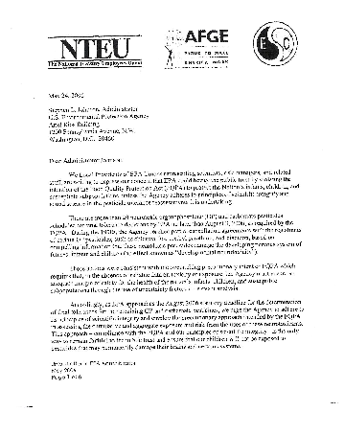
Undue Influence over Registration Decisions
Notes:
In 2006 9000 scientists and others at EPA took the unusual step of writing a letter through their unions to the head of EPA when he was about to re-register organophosphate pesticides. The letter objected to what EPA was about to do, said that agribusiness groups had too much influence, and express concerns about children’s health.

Slide 47

Big Money &
Public Relations
  Marketing
  Messages
  Front Groups
  Controlling the News
  Marginalizing People Who Threaten Profits

Slide 48
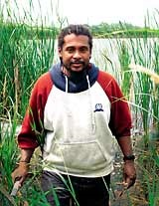
Scientist Tyrone Hayes found that Syngenta’s pesticide causes deformites in frogs.
Syngenta then worked to discredit him.
Notes:
University of California scientist Tyrone Hayes acused Sungenta, the chemical company that funded his research on their pesticide atrazine, of attempting to block him from publishing findings that shown problems in frogs from exposures. Hayes obtained funding from another source, published his findings, and continued to research separate from Syntenta.

Slide 49
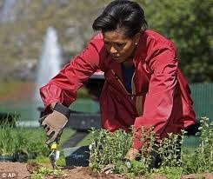
The staff at the Mid-America Crop Life Association “shuddered” when they heard that Michele Obama was making her White House garden organic.
Notes:
The Mid-America Crop Life Association’s Board is composed almost entirely of representatives of corporations that make or sell pesticides. The organization sent a letter expressing concerns to Mrs. Obama and used its resources to encourage farmers to send letters as well.

Slide 50
Big Money in Education
K-12
* Dow’s “Balanced Equation”
* Syngenta school garden program
Universities
* University of Michigan & Dow

Slide 51
Big Money & Science
Funding effect
Blocking research
Influencing research topics
Limiting data and public access to it.

Slide 52

Big Money in
International Forums
Trade agreements
Using ambassadors

Slide 53
Big Money’s stranglehold over
Wealth
Farmland
Water
Seeds
Jobs
And more
.

Slide 54
Farmland
Farmland is being bought up by investors.
Rent + Royalties (“Gold with yield”)
Spiking prices makes it hard for would-be farmers to get land
Trade deals promote privatization of communal farm lands. (NAFTA->dislocation)
Ongoing loss of land to development too.

Slide 55
Seeds
Monsanto, DuPont, Syngenta control 53% of global commercial seed market.
Top 10 seed companies: 73%
On GMO treadmill, farmers have to buy seeds each year, can’t save.
Those trying to avoid the treadmill often can’t find other seeds to buy.

Slide 56
Big Money buys elections AND
Legislation
Rules, non-enforcement
Science
Focus groups, psychologists, ads
Front groups
Access to students
News
Trade agreements
Ambassador assistance
Land, water, other resources
Lawsuits
Spies, violence………….

Slide 57
An economic system based on:
Private ownership of major industries and resources.
Private owners making decisions affecting humanity (food, environment, jobs, etc.) based on maximizing private profit.
Classes – owning and working
Owning class accumulation of wealth

Slide 58
Accumulation happens
48% of all Americans are “low income” or “poor”
By the end of 2016, the 1% will likely own more wealth than the 99%.

Slide 59
Is this what democracy looks like?
Vast majorities want sane life-saving policies and programs, but we can’t win them.
A few people live lavishly while most people struggle to get by.
Every aspect of discourse and decision-making is tainted by Big Money expenditures.
Our destiny is determined by a few wealthy people who control key resources and decisions.

Slide 60
Capitalism
Incompatible with democracy
Incompatible with sustainability

Slide 61
Beyond capitalism
Ownership and control over major industries and resources by working people, including farmers and farm workers.
Vibrant democratic structures.
Economic Bill of Rights
Public planning for public good.

Slide 62
PART IV
What to do.

Slide 63
For sustainable ag…..
For sustainable everything
Build a movement for economic democracy.
Envision a democracy-infused socialist alternative to our current undemocratic, unsustainable set-up.
Make that vision a reality.

Slide 64
Principles
Truth, not lies
Explicit, not vague
Unity, not competition
Every choice consistent with building a movement for economic democracy
True friends, not false ones

Slide 65
Specific Actions
Speak up everywhere.
Be choosey about the single-issue organizations we support.
Support socialist organizations.
Support pivotal protests and campaigns.
Build a political party of our own.
Put pieces of a better world in place, as a supplement to these actions, not a substitute for them.

Slide 66
PART V
Perspectives on non-profit organizations and careers.

Slide 67
Only 4% of foundation environmental funding goes to the environmental justice movement.

Slide 68
Big Money Philanthropy is only possible because wealth accumulates in the hands of the few.
It is only “necessary” for the same reason.

Slide 69


Together we can find a new path.

Slide 70
Carol Dansereau
What It Will Take.
Rejecting Dead-ends and False Friends
in the Fight for the Earth
Available via amazon.com
Contact Carol about discounts: info@caroldansereau.com
www.caroldansereau.com

Slide 71
Extra Slides:
The following are not part of the presentation; they are available in case needed during Q & A.

Slide 72
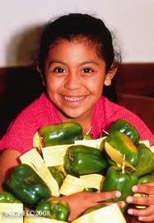

Slide 73
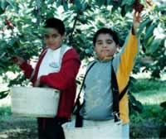
Children entering orchards
Notes:
Farm worker children are exposed at their homes, daycares and schools. Some also go into the orchards to work or if their parents take them there. Some may go into them to play even though there are warning signs about that.
Based on Department of Labor numbers, there may be as many as 250,000 teenagers doing farm work, including up to 75,000 who are between 14 and 17. A national report in 2000 said that 7% of farm workers with children 5 years or younger took their children to the fields with them, at least sometimes.

Slide 74
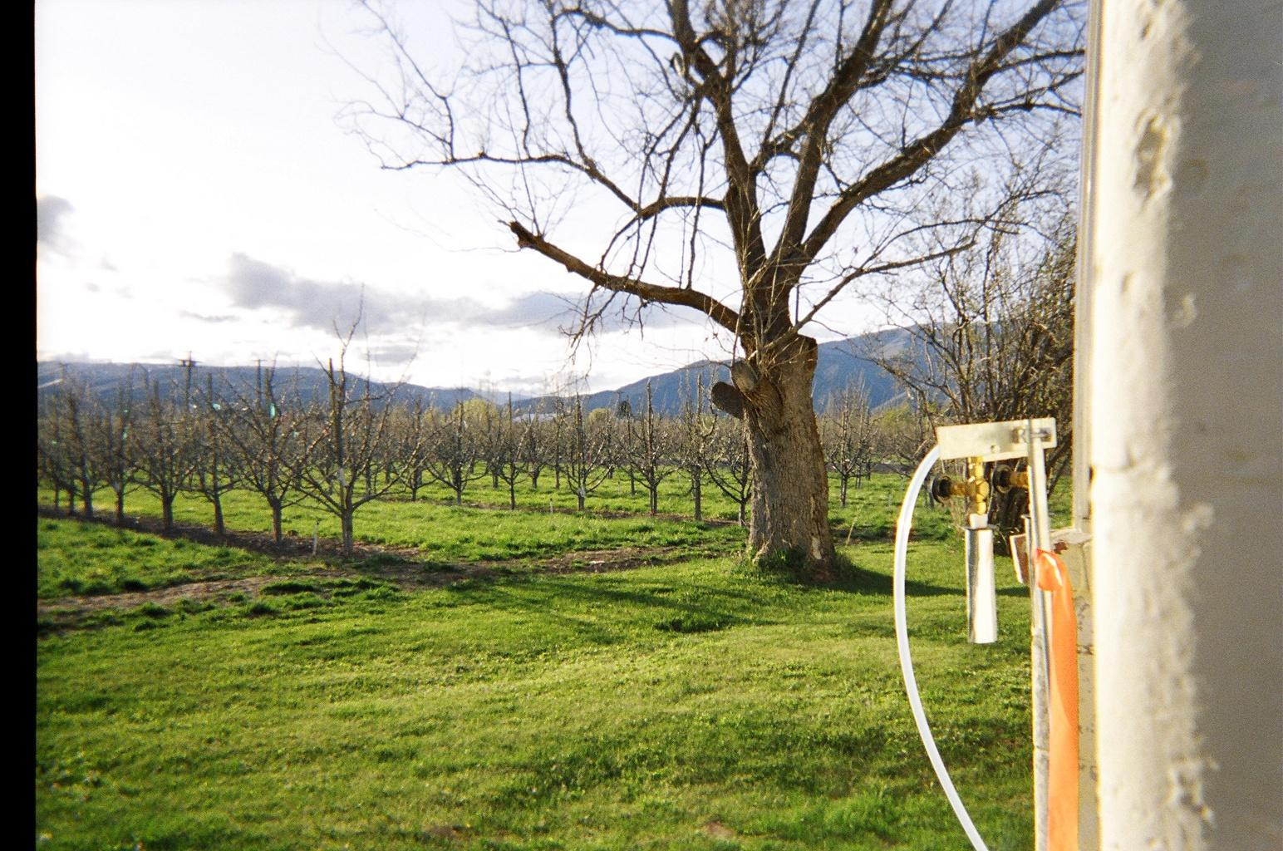
Drift Catcher next to a farm worker home.

Slide 75
Medical Monitoring, Washington State
Percent with Action-Level Cholinesterase Depressions (>20%)
2004 | 2005 | 2006 | 2007 | 2008 | 2009 | 2010
20.5 | 9.6 | 12.1 | 17.3 | 7 | 8.8 | 3.1
2011 | 2012 | 2013 | 2014
3.2 | 8.3 | 6.0 | 7.0
Program Basics:
1) covers those handling > 30 hours/30 days
2) goal = protect before acute poisoning
3) may not prevent non-acute problems
4) field workers not covered;
Notes:
In Washington State workers who handle “organophosphates” and “carbamates” are monitored under a program resulting from a worker’s lawsuit. Blood tests show whether an important chemical in the nervous system (“cholinesterase”) is going down. In the first year for 1 in every 5 handlers, cholinesterase went down more than 20% when they handled the pesticides. The program has helped to reduce the numbers of handlers experiencing that. It’s goal is to protect workers before they get poisoned.

Slide 76
FWPP air testing results
Notes:
This graph shows chlorpyrifos (Lorsban) found in the air by one of the families in Washington State in 2006. We do not know if there was any spraying on the land right next to the family’s home on any of these days, but chlorpyrifos was in the air in their yard every single day. The line in the middle shows the concentrations above which some would say people should be concerned with respect to a one year old child. As you can see on many different days chlorpyrifos was in the air at higher levels. Farm worker groups do not agree that the lower levels are safe though, because the “safe” levels are based on information from the pesticide manufacturer. Safety calculations do not take into account the full range of studies that have been done.

Slide 77
What UW Said…..
“….compared to existing EPA and California screening values for the protection of health, it does not appear that agricultureal spraying….posed a health hazard….”
“….no health impacts are anticipated…”
Notes:
When scientists made results available from air monitoring they did in 2008 for chlorpyrifos and another organophosphate, they downplayed the significance of the findings. The levels in the air were lower than screening levels, (“levels of concern”). The Farm Worker Pesticide Project decided to find out where those levels came from.

Slide 78

An analysis of Dow Chemical’s published chlorpyrifos studies by Professor Robert Sapolsky and other Stanford neuroscientists found rampant errors. When errors could affect conclusions about chlorpyrifos’ safety, 100% of the time they would under-estimate the health risks.

Slide 79
Many different studies have shown that pesticide handlers are being exposed.
For example, in a 2004 study in Washington, 100% of the pesticide handlers had pesticide residues in their urine.

Slide 80
Documentation of exposures
Many different studies have documented that field workers are exposed. In one study, for example:
93.3% of harvesters had a residue of organophosphates in their urine.
94% of the thinners did.

Slide 81


Many different studies document that farm worker children are exposed
Notes:
In study after study, scientists have collected urine samples from children, dust from the floor in areas where they play, and other information. Because of these it has been clear for decades that farm worker children are being exposed and that both drift and the take-home pathway are to blame. Children whose parents don’t work in the fields are exposed through drift.
The photo on the right shows a special vest used in a study of 8 children in Washington State living within 15 to 200 meters of a potato field. The vest had electronic equipment in it that let scientists track where the children went. None went into the fields. Nonetheless, the pesticide residues in their urine and on their hands went up after the fields were sprayed. Playground equipment and the air were contaminated. This happened although the scientists felt the applicators were particularly careful because they knew they were being watched. The scientists called the contamination levels “low” but scientific studies indicate that our cause for concern is valid.

Slide 82
Reported Farm Worker Pesticide Poisoning Cases
United States 1998-2005
2334
63% involved drift
17% entering sprayed fields
17% using pesticides in conflict with label
30% no obvious factor contributing to it

Slide 83

Near Benton City, WA
June 2002
6 field workers poisoned by drifting malathion.
Notes:
These are just a few examples of poisonings involving workers in Washington State. In the last example, Maria Mendoza (photo) and 5 other workers tending grapes were poisoned by “malathion” drift from a helicopter application on nearby cherry trees. It was obvious that the malathion was the cause of their sudden extreme illness which necessitated their being taken by emergency vehicles to local emergency rooms. Nonetheless it took over 5 years and law suit for a fine and a temporary license suspension to be imposed.

Slide 84
Near Royal City, WA
Spring of 2010
10 apple workers
poisoned by drifting chlorpyrifos

Slide 85
Drift from a Potato Field near Pasco
(MITC, October 2008)
  16 people sickened
  A baby 17 days old
  4 other children under 7 years of age
  4 children 12 to 18 years old.
  7 adults 19 to 65 years old.
  Symptoms:
  abdominal cramps
  shortness of breath
  nausea
  headaches
  irritation of the eyes, nose and throat
Notes:
Families, including children, suffer acute poisonings, too. This happens because homes, schools, daycares, and other workplaces are near fields and orchards where pesticides are applied.

Slide 86

Pesticides are a matter of
CIVIL RIGHTS
United Nations Stockholm Declaration 1972:
“Man has the fundamental right to freedom,equality and adequate conditions of life, in an environment of a quality that permits a life of dignity and well-being, and he bears a solemn responsibility to protect and improve the environment for present and future generations.”

Slide 87


Pesticide issues were very important to Cesar Chavez and those who fought alongside him.
He spoke about a boy born without arms and legs, and about children with cancer.
The struggle continues.

Slide 88


An Animal Study Example:
Mice exposed to chlorpyrifos before birth don’t learn as well.
Notes:
In this example, pregnant mice are given a small dose of the OP pesticide chlorpyrifos. Their children are then put one by one into a maze. Food is hidden in the maze, and the mice are hungry. The ones who have not been exposed to chlorpyrifos before birth learn very quickly how to go through the maze to their food. They are fast and alert. The exposed mice, on the other hand, are slow and confused. They hesitate and they take a longer time to get to their food. The exposures in this study are in the same range as those which human beings experience.
This is just example of countless studies, including many that expose animals to concentrations of OPs akin to what farm workers and others are being exposed to.

Slide 89

California Farm Worker Study
Scientists measured Organophosphate
(OP) residues in urine of pregnant
women and children.
10 times more OPs in mothers →
500 times greater chance of ADHD in children at age 5
10 times more OPs in the children at age 5 →
30% greater risk of ADHD
The higher the OPs in mothers, the lower the IQ test scores for children at age 7.

Slide 90
New York City Study #1
  Chlorpyrifos measured in umbilical cords
  Higher chlorpyrifos: mental deficits at age 3
  lower scores on mental development
  significantly more likely to experience
  - psychomotor and mental development delays
  - attention-deficit/hyperactivity disorder problems
  - pervasive developmental disorder problems
  Higher chllorpyrifos: deficits in working memory and full-scale IQ at age 7.

Slide 91
New York City Study #2
Blood and urine samples taken during pregnancy. Children tracked over time.
Findings suggest that prenatal exposures to organophosphates hurt cognitive development, especially perceptual reasoning.

Slide 92



Farm workers and their children do more poorly on neurological tests….
Notes:
Studies in Oregon, Arizona, North Carolina and Ecuador find that farm workers and our children do not do as well as other people less exposed to organophosphates on neurological tests. The photo on the left shows a child in the Oregon study doing the test at the computer. The photo on the right shows some of the things that are tested. Scientists see how fast people can “press 7” when they see it. They see how quickly they can tell which of the three boxes on the bottom match the box on the top. Farm workers and their children did more poorly than a comparison group. Among the farm workers, those with higer levels of pesticide residues in their urine did more poorly than others.

Slide 93
Applicator Study
(Iowa, North Carolina, 18,000 applicators)
More neurological symptoms if they handled organophosphates or organochlorines.
Symptom examples:
headaches, dizziness, nausea, inability to concentrate, numbness of hands and feet.
Happened even without poisonings or major exposures.
Notes:
These are just some examples of studies linking organophosphates to neurological damage in people.

Slide 94


Farm worker communities have tested the air and proven that drift is a problem.
Drift Catching equipment

Slide 95
Feeding the hungry world…
It is often asserted that pesticides are necessary to grow enough food to feed everyone….
But a United Nations report in 2011 concludes that “eco-farming” can double food production in 10 years…and that we must shift to more ecologically sound ways of growing food.

Slide 96
Organic farming is part of the solution to global warming.
Conventional farming releases carbon to the air and relies on many petrol-based pesticides which waste energy.
Organic farming can pull carbon from the air and store it in the ground.
Notes:
Organic agriculture is also part of the solution for global warming. Some estimate that agricultural land use contributes 12% of the emissions associated with global warming, and that worldwide transition to organic methods could sequester nearly 40% of the world’s current CO2 emissions in the soil.
In short, the farm’ workers struggle for health and justice is part of a larger global struggle. As the people closest to the point where pesticides are released into the world, farm workers can play an important role in healing problems that plague the ecosystems around us and the planet on which we live.

Slide 97


Slide 98


