Slide 1
Is Weeding Defensible?
Moral Consideration for Crabgrass
John Hainze
Center for Environmental Justice and Sustainability
Seattle University

Slide 2
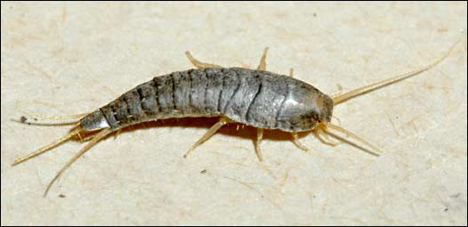
Silverfish
Photo by J. Hahn, University of Minnesota

Slide 3
Historical Relationship
Human Evolution
  Our Hominina lineage split from chimps about 7.5 million years ago and Homo sapiens appeared less than 500,000 years ago.
  Other living things were either food, dangerous, or neutral
  Adaptations such as ability to run long distances, large brain and cognitive abilities, and sociality enabled survival
  Humans as a social animal
    Survival involved protecting members of the group - altruism
    Source of our intuitions about other species

Slide 4
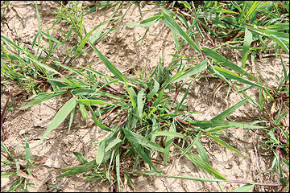
Crabgrass
Photo University of Missouri

Slide 5
Past Philosophical Positions
Aristotle – father of biology
  Humans as rational beings rank above animals
Descartes
  Practices vivisection
Kant
  Don’t kick the dog, but not for the dog’s sake

Slide 6
Changing Attitudes
Bentham
  “Can they suffer?”
Singer
  Speciesism
  Sentient beings deserve moral consideration
Regan
  Subjects of a life

Slide 7
Enlarging the Circle of Moral Concern
Schweitzer
  An ethic of respect for life
Goodpaster
  All living things have interests
  Moral considerability versus moral significance
Taylor
  Living things have a good of their own
  Living things have inherent worth
  The well being of living things is an end in itself

Slide 8
Buddhism
Interconnectedness
Compassion towards sentient beings
We should protect living and non-living things (Thich Nhat Hanh)
There is a hierarchical view of living things in the order of rebirth

Slide 9
Hinduism
Interconnectedness
All life is an incarnation of God (Gandhi)
Hindus may ask for pardon when they consume plant and animal food
Non-violence towards animals
Protection of cows symbolizes the protection of all that is helpless and weak in the world (Gandhi)
Hierarchical rebirth

Slide 10
Confucianism
Connection between humans and nature
Maintain a productive and respectful relationship with nature
Humans have a responsibility for nature – “Heaven is my father and Earth is my mother”
Humility towards nature – “such a small creature as I finds and intimate place in their midst”

Slide 11
Islam
The Earth is made for all creatures, not just human beings (Qur’an, Ar-Rahmaan 55:10)
One should be respectful towards nature
Muhammed says that planting food that may be consumed by other animals is a charitable act (Sahih Muslim 10:3769)
Created by God, nature is sacred and part of God’s revelation
All life sings praises to God

Slide 12
Judaism
Adam was created last so that “if a man’s mind becomes (too) proud he may be reminded that the gnats preceded him in the order of creation.” (Babylonian Talmud, Sanhedrin 38a:35)
God says, “…take great care that you do not damage and destroy My world...”(Ecclesiastes Rabba 7:13)
Caring for others may be expanded to the Earth and other species (Tirosh-Samuelson)

Slide 13
Judaism, Christianity and the Hebrew Bible
God is concerned equally with all of creation – in the Psalms (104)
God calls creation good - before the creation of human beings in Genesis
Human humility with respect to nature – in the Book of Job (38-41)
Humans have no advantage over animals – Ecclesiastes (3: 19,20)

Slide 14
Christianity
All of creation will be redeemed in Romans (8:21)
God’s throne is surrounded by creatures resembling a human being, an eagle, a bull, and a lion in the Book of Revelation (4: 6-8)
All of creation exists for God (e.g., Col. 1:16)
God cares for sparrows (Mt. 10:29) though may value humans more highly (Mt. 10:31)

Slide 15
Judaism, Christianity and Science
Augustine suggests we may misinterpret scripture if our interpretations depart from what we observe and our own reason.
Maimonides says that the truth should be accepted from all sources.
Science teaches our smallness in the universe
And, that the Earth’s resources are finite

Slide 16
Contributions of Science to Moral Consideration of Other Species
Humility – the position of human beings in the universe and relative to other living things
Relatedness to other living things
What is intrinsic value in biological terms?
  Ecosystem contributions
  Evolutionary success
    A product of adaptability and reproductive success
Understanding human evolution and the importance of sociality

Slide 17
Synthesis
Living things such as crabgrass and silverfish have tens of millions to hundreds of millions of years of evolutionary success, play important roles in their ecosystem, and thus have intrinsic value – they are due moral consideration.
These living things have interests or a good that may be fulfilled. We, as human beings must avoid interfering with the flourishing of other organisms.
These positions are consistent with strands of philosophical thought and major world religious traditions.

Slide 18
Synthesis
Moral significance. Is there a hierarchy in situations of conflict?
  Decisions that negatively affect other living things for reasons of financial gain, aesthetics, or convenience are difficult, if not impossible, to morally support.
  The right to feed, clothe, house, or defend oneself or one’s family is broadly accepted in philosophy and religious traditions, but as is particularly seen in indigenous traditions the impact on other organisms warrants respectful reflection.
  No reason to prefer one set of adaptations over another.
  Humans are social animals – our evolutionary success is largely the result of cooperative behavior. Though there may be no moral basis for choosing to save a human over another species, to prefer a human is part of what it is to be a human being.

