Slide 1
Team-Teaching Earth Spirituality and Justice Across the University
Just Sustainability: Hope for the Commons
Catherine Punsalan-Manlimos, Ph.D., Director, Institute for Catholic Thought and Culture
Le Xuan Hy, Ph.D., Director, Catholic Studies
August 9, 2016

Slide 2
Our goal is not to amass information or to satisfy curiosity, but rather to become painfully aware, to dare to turn what is happening to the world into our own personal suffering and thus to discover what each of us can do about it. [Laudato Si’ 19]

Slide 3
 | Ignatian Pedagogy | Practical Theological Method
What? | Context | In-depth examination of concrete experience, cultural reality, and religious tradition
 | Experience
So what? | Reflection | Mutual conversation of experience, culture, tradition
Now what? | Action | Transformative Action
 | Evaluation

Slide 4
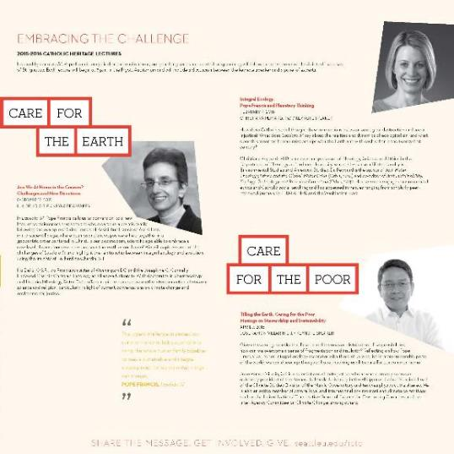
WHAT?
A team-taught, interdisciplinary, inter-generational series of courses taught in conjunction with the Institute for Catholic Thought and Culture’s Catholic Heritage Lectures: Care for the Earth, Care for the Poor

Slide 5
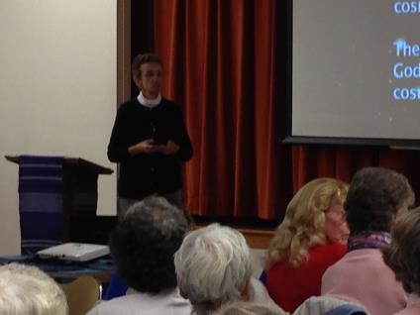
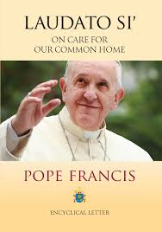
CHL 2015-16:
Care for the Earth, Care for the Poor
October 15, 2015
“Are We At Home in the Cosmos? Challenges and New Directions”
Keynote speaker: Ilia Delio, O.S.F
Respondent: Jason Wirth, PhD, Pigott-McCone Chair

Slide 6
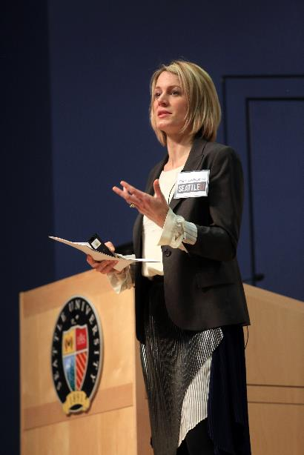
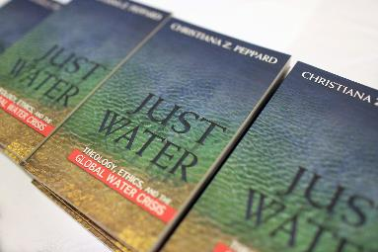
CHL 2015-16:
Care for the Earth, Care for the Poor
February 4, 2016
“Integral Ecology: Pope Francis and Planetary Thinking”
Keynote speaker: Christiana Peppard, PhD
Respondents: Wes Lauer, Director of Environmental Science and Christina Roberts, Director of Women and Gender Studies & Indigenous Initiatives

Slide 7
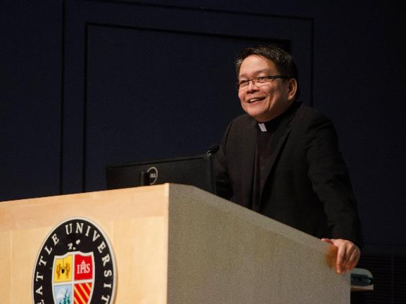

CHL 2015-16: Care for the Earth, Care for the Poor
April 7, 2016
"Tilling the earth, caring for the poor: Musings on Stewardship and Sustainability”
Keynote Speaker: Jose Ramon Villarin, S.J.
Respondents: Patty Bowman, Catholic Climate Covenant Ambassador; Jessie Dye, Program Director of Earth Ministry

Slide 8
Who’s in the Room
 | Fall | Winter | Spring
Undergraduates | 10 | 10 | 10
Graduate (MA) | 3 | 2 | 1
Graduate (EdD) | 1 | 1 | 1
We can no longer speak of sustainability without intergenerational solidarity.—Laudato Si’ 159

Slide 9
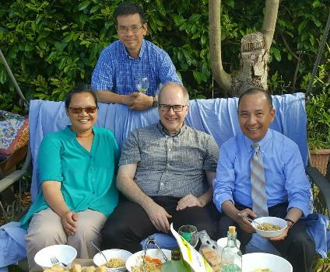
Faculty
Le Xuan Hy, Ph.D., Associate Professor, Psychology; Director, Catholic Studies
Faustino Cruz, S.M., Ph.D., Associate Professor, Pastoral Leadership; Associate Dean for Academic Achievement
Catherine Punsalan-Manlimos, Ph.D., Associate Professor, Theology and Religious Studies; Director, Institute for Catholic Thought and Culture
Robert Stephen, S.J., J.D., Chaplain for Ignatian Leadership, Campus Ministry & MAGIS
Trung Pham, S.J., MFA, Assistant Professor, Fine Arts

Slide 10
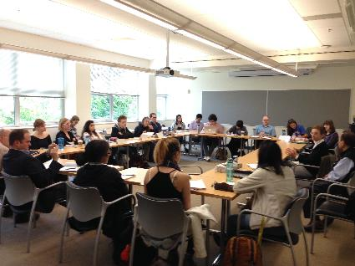
Course Description
The seminar introduces participants to Catholic social thought as it pertains to the current discussion on ecology and social justice. Inspired by Pope Francis’ encyclical, Laudato Si’, it invites students to explore the contributions of Catholic thinkers to a multidisciplinary, dialogical response to the ecological crisis faced today.
Students participate in seminar discussions among themselves in a personally engaged way. The mixture of graduate and upper-level undergraduate students in the seminar makes it possible to have even more enriched conversations.
Student conversation with Fall speaker, Ilia Delio, OFM, Ph.D.

Slide 11
Course Outcomes
Learning Outcomes | This learning outcome will be met through | This learning outcome will be assessed through
Students’ heart, mind, and gut are engaged so that each student will pick up one issue or dimension of the topic, work on it, and present it to class. | Critical engagement with and presentation of the issue or dimension of the topic chosen. | Completion of written assignments and postings, active class participation, and creative presentation of final project.
Students learn to draw from Catholic intellectual tradition, as they develop the final presentation. | Scholarly understanding and appropriation of sources from Catholic intellectual tradition. | Effective reading, synthesis, and reflection.

Slide 12
Course Requirements
Project
  Choose a presentation topic and have it approved by faculty advisor
  Meet with faculty advisor
  Present project to class and discuss others’ presentations
Attendance at the Catholic Heritage Lecture and conversation with CHL Speaker
Class Attendance
CANVAS Discussion Forum.

Slide 13
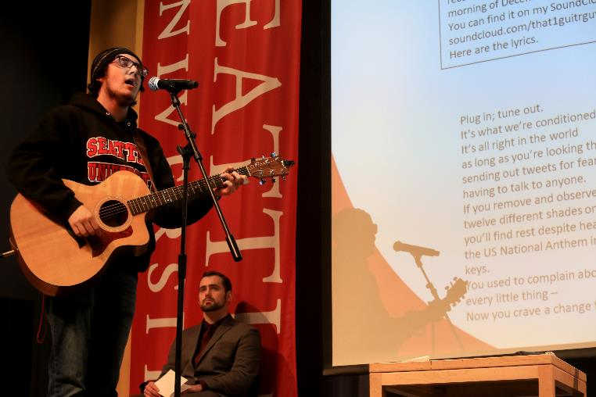
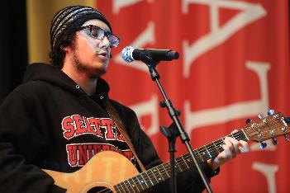
SO WHAT?
Fred Seymour, Film Studies
With a CAST Minor

Slide 14
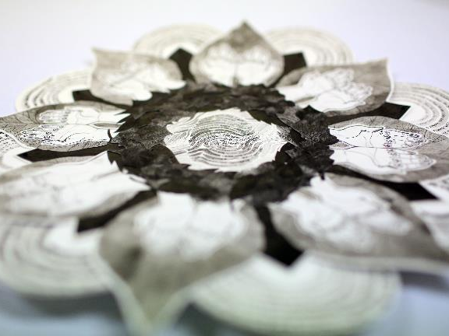
MAYA LALL, ’16, Fine Arts with a CAST minor
One of three pieces she created for each quarter of the course. This piece explores not only how Laudato Si’ challenges us to care for our common home but how this same call is found in many religions from around the world.

Slide 15
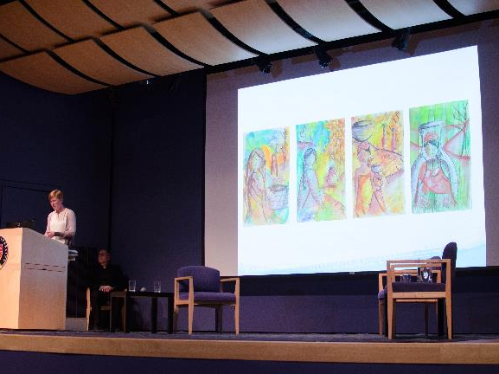
Jessica Palmer, ‘16, MA Transformational Leadership
Water color inspired by the final chapter of Christian Peppard’s Just Waters:
Woman at the Well
Hidden Life
Generations
Her Daily Toil

Slide 16
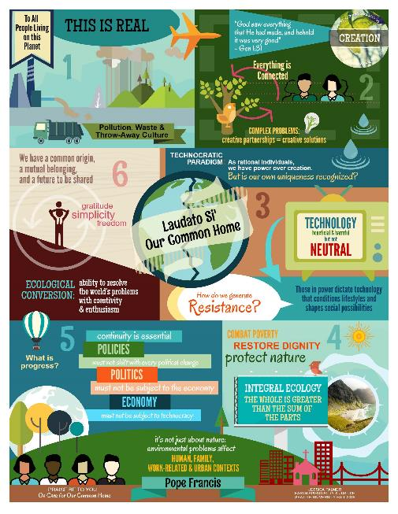

Slide 17
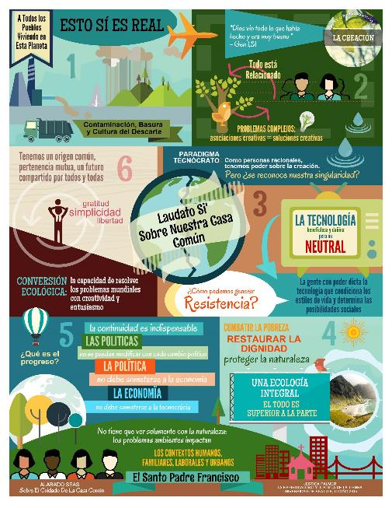

Slide 18
Student comments/discussions
What: I really look forward to discussing environmental issues during this quarter. I did not come to this course intentionally but I can already tell that I will get more out of this class than just the credits I need.
So what: To that means I hope that this course gives me an outlet to speak of science without religious affiliations. At the same time, I want to be open to the beliefs of others. I do not think that positive environmental change will ever occur without a dialogue that involves all sides listening and at least trying to understand. --Kate

Slide 19
What: Our technological prowess is causing us to continuously harm our earth and it's becoming more and more detrimental as time goes on. We're so focused on worshipping money, and converting our life to the economic world, that we've forgotten to give our attention to what the earth wants of us.
So what: Us [sic] human beings are disconnected from ourself [sic]vand nature. Self and nature is one, and the pope invites us to recognize that "all of us are linked by unseen bonds and together form a kind of universal family" (89).
Now what: Enter into reflection into what it means to be a human and reflect on our purpose of life as the Pope asks us to do. With reflection comes awareness and realization, and with that we can share with one another and have productive and active dialogue. --Maya, September 29

Slide 20
Hi Maya! I totally agree with you- advancements in technology have caused a heightened fixation over the years with money, especially within a capitalist economic system. I wonder if people, particularly Americans, are spending less time outdoors than indoors due to the recent innovations in technology. I mean, now you can have food brought to your house by putting in an order with Amazon!
Things like that scare me- by limiting our interactions with people and nature in an everyday, casual context, do we then place less importance on our collective role as people living off of the earth and therefore neglect to make the appropriate strides to protect it?—Alex, Oct. 1, 2015
Maya, I completely agree. The disconnect from our earth and each other is crucial. We feel so distant from the problems at hand even though we are each deeply intertwined with them. I think you pose a great ‘Now what’, reflection and dialogue is always a good place to start in becoming more aware and moved to act.—Monique, Oct 1, 2015

Slide 21
What?: On page 38, Peppard highlights that, "nearly 17 million barrels of crude oil are used annually to manufacture plastic bottles that are used once and then discarded. [...] And only 13 percent of those bottles are actually recycled after being discarded.“
So what?: If these numbers represented a population who relied on bottled water as their sole source of clean water, perhaps this number would not be so staggering. Unfortunately, Peppard goes on to write that, "the most prodigious consumers of bottled water have clean tap water at their fingertips twenty-four hours a day and are not in danger of drinking disease ridden water" (p. 38).
Now what?: Action must be taken in order to reduce unnecessary water bottle consumption on an international scale. Seattle University, along side many other universities across the United States, has already taken action to reduce water bottle waste through installing water container friendly water fountains, removing access to bottled water on campus, and improving access to bins for recycling. It would be interesting to see how the U.S. government may be able to incentivize all businesses, schools, and institutions alike to follow the model of Seattle University. –Pat, Jan. 15

Slide 22
These statements about the production and recycling of water bottles also resonated with me. I don't understand how the US, with all of its resources and educated leaders, can allow so much of the country to not have recycling laws. Even leaving the Seattle city limits is noticeable when it comes to recycling and composting. Even though recycling is a reactive measure rather than a proactive solution, its an important first step. –Jessica
That's the second time today I've heard someone talk of reactive measures and proactive solutions with regard to government policy. It seems like this is an issue across the board. When it comes to cognitive resources I guess this makes at least a little bit of sense. It is easier on the brain to think of how to respond in case a fire breaks out in your home than to critically think of all the ways in which action must be taken in order to have it prevented…. –Pat

Slide 23
Faculty Reflections
The course was inspirational. At the most basic level it has reminded me to pay attention to the beauty of nature all around me. This was a frequent topic of our discussions and one of the themes carried through the student presentations. We walk past so much beauty each day. I have found myself slowing down and paying attention more to my surroundings. Another way the course has inspired me is in my attitude toward the influence and power of our academic studies. It was eye-opening to see the quality of discussion, presentations, and final products produced by the students in this class. I do not think I have ever seen a higher level of commitment and results in any of the other courses I have been a part of over the years. I am not sure if it was the topic, the quality of the student, the innovative approach of the course, or something else, but the results were tremendous and continue to inspire me. --Fr. Bob Stephan

Slide 24
What might accountfor the success?
Class Size
Faculty Mentoring
Intergenerational Composition
Student interest and commitment to integral ecology
Ignatian Pedagogy/Practical Theological Method

Slide 25
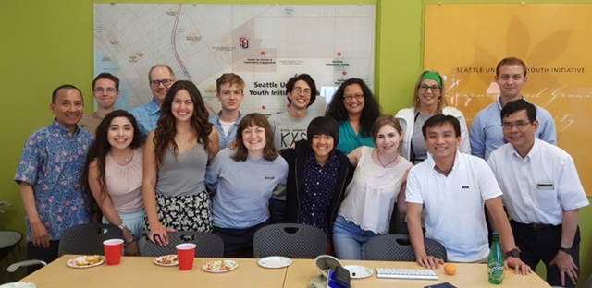
Now What?
Many things have to change course, but it is we human beings above all who need to change...A great cultural, spiritual and educational challenge stands before us, and it will demand that we set out on the long path of renewal.—Laudato Si’ 209

