Slide 1

ALL-COLLEGE MEETING: SPRING UPDATE
APRIL 18, 2019

Slide 2
GUIDING PRINCIPLES
Committee that is representative and includes faculty (tenure and non-tenure), staff and students.
Planning process that:
honors our mission and values
builds on our shared governance principles
aligns with our work on intersectionality
NOMINATIONS from:
Executive Committee
Faculty Staff Senate
Graduate student committee
Leadership Committee on Intersectionality and Justice
Undergraduate student committee

Slide 3
COMMITTEE MEMBERS
Alec Downing
Undergraduate Student
Ali Mian
Assistant Professor, Theology and Religious Studies
Hannah Tracy
Senior Instructor, English
Joseph DeFilippis
Assistant Professor, Anthropology, Sociology and Social Work
Kevin Ward
Associate Professor, Institute of Public Service
Lindsay Ohab
Program Coordinator, Institute of Public Service
Lucas Sharma, SJ
Lecturer, ASSW, Institute for Catholic Thought and Culture
Maureen Emerson Feit, Co-Chair
Director & Senior Instructor, Nonprofit Leadership
María Bullón-Fernández, Co-Chair
Professor, English
Samantha Drennon
Graduate Student
Executive Coordinator, Office of Diversity and Inclusion
Sonia Barrios Tinoco
Associate Professor & Chair, Modern Languages and Culture
Tasmia Moosani
Academic Advisor, Arts & Sciences Advising Center
Sonora Jha, Dean’s Liaison
Professor, Communication
Associate Dean for Academic Community, College of Arts & Sciences
Kate Reynolds
Administrative Support, Administrative Assistant, College of Arts & Sciences
Notes:
Acknowledge committee members

Slide 4
UPDATES ON TIMELINE: FALL 2018
Gathered input from you on how to design our process during the CAS Convocation
Launched webpage for College of Arts & Sciences Strategic Planning: https://www.seattleu.edu/artsci/faculty-and-staff-resources/strategic-planning/
Reviewed the University's strategic planning timeline and decided to:
  slow down our process so that we do not finalize our plan before the University Committee finishes its own;
  coordinate and communicate closely with the University Committee;
  work with a consultant who will help us bring an equity lens to the process
Sent feedback from A&S Convocation to University Strategic Planning Committee

Slide 5
UPDATES ON TIMELINE: WINTER 2019
Held a one-day design workshop in February
  Resulted in Strategic Planning process that is organized, engaging, transparent and centers equity throughout the process
Coordinated with University Strategic Planning Committee
  Members of University Committee invited to last hour of February design workshop
  Co-chairs met with co-chairs of University Strategic Planning Committee to share timelines and processes

Slide 6
COLLEGE OF ARTS & SCIENCES STRATEGIC PLANNING PROCESS
PHASE 1:
SPRING 2019
PHASE 2:
FALL 2019
PHASE 4:
SPRING 2020
PHASE 3:
WINTER 2020
Test Strategy Screen & Vision
Define and test Strategic Initiatives
Ratify & Communicate
Gather & Synthesize Data
Develop Strategy Screen & Strategic Vision
Gather data on Strategic Initiatives

Slide 7
KEY TERMS
Strategy Screen: Establishes criteria for ongoing decision-making inside and outside of the strategic planning process.
Strategic Vision: Aligns with the Strategy Screen and shows the specific future state we want to build over the next 5 years.
Strategic Initiatives: Prioritizes actions needed to achieve vision. Developed through an analysis of current state. For each initiative we will have clear success metrics and accountability.

Slide 8
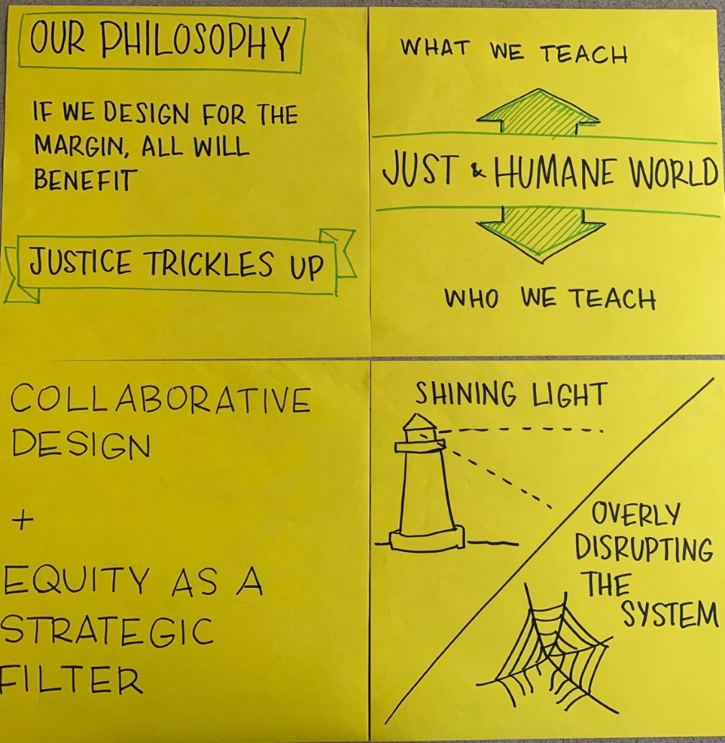
EQUITY LENS
We are committed to equitable representation in collaborative design and to using equity as a strategic filter.
We believe it is fully aligned with our organizational mission to state that if we design for the margins, all will benefit.
We envision a strategic planning process that centers our priorities on what will create the best outcomes for those on the margins.

Slide 9
PHASE 1:
SPRING 2019
Gather & Synthesize Data
Develop Strategy Screen & Strategic Vision
GOALS FOR PHASE 1
Engage stakeholders in identifying multiple possible futures for CAS.
Ensure a wide range of voices have input into our Strategic Vision and Strategy Filter.

Slide 10
PHASE 1:
SPRING 2019
Gather & Synthesize Data
Develop Strategy Screen & Strategic Vision
PREVIEW OF GUIDING QUESTIONS
How well are we living up to our mission and values?
What are our strengths as a college?
What are our biggest opportunities for the future?
What other input do you have for our strategy screen or 5 year vision?

Slide 11
PHASE 1:
SPRING 2019
Gather & Synthesize Data
Develop Strategy Screen & Strategic Vision
OPPORTUNITIES FOR INPUT
1. OPEN FORA
2. ONLINE SURVEY
3. SMALL GROUP DISCUSSIONS
4. OUTREACH to MARGINALIZED GROUPS
1. OPEN FORA
FACULTY AND STAFF
MONDAY, APRIL 29
3:35 to 5:00
ENGR 307
THURSDAY, MAY 2
12:00 to 1:30
SCTN 210
STUDENTS
Date TBD

Slide 12
PHASE 1:
SPRING 2019
Gather & Synthesize Data
Develop Strategy Screen & Strategic Vision
OPPORTUNITIES FOR INPUT
1. OPEN FORA
2. ONLINE SURVEY
3. SMALL GROUP DISCUSSIONS
4. OUTREACH to MARGINALIZED GROUPS
2. ONLINE SURVEY
To be launched in early May
Open to all faculty, staff, and students in the College
Please complete the survey in addition to any other fora or discussions you join

Slide 13
PHASE 1:
SPRING 2019
Gather & Synthesize Data
Develop Strategy Screen & Strategic Vision
OPPORTUNITIES FOR INPUT
1. OPEN FORA
2. ONLINE SURVEY
3. SMALL GROUP DISCUSSIONS
4. OUTREACH to MARGINALIZED GROUPS
3. SMALL GROUP DISCUSSIONS:
Facilitated small group discussions with CAS departments, committees and affinity groups
Committee will provide guidelines and discussion questions (INPUT KIT) for the conversations
Groups asked to send back feedback by early June

Slide 14
PHASE 1:
SPRING 2019
Gather & Synthesize Data
Develop Strategy Screen & Strategic Vision
OPPORTUNITIES FOR INPUT
1. OPEN FORA
2. ONLINE SURVEY
3. SMALL GROUP DISCUSSIONS
4. OUTREACH to MARGINALIZED GROUPS
4. MARGINALIZED COMMUNITIES
Committee will do outreach to and seek input from marginalized communities in the College

Slide 15
TASK FORCES
Survey task force: Kevin Ward, Tasmia Moosani, Ali Mian
Large open fora task force: Maureen Emerson Feit, María Bullón-Fernández, Alec Downing
Self-facilitation task force: Hannah Tracy, Lindsay Ohab
Targeted outreach to marginalized groups task force: Lucas Sharma, SJ, Samantha Drennon, Sonia Barrios Tinoco (Joseph DeFillippis currently on SQ sabbatical)

Slide 16
PHASE 1:
SPRING 2019
Gather & Synthesize Data
Develop Strategy Screen & Strategic Vision
Environmental Scan
Current State Mapping
ADDITIONAL COMMITTEE WORK
ENVIRONMENTAL SCAN
What are prospective students looking for in choosing a university?
Why do students choose SU/CAS?
In what ways are CAS applicant trends shifting?
What are perceptions of A&S vs. STEM among prospective students?
What is driving some schools to go out of business?
What can we learn from experiments in online learning?
What trends in Seattle are relevant? Cost of living?
What are

Slide 17
PHASE 1:
SPRING 2019
Gather & Synthesize Data
Develop Strategy Screen & Strategic Vision
Environmental Scan
Current State Mapping
ADDITIONAL COMMITTEE WORK
CURRENT STATE MAPPING
Document the current state of CAS’s operating model to provide clarity to the SPC and ensure there is an aligned starting point from which to build possible future alternatives.
What are

Slide 18
THANK YOU!
The Committee looks forward to engaging with you
Feel free to reach out to us with questions or suggestions:
María Bullón-Fernández bullon@seattleu.edu
Maureen Emerson Feit feitm@seattleu.edu

