Slide 1


Jacqueline McMurtrie
Lara Zarowsky

Slide 2

WashIP was founded in 1997 as the third innocence organization in the U.S.
Today there are 67 independent members of the Innocence Network worldwide

Slide 3
How Many People Are Wrongly Convicted?
  367 DNA exonerations in the U.S.
  Source: The Innocence Project
2,618 exonerations nationwide since 1989
  Source: The National Registry of Exonerations
167 capital defendants exonerated from death row
  Source: Death Penalty Information Center
50 documented exonerations in Washington State
  15 WashIP exonerations, including 5 DNA exonerations
  Source: The National Registry of Exonerations
  Updated: May 20, 2020

Slide 4
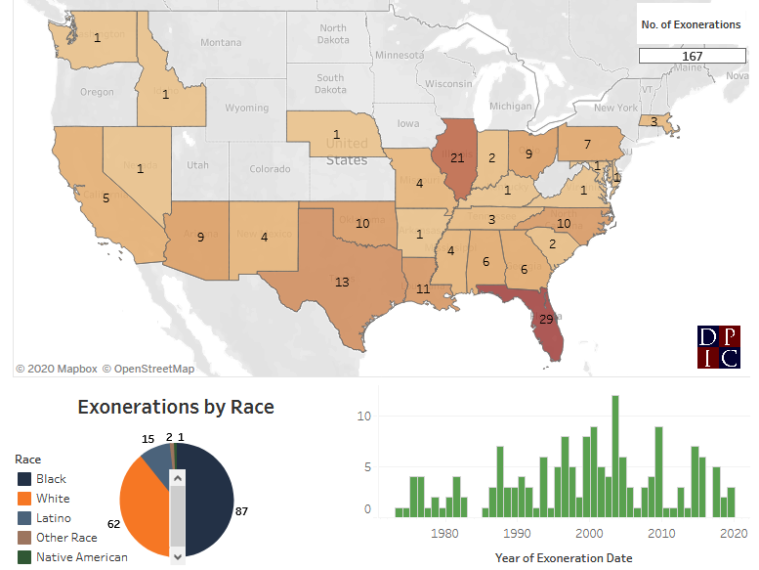
Innocent People Are Sentenced to Death
  Source: Death Penalty Information Center

Slide 5
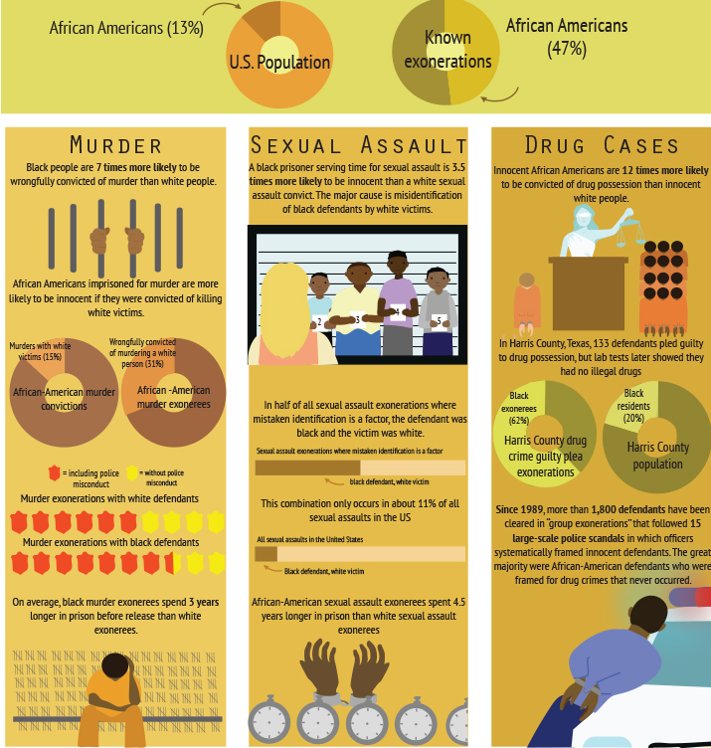
Race
Matters
Source: National Registry of Exonerations

Slide 6
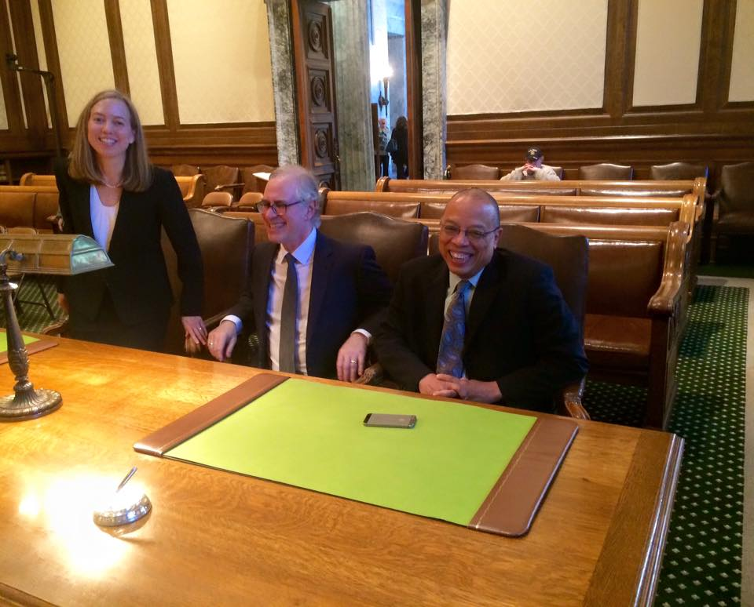

State v. Gregory (2018)
Washington State’s death penalty is unconstitutional because it was imposed in an arbitrary and racially biased manner.

Slide 7
Leading Causes of Wrongful Convictions
Mistaken eyewitness identification
Coerced confessions
Unreliable forensic work
Informant/Snitch testimony
Police & prosecutorial misconduct
Ineffective defense counsel

Slide 8
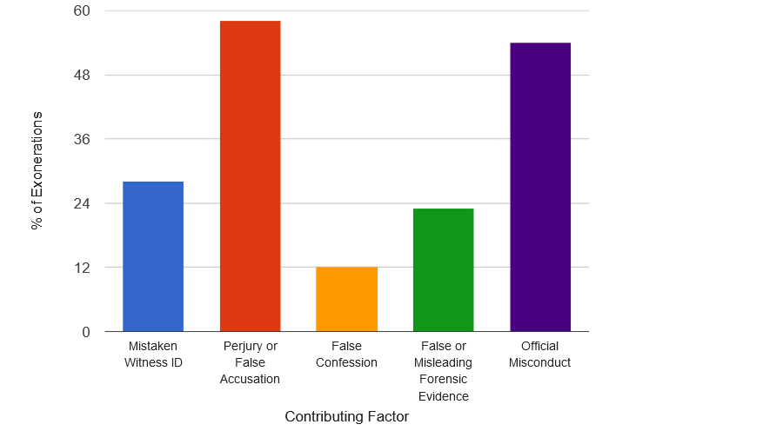
What Exonerations Have Taught Us
Source: National Registry of Exonerations

Slide 9
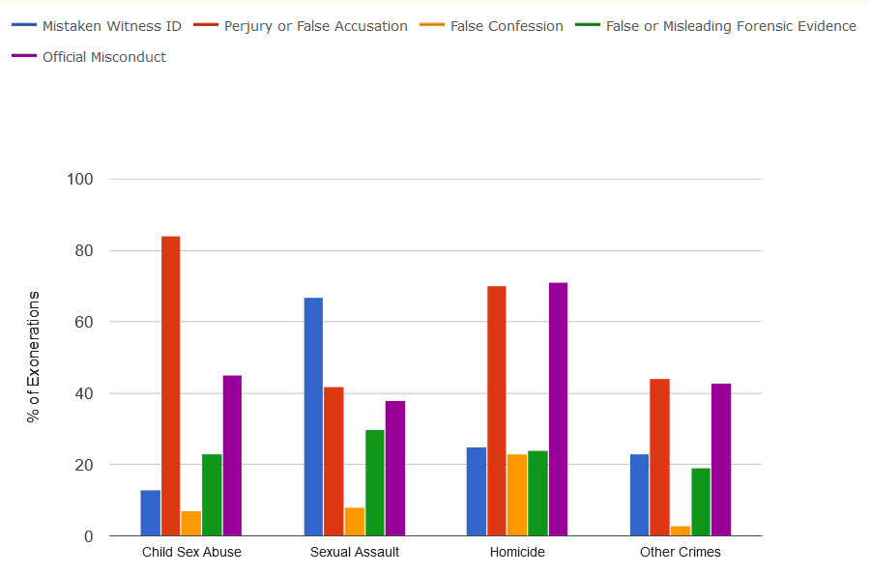
Contributing Factor and Type of Crime
Source: National Registry of Exonerations

Slide 10

Donovan Allen – 2002-2015
Convicted of Aggravated Murder in the First Degree
Sentenced to Life Without the Possibility of Parole
Contributing Factors:
  False Confession
  Perjury or False Accusation
  Official Misconduct

Slide 11
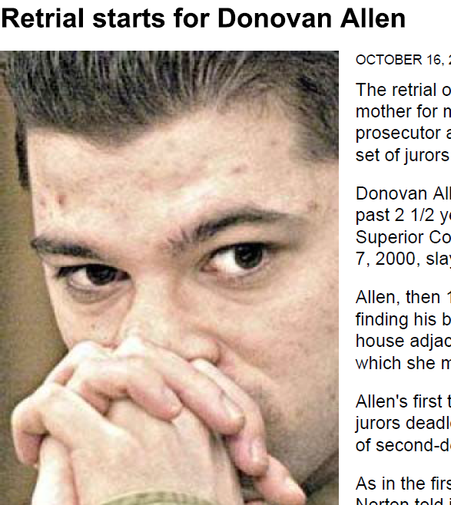

Donovan Allen
2002
2015
Notes:
Donovan had just turned 18 when was arrested for the 2000 murder of his mother in Longview, Washington. He spent nearly 16 years imprisoned for a crime he did not commit.
When Donovan found his mother, Sharon Cox, bleeding on the floor of her home, he called 911 pleading for help. She died at the scene and police later determined she had been bludgeoned with the butt of a rifle and manually strangled after a struggle with her attacker.
Donovan spent the weeks after his mother’s death cooperating with the police and insisting he was not involved in the crime. Police continued to focus on Donovan and did not pursue other suspects even though no physical evidence tied him to the attack on his mother.
Eventually police arrested Donovan and after a sequence of coercive interrogations spanning overnight and into a second day, he gave a false confession. Many of the statements Donovan made were inconsistent with the physical evidence, the result of suggestions by the police based on their initial theories that ultimately conflicted with the evidence in the case.
Early attempts at DNA testing in the case failed to implicate Donovan, but also did not identify another perpetrator.
Armed with this confession and the assistance of jailhouse informants and incentivized witnesses, the state tried Donovan twice. The first trial ended in a hung jury and mistrial, but after the second trial he was convicted and sentenced to LWOP.
IPNW worked with juvenile false confession expert Professor Steven Drizin who identified significant problems with the tactics used and reliability of the confession in the case to help support IPNW’s request for post-conviction DNA testing and won a court order for testing.

Slide 12
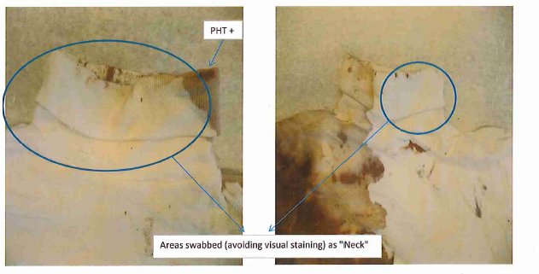
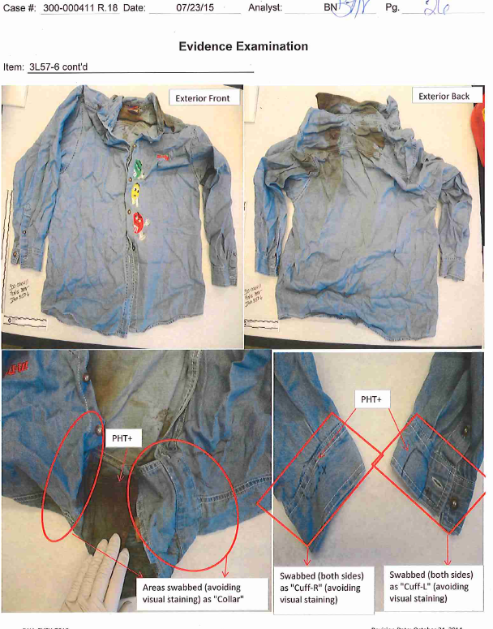
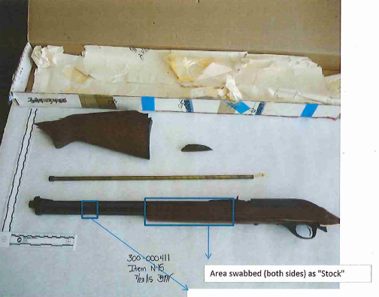
Items Tested
Notes:
WSP conducted modern DNA testing on several evidence items, including the clothing worn by the victim – testing focused on the turtleneck and collared shirt where she was manually strangled (confirmed by autopsy/handprint bruising);
Testing also conducted on the gun that was used as bludgeon and then hidden in the garage when the perpetrator fled the scene.
Donovan Allen was excluded from all this testing. However, DNA connected to a cousin who acknowledged going to her residence earlier that day was identified in significant areas of the collar and on the firearm.
Advances in sensitivity of DNA testing and techniques used by analyst as well as proper storage and retention of the physical evidence made DNA testing viable for these items.
After reinvestigating the case considering these DNA results, the state agreed to Donovan’s release and vacated his conviction in December 2015.

Slide 13
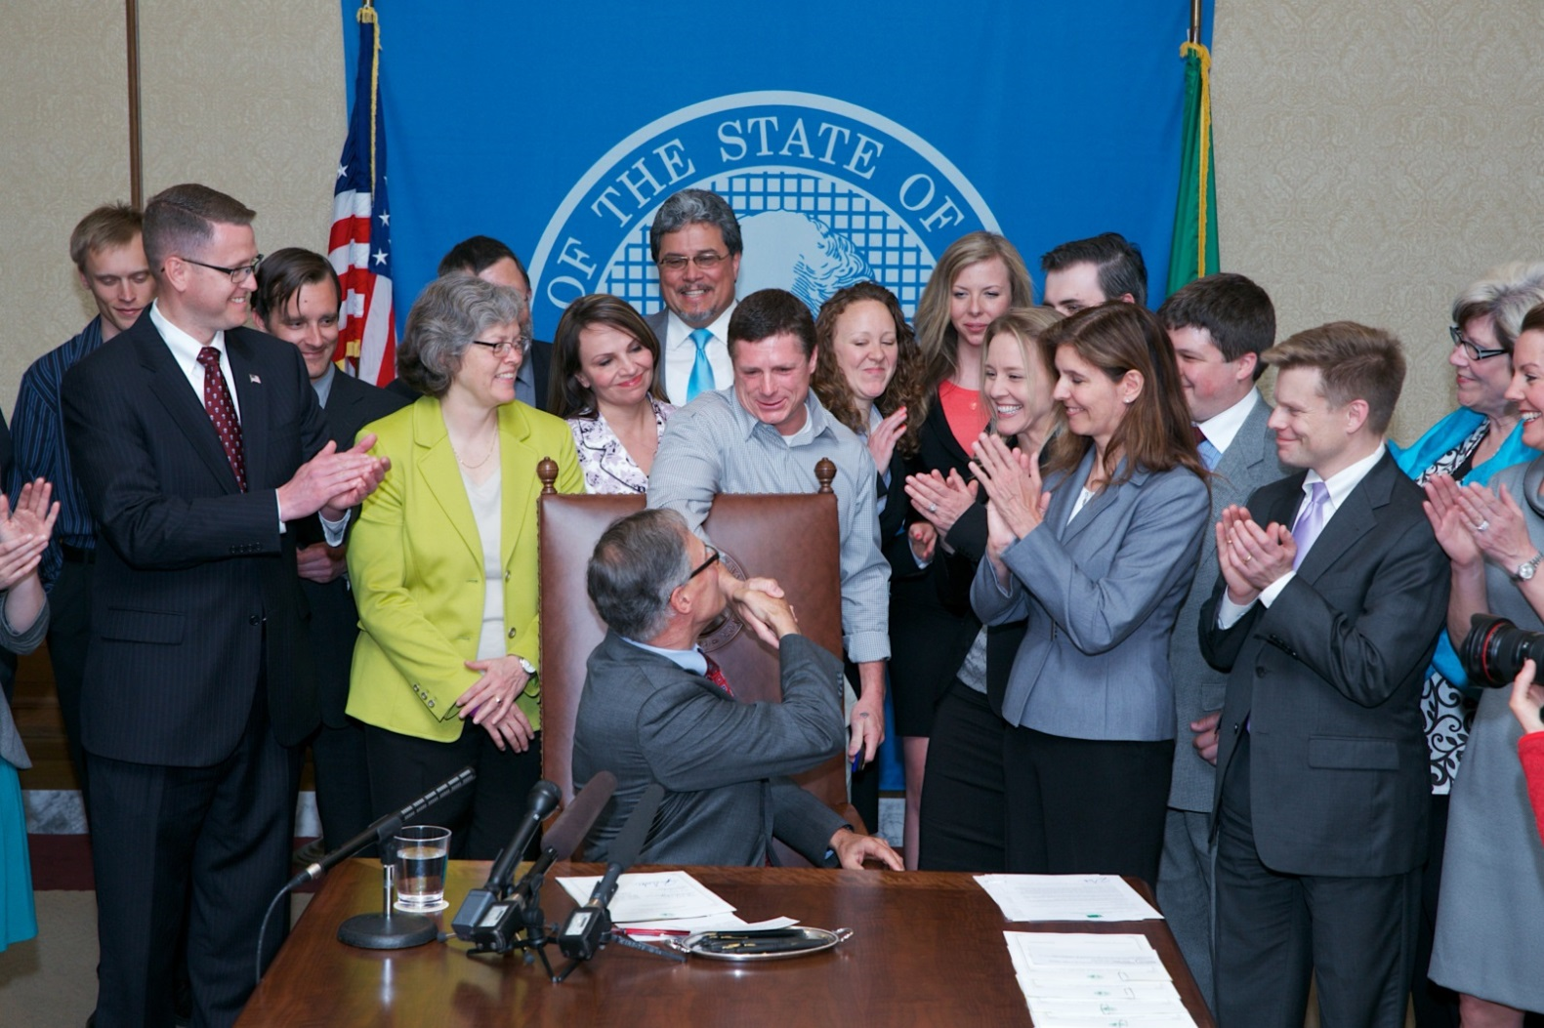
Policy Efforts: Washington State Compensation Statute
Notes:
Clinic at the UW law school
Our policy work has led to 2 bills being passed: 2013- the exonerated deserve compensation. 2015: DNA evidence must be preserved.

Slide 14
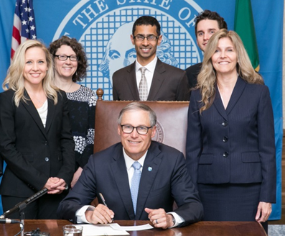
Policy Efforts: Washington State Evidence Preservation Statute

Slide 15
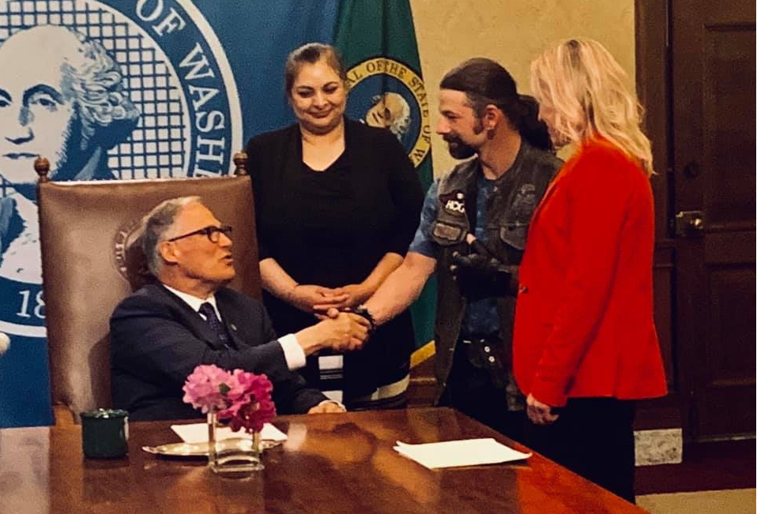
Policy Efforts: Establishing Best Practices for Eyewitness and Incentivized Witness Evidence

Slide 16


