Slide 1
The Role of Social Science in Abolishing the Death Penalty in Washington State
Heather D. Evans, PhD
University of Washington
hdevans@uw.edu

Slide 2
State v. Gregory (2012-2018)
Defendant was an African American man sentenced to death for aggravated murder of a white woman in Pierce County
Mr. Gregory was 24 years old at time of the crime had one prior felony conviction
Notes:
Lila and Neil were representing Mr. Allen Gregory – slide facts
Pierce County notorious for both racial inequities and prosecutorial misconduct
In response to comments by Justice Wiggins about the apparent role of the race of the defendant, Washington Appellate Project attorneys decided to commission a study of the role of race in the adjudication of the death penalty as part of their defense of Mr. Gregory.

Slide 3
Attorneys & Social Scientists Working Together
Commissioned by Washington State Appellate Project
Collaboration between two social scientists: me and Dr. Katherine Beckett, and two attorneys: Neil Fox and Lila Silverstein
Goal: examine all death penalty cases in WA State to determine if evidence of racial bias

Slide 4
At First Glance…
 | Black Defendants | NonBlack Defendants | White Defendants
Percent Sentenced to Death | 64.3 % (9/14) | 38.8 % (26/67) | 40.4 % (23/57)
N = (14 + 67) = 81
Differences in proportion sizes may indicate racial disparity

Slide 5
Trial Reports – Building a Dataset Appropriate for Statistical Analysis
Every aggravated murder case to have a “trial report” completed by judge
For cases in which prosecutor sought death sentence, a “special sentencing” section completed on trial report
Developed Coding Protocol used to review each trial report to record characteristics of each aggravated murder case
Trained team of UW undergraduate students to code just over 300 trial reports

Slide 6
Trial Report Coding Protocol Example
10. Race or ethnic origin of defendant:
  Enter 1 for White or Caucasian
  Enter 2 for Black or African-American
  Enter 3 for Hispanic, Latino/a, Mexican, or Mexican-American
  Enter 4 for Native American, Alaska Native, or American Indian
  Enter 5 for Asian or Pacific Islander
29. Plea:
  Enter 0 if the defendant plead guilty
  Enter 1 if the defendant plead not guilty
  Enter 2 if the defendant plead not guilty by reason of insanity

Slide 7
WA State Death Penalty Dataset, 1981-2016
202 Variables of Case Characteristics:
  Defendant demographic info (race, gender, age, etc.)
  Defendant criminal history
  Offense info (included sexual assault, prolonged suffering, type of weapon)
  Mitigating and aggravating circumstances
  Victim info (number, race, gender, age, etc.)
  Attorney info (public defender, private defense)
  Jury info (race composition, instructions given, etc.)
  Outcome 1: Prosecutor sought death penalty or not
  Outcome2: Death Sentence or Life without Parole

Slide 8
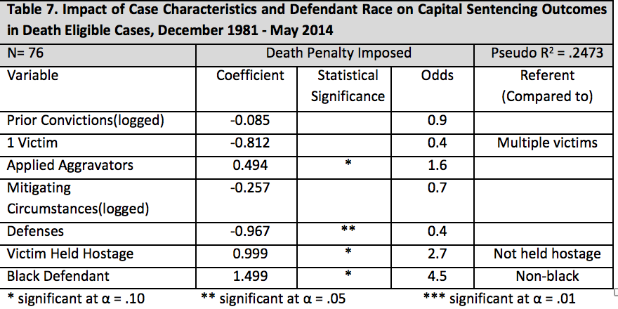
Preliminary Analysis and Results: Sentencing Decisions
Notes:
But most dramatic finding pertained to jury decision-making
Note about implications of smaller number of cases: can’t include as many variables in the model; tested everything; final models include legally relevant variables as well as defendant race
These findings indicate that Black defs are 4.5 times as likely as non-Black defs to be sentenced to death after controlling for the other variables shown here

Slide 9
Key Finding
At sentencing stage, African American defendants are 4.5 times as likely to be sentenced to death as other defendants
This result was obtained after controlling for legally relevant factors and was consistent across numerous models

Slide 10
State Challenges Report
State hires an expert to counter our findings
Two years of special proceedings after oral argument
All in writing – interrogatories, additional expert reports and briefing
Technical issues about statistics, p-values, sample sizes, accuracy of dataset and coding

Slide 11
Key Finding – Still…
At sentencing stage, African American defendants are more than 4 times as likely to be sentenced to death as other defendants. (Updated analysis shows 4.6 rather than 4.5 times as likely)
Result was obtained after controlling for legally relevant factors and was consistent across numerous models

Slide 12

State V. Gregory Decision (October 11, 2018)
“The death penalty is invalid because it is imposed in an arbitrary and racially biased manner.”
Chief Justice Fairhurst, author of the majority opinion

Slide 13
State V. Gregory Decision (October 11, 2018)
“Our capital punishment law lacks ‘fundamental fairness’ and thus violates article I, section 14. …
All death sentences are herby converted to life imprisonment.”

Slide 14
Ultimate Outcome
Washington State Supreme Court determines research provides evidence that the Death Penalty has been applied in an “arbitrary and racially biased manner” and is therefore unconstitutional
Abolishes Washington’s capital punishment scheme under state constitution
Supreme Court Decision is unanimous (9-0)
Eight men on death row have their sentences immediately converted life without parole

Slide 15
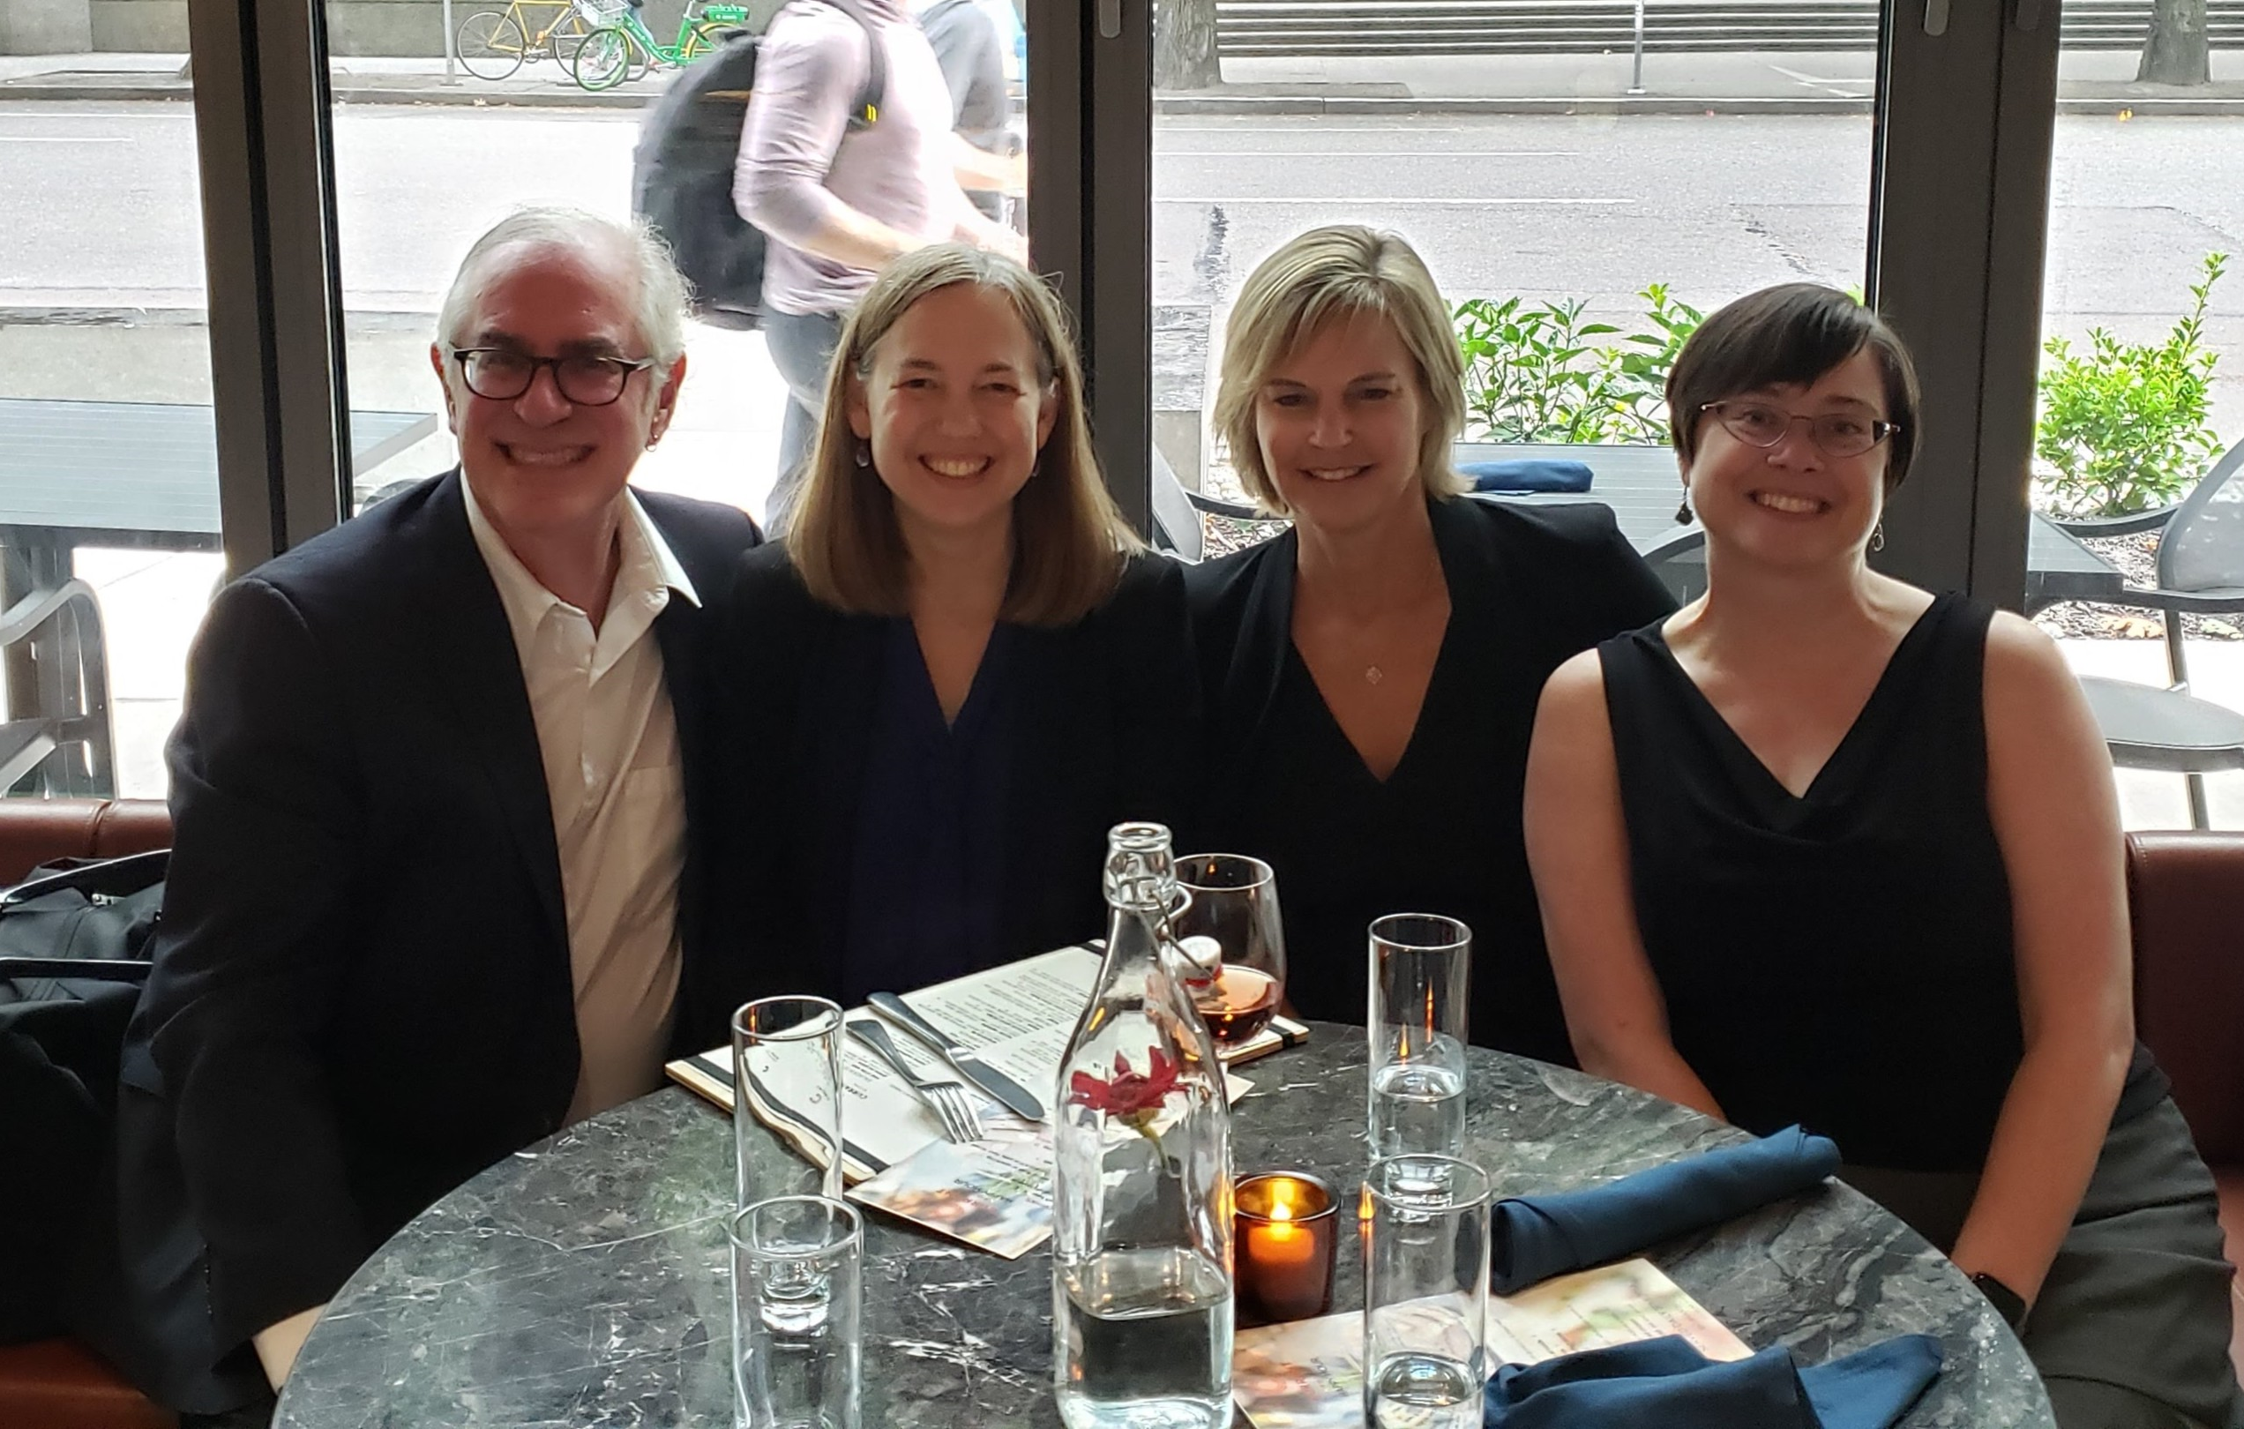
The Team
Legal Team:
Lila Silverstein, WA Appellate Project
Neil Fox,
Private Attorney
Academic Team:
Dr. Katherine Beckett
Dr. Heather D. Evans
with the help of undergrad coders

Slide 16
To Learn More about Abolishing the Death Penalty in WA…
Sudermann, Hannelore. Mar 12, 2019. “Abolished: How UW Research Convinced Our State’s Highest Court to Toss Out the Death Penalty, Columns UW Alumni Magazine. Available online at: https://magazine.washington.edu/feature/death-penalty-washington-state/
Westneat, Danny. Oct. 12, 2018. “Meet the UW Professor Who Just Killed the Death Penalty,” The Seattle Times. https://www.seattletimes.com/seattle-news/crime/meet-the-uw-professor-who-just-killed-the-death-penalty/
Beckett, Katherine and Heather D. Evans. Mar 14, 2019. “The Effect of Race on Sentencing Decisions in Washington,” Podcast. Death Penalty Information Center. Available online at: https://deathpenaltyinfo.org/podcast/audio/discussions/discussions-e25.mp3
Beckett, Katherine and Heather D. Evans. Mar 14, 2019. “Episode 167: A Case of Life and Death,” No Jargon Podcast, Scholars Strategy Network. Available online at: https://scholars.org/podcast/case-life-and-death

Slide 17
Thank you!!

