Slide 1
Master of Science in Computer Science (MSCS)
New Students Orientation
Fall 2022

Slide 2
Outline
Graduate programs
  MSCS - General
  MSCS-SE (Software Engineering Specialization)
  MSCS-DS (Data Science Specialization)
MSCS course numbers
Internships
Advising and class registration
Course waiver & credit transfer
CS Community
Q & A

Slide 3
Graduate Programs
MSCS General
  Course only option
  Research project option
MSCS-SE (Software Engineering Specialization)
  A two-quarter-long, industry-sponsored capstone project
MSCS-DS (Data Science Specialization)
  A one-quarter-long, real world data science capstone project
Notes:
1. The MSCS program curriculum includes required advanced courses in core areas of computer science while remaining flexible to meet your needs and interests. The program offers 3 unique options to supplement your learning.
2. The MSCS general option allows students to choose 2 electives to develop a solid, broad foundation in computer science and software engineering as it fits your passions and academic goals.
3. The MSCS-SE program builds the skill set you need for a career in the software industry. In the capstone project, the team will tackle a real-world problem, manage your project from inception through design and implementation, and deliver a functioning software application.
4. The MSCS-DS program provides the skills to develop computer solutions that require expertise in data science. The program consists of requirements in machine learning, big data analytics, visual analytics, and an advanced data science elective.

Slide 4
Minimum Credits for Degrees
MSCS Program Options | Minimum Credits
General Option | 45
DS Specialization | 49*
SE Specialization | 48
* Students who have taken calculus-based probability and linear algebra can be waived from MATH 5315 and reduce the overall required credits for the degree to 46.

Slide 5
MSCS General

Slide 6
MSCS General
Degree Requirements
Other Electives
CPSC 5100 – 5799
(5 credits)
Min. Credits: 45
Graphics
CPSC 5700
Special Topics
CPSC 5910
CPSC Electives
(10 credits)
SAAS
CPSC 5240
Mobile Dev
CPSC 5250
Physical DB
CPSC 5300
Compiler
CPSC 5400
Parallel Computing
CPSC 5600
AI
CPSC 5610
Computer Networks
CPSC 5510
Distributed Systems
CPSC 5520
Course option
CPSC 5890 Seminar (B- or better) + one CPSC elective
Research option
CPSC 5990 Graduate Research Project (B- or better, 2 quarters)
Choose One
(8 credits)
OR
Ethics
CPSC 5800
(2)
Fund. of SE
CPSC 5110
Software Arch. & Design
CPSC 5200
Applied Algorithms
CPSC 5600/5610
Systems
CPSC 5510/5520
Software Development
CPSC 5240/5250/5300
/5400/5700
Required Courses
(27 credits)

Slide 7
MSCS General
CPSC 5110 should be taken as early as possible. It is a prerequisite for CPSC 5200 and several other MSCS courses.
  Students graduated from CERT must take it
  Students with SE experience can be waived from CPSC 5110
    Fulfill the requirement by taking an additional 5 credits of CPSC electives instead.
Students cannot take the following two 3-credit courses for the electives
  CPSC 5305 for MSCS-DS only
  CPSC 5120 for MSCS-SE only

Slide 8
MSCS General:
Graduate Research Project Option
8 Credits, spanning over two quarters
The student must find a research advisor the quarter prior to starting the project
  The department runs a research info session in January
Deliverables
  A technical paper
  A final presentation
Standardized procedure
  Request form (needs dept. approval)
  MSCS Research Project Guidebook for Faculty and Students
  URL: https://www.seattleu.edu/scieng/computer-science/projects/grad-research/

Slide 9
MSCS-SE

Slide 10
MSCS-SE
Degree Requirements
Other Electives
CPSC 5100 – 5799
(5 credits)
Min. Credits: 48
Graphics
CPSC 5700
Special Topics
CPSC 5910
One CPSC Elective
(5 credits)
SAAS
CPSC 5240
Mobile Dev
CPSC 5250
Physical DB
CPSC 5300
Compiler
CPSC 5400
Parallel Computing
CPSC 5600
AI
CPSC 5610
Computer Networks
CPSC 5510
Distributed Systems
CPSC 5520
CPSC 5120
Software Proj. Management (3)
CPSC 5210
Software Testing & Debugging
CPSC 5810
Capstone Project I (4)
CPSC 5820
Capstone Project II (4)
Required Courses
(43 credits)
Ethics
CPSC 5800 (2)
Fund. of SE
CPSC 5110
Software Arch. & Design
CPSC 5200
Applied Algorithms
CPSC 5600/5610
Systems
CPSC 5510/5520
Software Development
CPSC 5240/5250/5300
/5400/5700

Slide 11
MSCS-SE
For students starting this fall wishing to finish in five quarters, they must take:
  CPSC 5110 in the fall
  CPSC 5120 in the winter
  CPSC 5200 in either winter or spring
  CPSC 5210 in either fall (if waived from 5110) or spring
Students with SE experience can get waived from CPSC 5110
  Students graduated from CERT must take it
  Fulfill the requirement by taking an additional 5 credits of CPSC electives instead.
Satisfactory performance (B- or better) in CPSC 5810 and CPSC 5820 is required.

Slide 12
MSCS-SE
Software Engineering Project
Teams of 4 or 5 students
Industry sponsored, using an agile development process
Substantial team responsibility for working with the sponsor to determine requirements
Must be taken in two consecutive quarters
Full-time students starting this fall must take the project starting in Fall 2023 - Winter 2024.
Notes:
Note: There will be a project that starts the spring 2022 and finishes this fall but that will only be open to students who started in Spring 2022 or earlier. It is NOT open to students who start in Fall 2022

Slide 13
MSCS-SE: Typical Schedules
Full-time
Part-time
Year | Fall | Winter | Spring
1 | CPSC 5110 core / elective | CPSC 5200 CPSC 5120 (3 cr.) CPSC 5800 (2 cr.) | CPSC 5210 core / elective
2 | CPSC 5810 (4 cr.) core / elective | CPSC 5820 (4 cr.) core / elective
Full-time
The set of “core / elective” courses consists of three core courses (see below) and one elective (any 5 credit MSCS course)
  algorithms: 5610 (fall & spring) or 5600 (winter)
  systems: 5520 (fall & winter) or 5510 (fall & spring)
  software development: choice of five courses; at least one is offered each quarter (except summer)

Slide 14
MSCS-DS

Slide 15
MSCS-Data Science
Degree Requirements
Min. Credits: 49
CPSC 5600
Parallel Computing
One DS Elective
(5 credits)
CPSC 5340
Text Proc. & Search
CPSC 5350
Social Media Analytics
MATH 5315
Mathematical Foundations of Data Science (3)
CPSC 5830
Capstone Project (5)
CPSC 5305 Intro to Data Science (3)
CPSC 5310 Machine Learning (5)
CPSC 5320 Visual Analytics (3)
CPSC 5330 Big Data Analytics (3)
Required Courses
(44 credits)
Ethics
CPSC 5800
(2)
SE Course
CPSC 5110 or 5200
Applied Algorithms
CPSC 5610
(AI)
Systems
CPSC 5520 (Distributed Sys)
Software Development
CPSC 5240/5250/5300
/5400/5700

Slide 16
MSCS-DS
Take either CPSC 5110 or CPSC 5200 depending on experience.
  Students without prior SE experience take CPSC 5110.
  Students take CPSC 5200 otherwise.
Satisfactory performance (B- or better) in CPSC 5830 is required.
Students who have taken calculus-based probability and linear algebra can be waived from MATH 5315 and reduce the overall required credits for the degree to 46.

Slide 17
MSCS-DS
For full-time students starting this fall wishing to finish in five quarters, they must take:
  CPSC 5305 and MATH 5315 in the fall
  CPSC 5310 in the winter
  CPSC 5320 and CPSC 5330 in the spring
Additional prerequisite:
  Calculus sequence (needed for the MATH 5315)

Slide 18
MSCS-DS: Typical Schedules
Full-time
Part-time
Year | Fall | Winter | Spring
1 | Math 5315 (3 cr) CPSC 5305 (3 cr) CPSC 5610 or CPSC 5520 | CPSC 5310 SE (5200) / DS elect / SW dev | CPSC 5320 (3 cr) CPSC 5330 (3 cr) SE (5110 or 5200) / SW dev
2 | CPSC 5610 or CPSC 5520 SE (5110) / DS elect / SW dev | CPSC 5830 CPSC 5800 (2 cr)
Full-time

Slide 19
Notes on MSCS Course Numbers
MSCS courses are numbered 5100 and above.
Allowable elective courses are numbered 5100-5799 and 5910 (special topics)
Students are not allowed to take undergraduate courses (1000-4990).
Students are not allowed to take courses numbered 5000-5099 for MSCS credits.
  These are courses for the certificate of computer science fundamentals and other graduate programs.
  Exception: If you received conditional admission, you will be required to take the specified prerequisite courses with a grade of B better within the first year.

Slide 20
Internships
How many credits should you register?
Credits to register | Min. hours/quarter | Max. hours/week
1 | 100 | 20
2 | 150 | 20
3 | 200 | 40
International students must maintain full-time status except during vacation quarters
Domestic students do not need to register for internships.

Slide 21
Internships
Before starting your internship
  Identify an internship faculty advisor
  Require the following docs
    Internship offer letter
    Internship request form (CPSC 5950 Internship) for course registration
    CPT support letter/form for international students

Slide 22
Internships
After starting your internship, complete:
  Internship Weekly Report
  Project Agreement Form
  Project Completion Form
  Intern Evaluation Form
  All are required to receive credit(s) for your internship!
Internship Guidebook
  URL: https://www.seattleu.edu/scieng/computer-science/student-resources/internships/

Slide 23

Internship Credits
Do not count towards your MSCS degree requirements.

Slide 24

Advising
Meet with your advisor each quarter
  Discuss your programs of study
  Course selection & planning
Online tool: my.seattleu.edu
  Program evaluation
  Search for courses + Registration
  Create an academic plan
    Submit it to your academic advisor for review

Slide 25
Registration
Check my.seattleu.edu for your registration time
  Depends on the number of credits you’ve earned.
Register as soon as possible once your registration time begins
If you are unable to get into a class, please fill out the WISE (waitlist) form.
  WISE forms are not processed in real time (batch processing)

Slide 26
Course Waiver
MSCS Preparatory Courses
  The waiver decision is made during admission
  The waiver process is initiated by the department
MATH 5315 or CPSC 5110
  Students need to submit the Petition to Waive MATH5315 or CPSC5110 Form and required materials to the department for approval

Slide 27
Credit Transfer from Prior Institutions
Only for graduate credits
A max of 10 credits
Students need to submit your request to the department for approval

Slide 28
Academic Performance, Probation & Dismissal
Placed on probation with cumulative and/or term GPA is < 3.0
Immediate actions
  Review your schedule with your advisor to make any necessary changes to your course load.
  Review university policies regarding progression and course repeats
Conditions for removal from probation
  You must earn a term GPA ≥ 3.0
  You must earn no grade below B
Failure to improve academic performance including violation of probation conditions could ultimately lead to dismissal

Slide 29
Other Academic Regulations
Must attain a grade of C or better in all courses
  Courses graded C- or below must be repeated
  Graduate projects & CPSC 5890 Seminar requires B- or better!
Must maintain a Cumulative GPA of 3.0 or better
SU has an academic honesty code
  See SU Graduate Bulletin of Information
You must apply for graduation
6 Year Limit
  All degree requirements must be completed within six years after course work is begun

Slide 30
International Students
Must maintain a full-time status (a minimum of 6 credits) except for the graduating quarter
All international students can work on-campus for a maximum of 20 hours per week
International Student Center hold for registration
New MSCS students must contact ISC before class registration
Main contact: ISC

Slide 31
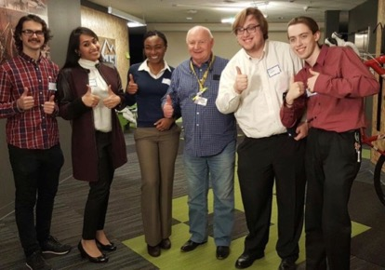
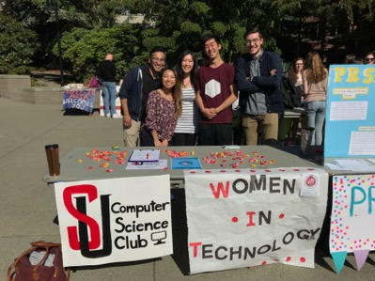
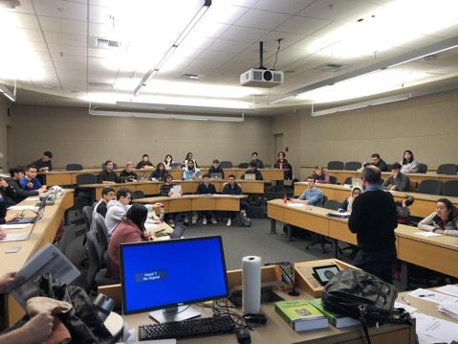
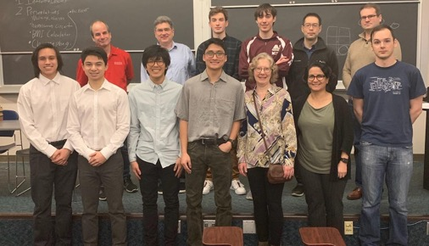
IT Architecture Competitions
Clubs
Interview/Resume Workshops
End of Year
Celebrations and Awards
Personal Projects

Slide 32
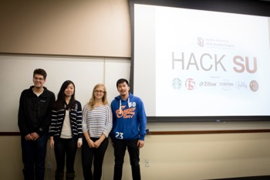
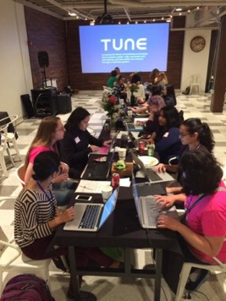
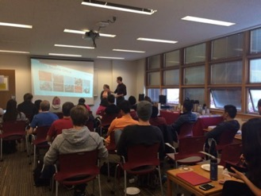
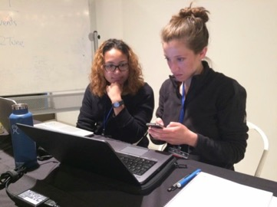
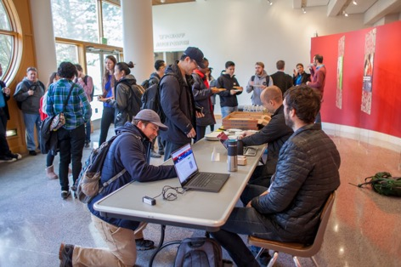
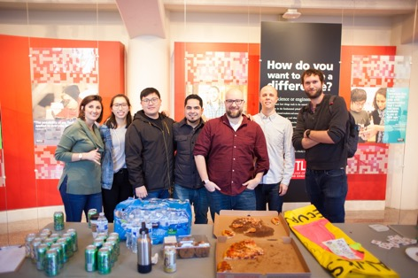
Hackathons
Seminars
Visiting F5
CyberHawks
Notes:
Roshanak

Slide 33
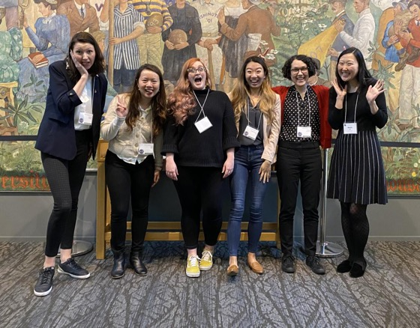
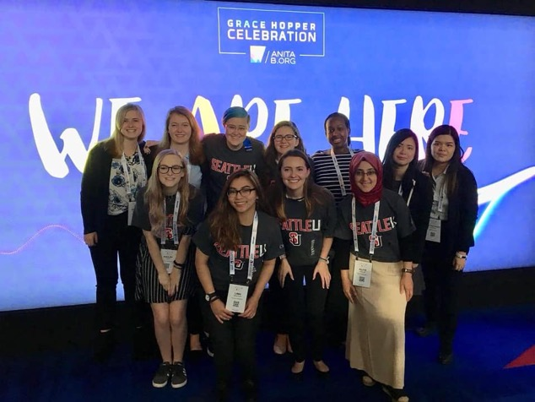
Women in Tech
@ GHC

Slide 34

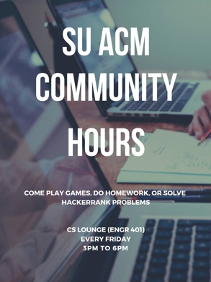
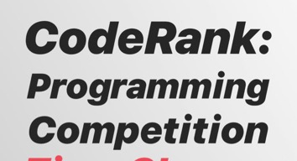
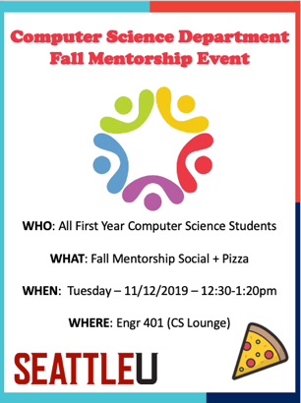
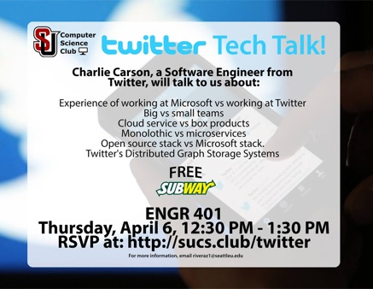
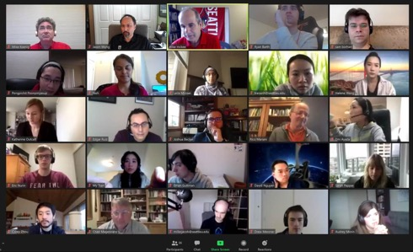

Slide 35


