Slide 1
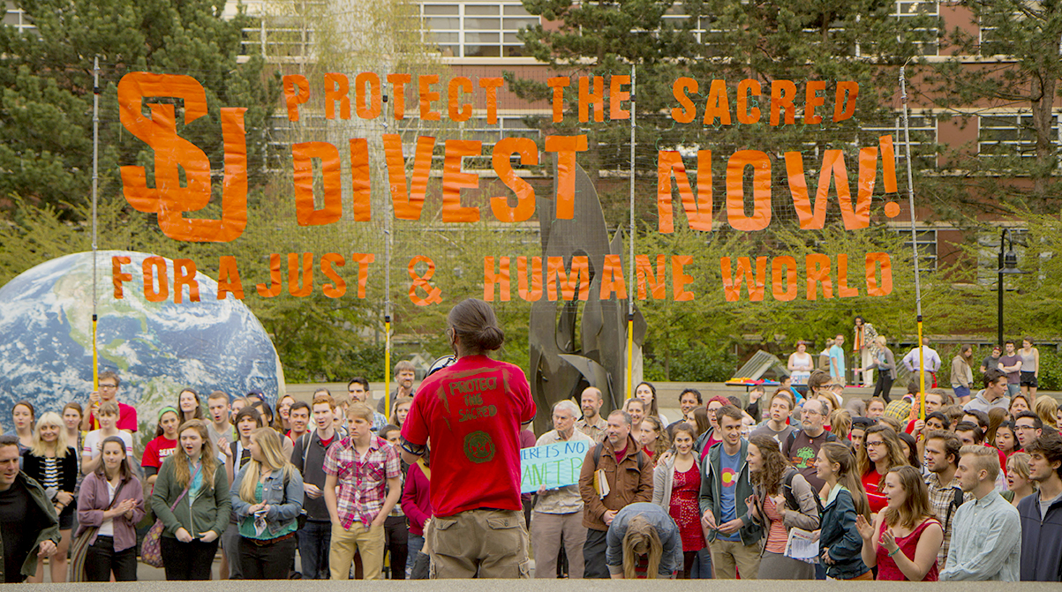
Fossil Fuel Divestment Movement at SU

Slide 2
SSA Petition for Fossil Fuel Divestment May 2013
Delivered to President Sundborg following divestment rally
34 companies of immediate concern
Asked that Seattle University
Freeze new investments in the companies or comingled funds with investments in the companies
Divest within 3 years from direct ownership and comingled funds with investments in the companies

Slide 3
Student Government of Seattle University (SGSU) October 2013
Approved resolution that asks Administration to freeze new investments in fossil fuel companies and to divest within three years from direct ownership and from commingled funds that include fossil fuel public equities and corporate bonds
Proposed timeline asks:
Year 1: Sell direct holdings; Perform an internal feasibility study on the full spectrum of reinvestment alternatives; Commit to full divestment or issue a public statement that addresses why Seattle University refuses to do so
Year 2: Work with Cambridge Associates to complete transfer of all commingled funds to SRI funds
Year 3: Complete divestment; Produce a public statement encouraging other schools to follow suit.

Slide 4
Academic Assembly (AcA) November 2013
Endorsed bringing SGSU’s resolution forward to administration
Spring 2015 - formed a subcommittee to continue to look into the issue of fossil fuel divestment

Slide 5
University’s Formal Response February 2014
Stated not prepared to move forward with feasibility study on divestment from fossil fuel companies
Requested continued engagement with SSA on ways to broaden and deepen SU’s commitment to sustainability and consider options to address student concerns on endowment investments

Slide 6
SSA Investment Working Group May 2014 - March 2015
Three SSA members met with CFO and VP Student Development bi-monthly
Discussed potential responses to student concerns and moving forward the issue of responsible investing more broadly
Students worked with Mission and Ministry and Human Resources to educate faculty and staff on socially responsible investment options within SU’s retirement portfolio

Slide 7
SRI Task Force (Conception and Formation)
President Sundborg approached Investment Committee about forming a Socially Responsibly Investments Task Force.
Investment Committee approved the idea
Worked with SGSU, AcA, the Investment Committee and the Alumni Association to recruit qualified task force members

