Slide 1

History of Divestment
The South African Divestment Movement that began in the 1960’s ultimately led to the dismantling of the Apartheid system in the 1980’s.
Since the South African divestment movement there have been several less successful movements to divest such as, Tobacco, BDS, Sudan, and Fast Food.

Slide 2
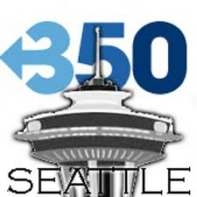
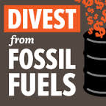
350.org
“350.org is building a global climate movement. Our online campaigns, grassroots organizing, and mass public actions are coordinated by a global network active in over 188 countries” 350.org
Carbon Tracker 200 and Filthy 50
Founded in 2008 by Bill McKibben
  Authored (The End of Nature) in 1989
  Middlebury College
Focuses
  Fossil Fuel Divestment
  Keystone Pipeline
  Hydraulic Fracking

Slide 3
SRI / ESG
Positive Screens
  Micro-Lending
  Community Development
Negative Screens
Endowment Sleeves
  Option for donors to direct gifts to an SRI sleeve
Implement ESG Factors into Stock Valuation
Shareholder Advocacy

Slide 4
AJCU
Three schools have decided to not implement SRI into the endowment
Only two universities are currently divested from any industry
Ten schools use an SRI strategy or a blend of strategies
Four schools have created committees to review holdings or investment policies
Eight schools have yet to comment or be impacted by the divestment movement

Slide 5
Case Studies
Approaches to responsible investing
  Creighton University
  Loyola University of Chicago
Responses to fossil fuel divestment movement
  University of Dayton
  Gonzaga
  Stanford

Slide 6

Creighton University
U.S. Conference of Bishops’
SRI Guidelines for Church Funds
Negative Screens
Abortion
Contraceptives
Embryonic Stem Cell / Human Cloning
Human Rights Violations
Racial/Gender Discrimination
Pornography
Production and Sale of Weapons
Positive Screens
Affordable Housing
Micro-lending
Protect Environment
Encourage corporate Responsibility
Shareholder Activism

Slide 7
Loyola University of Chicago
Shareholder Advocacy Committee
  Committee is made up of 9 student members
  The Committee advises the Investment Office who has ultimate fiduciary responsibility and decision making authority
  Actions
    Write letters of concern to companies
    Advise Investment Office on proxy voting
    Collaborate with like-minded advocacy groups

Slide 8

University of Dayton
Only Catholic university to divest from Fossil Fuel - June 2014
Decision of president / board with no student movement
$670 million endowment
Divestment will happen in 3 phases
  Domestic equity
  Developing plans to eliminate international holdings
  Investing in Green technologies or holdings

Slide 9

Gonzaga
“The only way to really avoid investing in fossil fuels is to not invest in mutual funds that have holdings in those companies and, as fossil fuels are such a big part of our economy, it would be financially troubling to make such a decision”
Instead of divesting the school is focusing on making the campus more sustainable

Slide 10
Stanford University
Advisory Panel on Investment Responsibility and Licensing (APIRL 1971)
  12 members confirmed by the University President (Students, Faculty, Members of the community)
APIRL decision on Coal Divestment
  Replacing other fossil fuels with renewable energy sources also is a desirable goal, the APIRL said, but fewer alternatives are readily available for these other energy sources on the massive scale that will be required to replace them broadly in the global economy

Slide 11
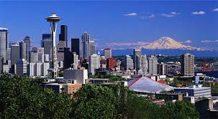
Other Divestments
21 universities have divested from fossil fuel
42 Cities have divested from fossil fuel
Seattle City Employees Retirement system is currently pursuing divesting its $1.9 billion fund

