Slide 1
Seattle University’s endowment and investment policy

Slide 2
Agenda
Overview
What is an endowment?
What are the different kinds of endowments?
Pool accounting
Investment policy
Asset Allocation
Performance
Spending policy and distribution
Liquidity
Confidential

Slide 3
Investments Overview
Overseen by Investment Committee of the Board of Trustees
Guided by the Investment Policy Statement
Outside investment advisor
Investments in pooled funds
  No direct investments in any companies
Confidential

Slide 4
What is an Endowment?
Confidential

Slide 5
What is an endowment?
An endowment is created when funds are invested for the purpose of creating present and future income that can be used for a particular purpose
Seattle University has 278 endowments with a market value of ~$211 million (as of June 30, 2014)
Confidential

Slide 6
What are the different kinds of endowments?

Slide 7
Types of Endowment
There are three types of endowments:
  True
  Term
  Quasi

Slide 8
True Endowments
Also known as permanent endowments
Resources given to the University where a donor has stipulated, as a condition of the gift, that the gift be maintained in perpetuity
Can only be created by donor stipulation
Evidenced by a gift agreement or by bequest
Confidential

Slide 9
Term Endowments
Similar to true endowments except that, upon the passage of a stated period of time or the occurrence of a particular event, all or part of the donation may be expended
Generally not as common as true and quasi (we don’t have any)
Also created by donor intent and evidenced by gift agreement or bequest
Confidential

Slide 10
Quasi Endowments
Also known as funds functioning as endowment
Resources that the Board, rather than donor, determines should be retained and managed like an endowment
Controlled by the Board
Receive distributions like true and term endowments
Confidential

Slide 11
Summary of Endowment Assets
As of June 30, 2014
True | $ 150,893,000
Term | -
Quasi | 59,749,000
Total | $ 210,642,000
Note: 28% of the assets are in our quasi-endowment
Confidential

Slide 12
Endowment Value Over Time
$m
Confidential

Slide 13
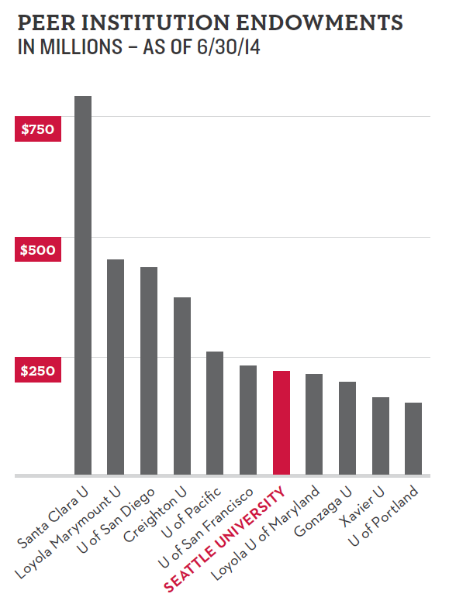
Confidential

Slide 14
Endowment Value
Depends on:
  Original gift value
  Investment returns
  Spending rate
  Gifts/transfers
Confidential

Slide 15
Endowment Activity
$m
Confidential

Slide 16
Pool Accounting
Confidential

Slide 17
Pool Accounting
Gift funds are invested into the endowment pool once the gift agreement is executed and the funds are received
Endowment “buys” units in the pool, similar to the way a mutual fund works
  Number of units received = invested amount divided by the pool unit market value
  Number of units changes when income on the pool assets is received or distributions are made
Confidential

Slide 18
Investment Policy
Confidential

Slide 19
Investment Policy Statement
The Investment Policy Statement governs the management of the investment portfolio. It is administered by the Finance and Investment Committees.
Adopted by the Board
Represents optimal investment strategy given stated financial objectives and spending policy
Confidential

Slide 20
Investment Objectives for the Endowment
Provide an annual, predictable, source of revenue for operations and scholarships
Preserve the purchasing power of the original gifts
The University targets a 7.5 to 8.0% return for the endowment over the long-run
Confidential

Slide 21
Investment Objectives for the Endowment
  Achieve a total rate of return in excess of sum of spending + inflation + growth + expenses
    Spending rate 4.5%
    Inflation rate 2.0%
    Growth rate 0.5 – 1.0%
    Fees 0.5%
    Target return 7.5 – 8.0%
Confidential

Slide 22
Asset Allocation
Confidential

Slide 23
Asset Allocation
Asset allocation goals:
  Risk-appropriate returns
  Diversification
  Liquidity
Confidential

Slide 24
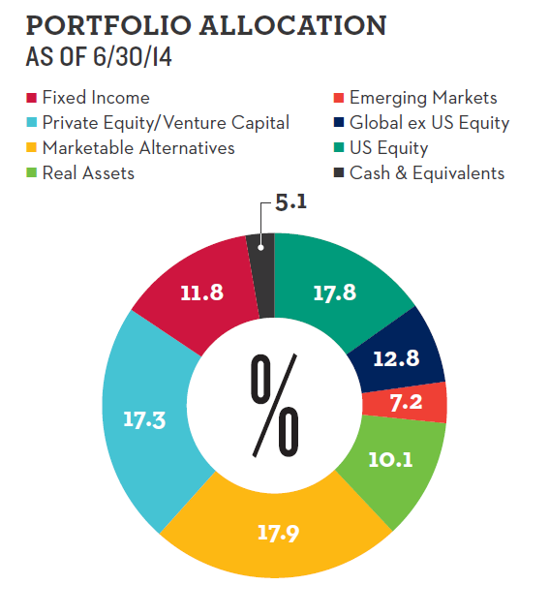
Current Asset Allocation
 | %
US Equity | 17.8
Global ex US Equity | 12.8
Emerging Markets | 7.2
Private Equity/Venture Capital | 17.3
Marketable Alternatives | 17.9
Real Assets | 10.1
Fixed Income | 11.8
Cash and Equivalents | 5.1
Total | 100.0
Confidential

Slide 25
Performance
Confidential

Slide 26
Historical Performance
Confidential

Slide 27
Spending Policy and Distribution
Confidential

Slide 28
Spending Policy
Structured to provide annual revenue for University operations and scholarships while preserving the original value of the gifts
Designed to smooth out the impact of large fluctuations in performance year over year
Recommended annually to the Finance Committee and Board of Trustees for approval through the budget process
Confidential

Slide 29
Spending Policy (con’t)
The annual spending amount is based on the average market value of the endowment over the previous 12 quarters times the spending rate (currently 4.5%)
Confidential

Slide 30

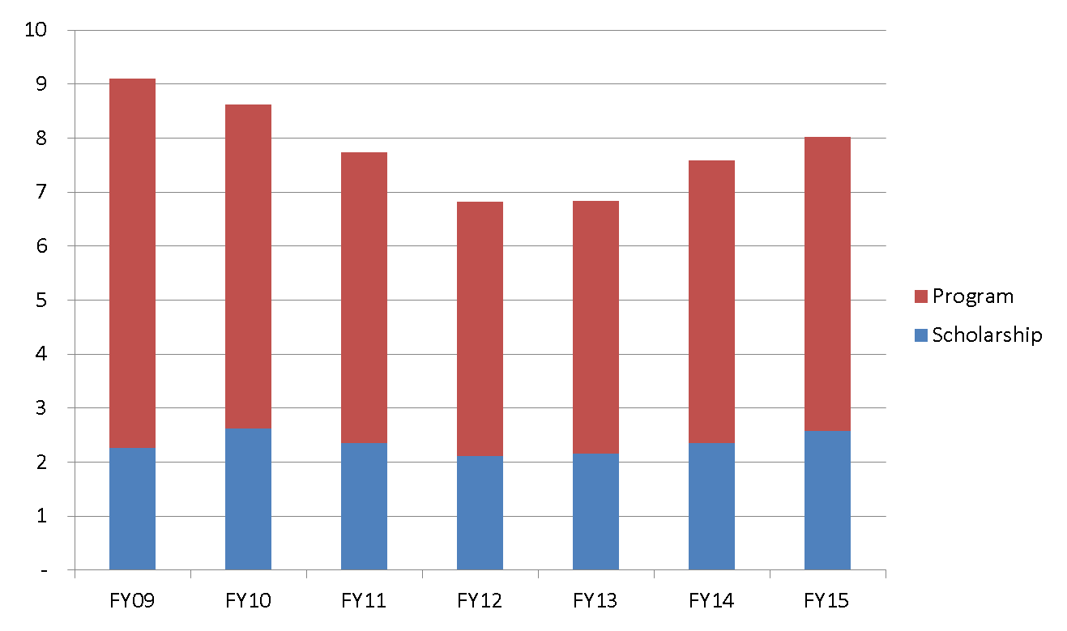
Endowment Income
Provided $8m Support in FY15
Confidential
Notes:
Comp and benefits account for over 70% of total expenses in operating budget

Slide 31
Liquidity
Confidential

Slide 32
Liquidity
Confidential

