Slide 1
Enhancing Mental Focus and Well-Being
Rachel Turow, Ph.D.

Slide 2
Introduction & Today’s Intention
My background: science, practice, person
Enhancing mental focus and well-being is a normal, human, lifetime task—it doesn’t reflect that there is anything “wrong” with you
Stress, trauma, anxiety, and depression make it harder to pay attention
Practicing specific techniques can help!
You can decide which skills seem like the best fit for you

Slide 3
Getting Distracted
You are probably going to have lots of thoughts in the next 45 minutes
During this session, let’s practice returning your mind back when it wanders away
Let’s try choosing something specific to come back to, like wiggling your toes, touching an object, tuning into the breath, or looking at something in this room
Try not to judge yourself when you get distracted and need to bring your mind back

Slide 4
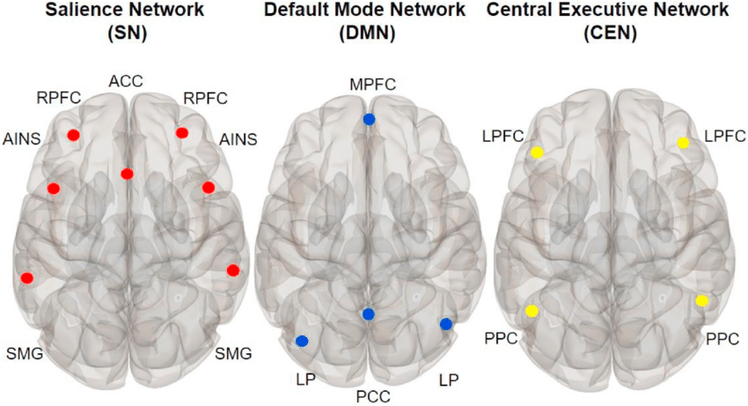
The Brain’s Attention Networks
Default Mode Network (DMN)
Task Positive Network/ Central Executive Network
The Salience Network

Slide 5
Counting 10 Breaths
Pay attention to our breath for 10 breaths. It is normal that your attention will wander. When it goes away, bring it back, as non-judgmentally as possible. The process of bringing back your attention strengthens your “mindfulness muscle.”
When your mind wanders, bring it back; if you have lost track of the count, start again
When you reach 10, start again at 1

Slide 6
Attention and Well-Being
Stress, trauma, depression, and anxiety each make attention and concentration more difficult
Difficulties with attention and concentration can contribute to stress, depression, and anxiety
Improving attention and concentration can enhance well-being. Why?
Cultivating present-moment awareness can reduce rumination, decrease self-judgment, and improve emotion regulation

Slide 7

Is this ADD or ADHD? How do I know if I have ADHD?
It’s normal to struggle with attention, and it doesn’t necessarily mean that you have ADD/ ADHD. Attention difficulties aren’t all or nothing. People with or without ADD/ ADHD can improve attention with practice.
Notes:
We can consider alternative interpretations. Example: If a friend hasn’t called me back, I might notice myself thinking, “she doesn’t like me anymore.” Once I notice this, I can come up with some alternative explanations. The same is true when an emotion arises

Slide 8

Establish a
Mental
Home
=

Slide 9
Counting 10 Breaths
Pay attention to our breath for 10 breaths. It is normal that your attention will wander. When it goes away, bring it back, as non-judgmentally as possible. The process of bringing back your attention strengthens your “mindfulness muscle.”
When your mind wanders, bring it back; if you have lost track of the count, start again
When you reach 10, start again at 1

Slide 10

Mindfulness/
Embodied Awareness
Mindfulness is the practice of paying attention to your experiences in this moment with care, openness, and curiosity rather than judgment. It is not “clearing the mind.”
Some people prefer the term “embodied awareness.”
The specific time that you set aside to practice mindfulness is called meditation.

Slide 11

Two Kinds of Attention Skills
Focusing
Shifting

Slide 12
There’s More in This Moment
Take a minute to check in with how you’re feeling in this very moment (not your thoughts)
Notice what’s obvious, but then notice some things that are less obvious
Can you find more in the present moment to notice? What do you hear? What do you see?

Slide 13
Your Goal is Not to “Stay Focused,” but to Return Your Focus Quickly
If you have a mind, it will probably wander away
You can train your focus by practicing returning it quickly and non-judgmentally when you are distracted
It’s nice to have an object of present-moment focus to go back to, such as:
-the breath
-wiggling your toes
-an object that you can touch or look at

Slide 14
Establish a
Mental
Home
=

Slide 15
Counting 10 Breaths
Pay attention to our breath for 10 breaths. It is normal that your attention will wander. When it goes away, bring it back, as non-judgmentally as possible. The process of bringing back your attention strengthens your “mindfulness muscle.”
When your mind wanders, bring it back; if you have lost track of the count, start again
When you reach 10, start again at 1

Slide 16
Benefits of Mindfulness Practice:
What’s the Research?
Increases ability to direct attention (e.g., Morrison et al., 2014; Solhaug et al., 2016)
Reduces anxiety and panic attacks (e.g., Miller, Fletcher, & Kabat-Zinn, 1995)
Improves overall general health, mental health, social functioning, serenity, and empathy (Bazarko et al., 2013)

Slide 17

Two Minutes of Mindfulness
Feel your fingers; Now feel your toes. Try to stay open and curious to how they feel right now, in this moment
Feel yourself take one breath, and then another. Notice the breaths as they are happening, in this very moment
Notes:
Fix so that you can only see one bullet at a time

Slide 18

Self-Compassion
Self-compassion cultivates the quality of being a kind, encouraging friend to oneself in any circumstance
Self-compassion is not the same as self-esteem or thinking positive
Self-compassion is a powerful antidote to self-criticism
Notes:
Self-compassion associated with a range of health and wellness benefits

Slide 19
Two Minutes of Self-Compassion
“Inhale, my friend; Exhale, my friend”
Where do I feel the difficult emotion in my body, in this moment?
Self-Compassion Break (Neff, 2011)
Notes:
When you feel yourself upset or stressed, take a moment to check in with how you feel in your body and what is happening in your mind. Try telling yourself these things, or something similar, slowly and calmly:1. This is a moment of suffering 2. Suffering is a part of life 3. May I be kind to myself in this moment

Slide 20
Lovingkindness Meditation
Research demonstrates that practicing this meditation reduces depression and anxiety and improves physical health (Hoge et al., 2013; Simpson et al., 2013)
The meditation involves silent repetition of the following phrases, over and over, matched to the breath if you like, for at least 5 minutes per day:
- May I be safe
- May I be happy
- May I be healthy
- May I live with ease
Notes:
Feel free to look on google scholar or PubMed. PubMed is the US National Library of MedicineNational Institutes of Health

Slide 21
Establish a
Mental
Home
=

Slide 22

Research Evidence
Hundreds of research studies demonstrate that these skills are strongly related to well-being
Studies also show that these skills can be learned, and are linked with changes in our thoughts, thoughts, feelings, brains, and nervous systems
You can investigate these topics and find research examples on Google Scholar or on PubMed.gov
Notes:
Feel free to look on google scholar or PubMed. PubMed is the US National Library of MedicineNational Institutes of Health

Slide 23
Resources
CAPS - Pavilion 120, (206) 296-6090
caps@seattleu.edu
www.PsychologyToday.com (off-campus therapy)
Relaxation/mediation tracks: http://marc.ucla.edu/body.cfm?id=22
YouTube channel: HowtoADHD
https://www.youtube.com/watch?v=l--Sa_C4bcY&ab_channel=HowtoADHD
Urgent Mental Health/Suicide/Emergency: Public Safety, x5911

Slide 24
Thank You!

