Slide 1
NIH R15 program: AREA and REAP Grants
Michelle Hamlet, PhD
Division of extramural sciences
National institute of nursing research
Notes:
Good morning. I am a health specialist with the NIEHS, and I am the NIH representative today that will talk about the R15 Academic Research Enhancement Award (AREA) R15 Research Enhancement Award Program (REAP). Out of curiosity, how many here have applied for AREA before? How many are thinking of applying for AREA? What about REAP? How many are not sure what the difference is between these two?

Slide 2

Today’s Topics
Overview of R15 Program goals
How to read R15 Funding Opportunity Announcements (FOAs)
Learn how R15 applications and projects differ from R01s
Differences between AREA and REAP
Strategies for success
Notes:
READ SLIDE
For any application you submit to NIH, you will apply through a funding opportunity announcement (FOA). All federal grant funding agencies use FOAs to announce their funding opportunities.

Slide 3

R15 foa options
  Academic Research Enhancement Award (AREA)
    Undergraduate-Focused Institutions
    PAR-18-714 (no Clinical Trial, [CT]) and PAR-19-133 (CT)
  Research Enhancement Award Program (REAP)
    Health Professional Schools and Graduate Schools
    PAR-19-134 (no CT) and PAR-19-135 (CT)
Notes:
There are 4 FOAs you should be aware of now. Two AREA FOAs without and with clinical trials allowed. Two REAP FOAs without and with clinical trials allowed.
Schools of medicine, dentistry, osteopathy, pharmacy, nursing, veterinary medicine, public health, optometry, allied health, chiropractic, naturopathy, and podiatry

Slide 4

Program Goals
Strengthen basic and clinical research environment at institutions without significant NIH funding
Support meritorious research
Expose students to primary research
Notes:
Institutions with little NIH funding often offer significantly fewer opportunities for students to do hands-on research.

Slide 5

Key Features
Research Grant mechanism
Up to $300,000 direct cost to be spent over 3 year-project period
12-page Research Strategy
  - Same review criteria as R01 with different emphasis
Grants are renewable
Notes:
The key features of these R15 FOAs to be aware of are that these are… READ SLIDE

Slide 6

R15 vs. R01
Overall impact of R15 differs from R01
  Smaller-scale research projects
  Scope aligned with available and requested resources
Must describe opportunities for students
Must describe how award will strengthen research environment of the institution
Notes:
So how is this different from the R01 research grant? Some describe the R01 as a mature award that gives you four or five years of independent support. The R15 is for smaller scale research projects of more limited scope, generally because of smaller resources at the institution—personnel and facilities. The R15 also requires that you describe opportunities for students and how the award will strengthen the environment of your institution. These requirements are absent from the R01 application.

Slide 7
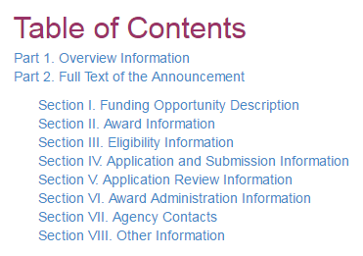
R15-Specific Eligibility Criteria: Part 2, Section III, Part 1
Notes:
So let’s talk about eligibility, found in this section of the FOA…

Slide 8

AREA and REAP are Mutually Exclusive
Each program targets a different pool of faculty
  REAP: faculty at Health Professional Schools or Graduate Schools
  AREA: faculty at undergraduate-focused schools and colleges (not Health Professional or Graduate)
Institution could have faculty eligible for each program
  However…individual faculty cannot apply for both R15 programs
Notes:
READ SLIDE

Slide 9
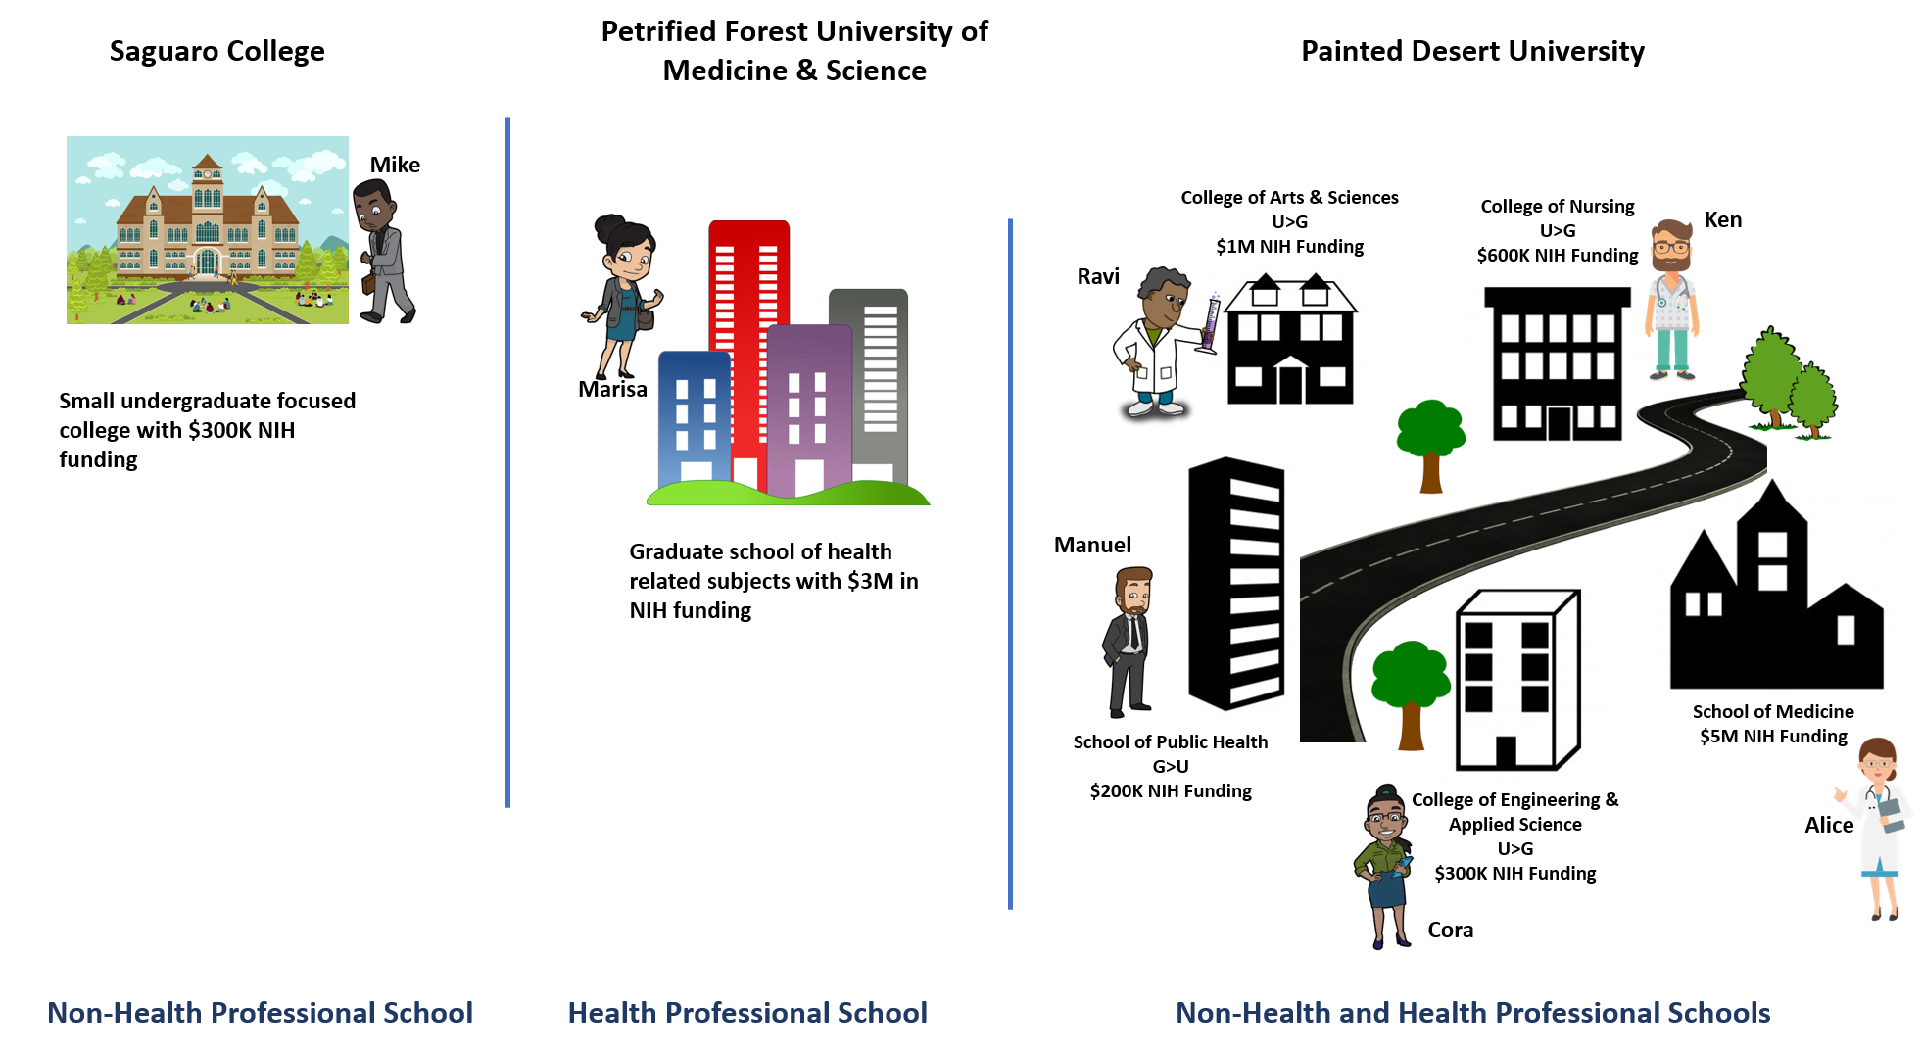
R15 Primary faculty Appointment
Notes:
Let’s look at some AREA vs. REAP scenarios, and I will start with primary appointments. Mike is a professor at a small undergraduate-focused college, which is a non-health professional school. He will be looking at the AREA R15 FOA. Marisa, on the other hand, is a professor at a graduate school of health-related subjects, meaning there are schools of pharmacy, dentistry etc. and no undergraduate school components. This is a health-professional school, and she will be looking at the REAP R15 FOA. At Painted Desert University, there are various institution components. Some that are undergraduate-focused and some that are not. Ravi is a professor with a primary appointment at the College of Arts and Sciences, working with the biology department. Cora is a mathematics professor with a primary appointment at the College of Engineering & Applied Science. Both of these components where Ravi and Cora have their appointments have more undergraduates enrolled than graduate students. These are non-health professional schools; therefore, Ravi and Cora would read the AREA R15 FOA.
Ken has his primary appointment as a professor at the School of Nursing, which awards mostly a Bachelor’s in Nursing. This school has more undergraduate students than graduate students; however, because it is a nursing school, it fits the definition of a health professional school as determined by the REAP R15 FOA. Just a reminder of what it says in the FOA– health professional schools include, but are not limited to, Schools of medicine, dentistry, osteopathy, pharmacy, nursing, veterinary medicine, public health, optometry, allied health, chiropractic, naturopathy, and podiatry. Moving on… Manuel’s appointment is at the School of Public Health, which has more graduates enrolled and also fits the definition of a Health-Professional School. Alice has her appointment at the School of Medicine—another Health Professional School. Ken, Manuel, and Alice would all consider the REAP R15 FOA and NOT AREA.

Slide 10

R15 PI Eligibility Criteria: Primary faculty Appointment
Primary appointment at eligible institution
REAP
  Heath Professional School or Graduate School faculty
  PAR-19-134 (no CT) and PAR-19-135 (CT)
AREA
  Non-Health Professional School faculty
  PAR-18-714 (no CT) and PAR-19-133 (CT)
Notes:
Recap…READ slide

Slide 11
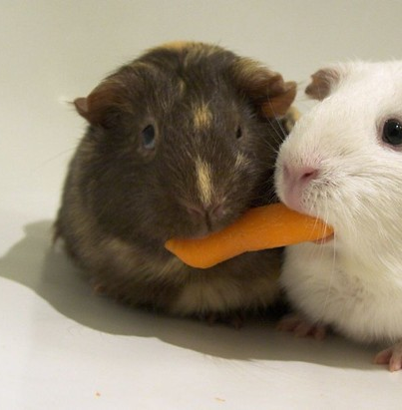
R15 PI Eligibility: Multiple PI (MPI) and Collaborators
MPI is OK, if all are FOA-eligible
What about an ineligible collaborator?
  Yes!
  However…. Be mindful of the intent and unique goals of the R15
    Majority of research should be directed by PI at grantee institution
    Student profile & student inclusion are for applicant/eligible component
Notes:
READ slide

Slide 12
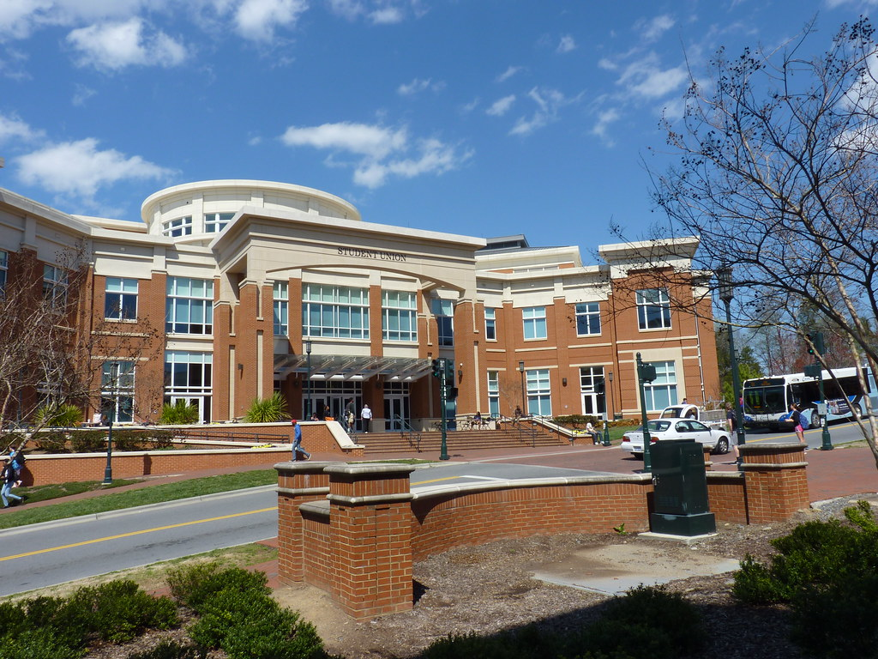
Other R15 PI Eligibility Criteria
PI may not have an active NIH grant at time of award*
  Can be Key Personnel on another PI’s research NIH grant
  *Instrumentation awards (S10), conference grants (R13) and institutional training grants (T32s) do not count against R15 PI eligibility
Notes:
The criteria are the same for all the R15 announcements… READ slide

Slide 13

Organization eligibility - AREA
All non-health professional components of the institution must have no more than $6 million per year in 4 of the last 7 years of total NIH support
  Health professional schools not included in this calculation
Undergraduate enrollment MUST be greater than graduate enrollment in the non-health professional school
Notes:
https://grants.nih.gov/grants/funding/Determing-Organization-Funding-Levels-R15-Eligibility.pdf

Slide 14
Area eligibility
Notes:
This slide is animated.
Let’s return to our professors now that we know the rules about non-health professional vs. health professional schools and add the funding criterion for AREA R15s.
Mike is at Saguaro College, which is an undergraduate institution that has about $300K in NIH funding per year in 4 of the last 7 years. This is less than $6M, so he qualifies for AREA.
Marisa is at a Health Professional Institution (as we discussed earlier), so she does not qualify for AREA.
At Painted Desert University, we determined earlier that Ken, Manuel, and Alice had appointments at Health Professional Schools, so they do not qualify for an AREA grant.
Ravi and Cora, however, both had appointments at components of the institution that had more undergraduate enrollment than graduate and that were non-health professional schools. They qualified for AREA based on that criterion, but they also have to qualify with the NIH funding rule. We have to add up the amount of NIH funding of all the potentially AREA-eligible components—the non-health professional schools. In this case, Ravi’s school has $1M in NIH funding and Cora’s school has $300K. Again this is supposed to symbolize the per year in 4 of the last 7 years. This adds up to less than $6M; therefore, Ravi and Cora both can apply for an AREA R15 grant.

Slide 15

Organization eligibility - REAP
The entire institution (all components) must have no more than $6 million per year of NIH support in 4 of the last 7 years
  Includes support for non-health professional and health professional schools
Undergraduate enrollment level is not a factor for eligibility
Notes:
READ slide… also
Reminder: Health Professional Schools and Colleges provide education and training leading to a health professional degree (including but not limited to: MD, DDS, DO, PharmD, BSN, DVM, OD, DPT, DC, ND, DPM).
https://grants.nih.gov/grants/funding/Determing-Organization-Funding-Levels-R15-Eligibility.pdf
May provide research experiences to undergraduate and/or graduate students pursuing biomedical or behavioral research.

Slide 16
Reap eligibility
Notes:
This slide is animated.
Let’s revisit our professors. We know that Mike is at a non-health professional school and qualifies for AREA, not REAP. Marisa on the other hand is at a health-professional school. The institution has $3M in NIH funding per year in 4 of the last 7 years, which is below $6M. She qualifies for the REAP R15.
What about Ken, Manuel, and Alice at Painted Desert University? This school has multiple components with some schools that are non-health professional and some that are professional. We have already determined that Ken, Manuel, and Alice are at Health Professional Schools and should consider REAP, but do they qualify on the NIH funding levels. We just saw that Ravi and Cora qualified for AREA after adding up the NIH funding for the non-health professional components. However, if Ken, Manuel, or Alice want to apply for an R15, they cannot add up NIH funding for the health professional components alone. They have to add up ALL the components, including those where Ravi and Cora have primary appointments. In other words, for REAP we look at the NIH funding levels for the entire institution. If we add up the NIH funding for ALL the components, then you see that Painted Desert University as a whole has more than $6M in NIH funding per year in 4 of the last 7 years. Therefore, Ken, Manuel, and Alice cannot apply for a REAP grant after all.

Slide 17
Reconsider reap eligibility By Changing funding status
Notes:
Animated slide.
However, what happens if we change the $5M NIH funding of the medical school?

Slide 18
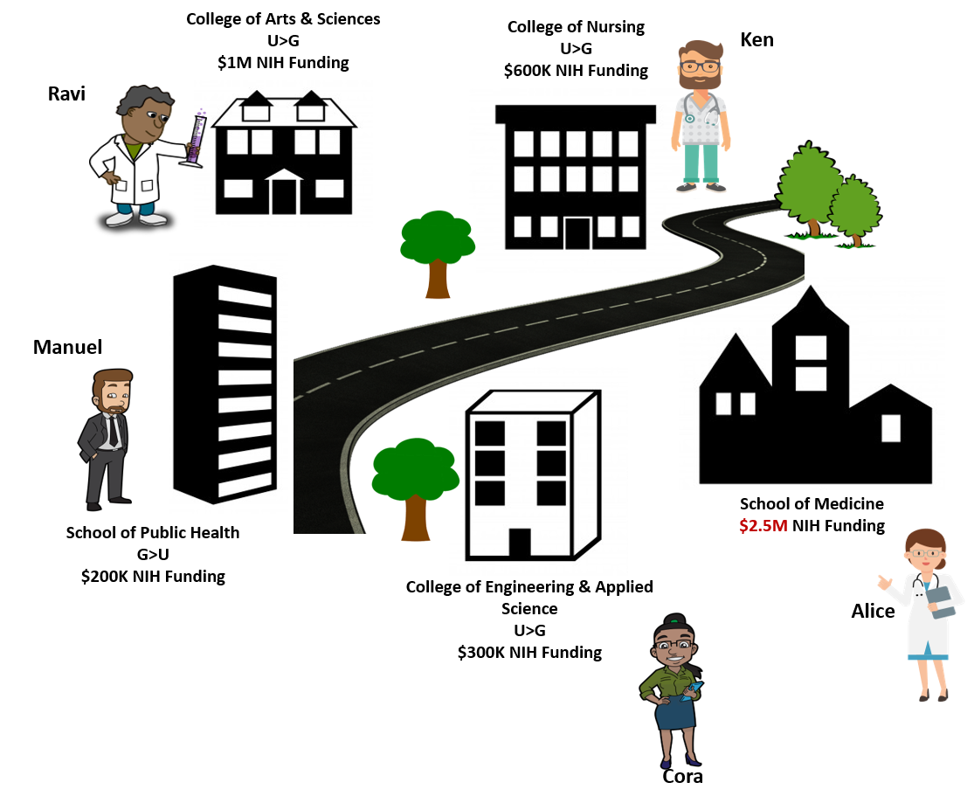
REAP Eligibility Scenario II
Non-Health Professional and Health professional Schools
Painted Desert University
Notes:
Animated slide.
Here, we changed the $5M to $2.5M. Now, if we add up all the components, non-health professional and health professional, we are under the $6M of NIH funding rule. Therefore, Ken, Manuel, and Alice could each apply for a REAP R15 grant. Of course, Ravi and Cora do not qualify for REAP.

Slide 19
Provost Letter
Both AREA and REAP require a signed letter from the Provost or similar official verifying eligibility as specified in the appropriate FOA
Applications submitted without this letter will be withdrawn and returned without review.

Slide 20
Application instructions: Part 2, Section IV, Part 2
Notes:
So let’s talk about the application– found in this section of the FOA…

Slide 21
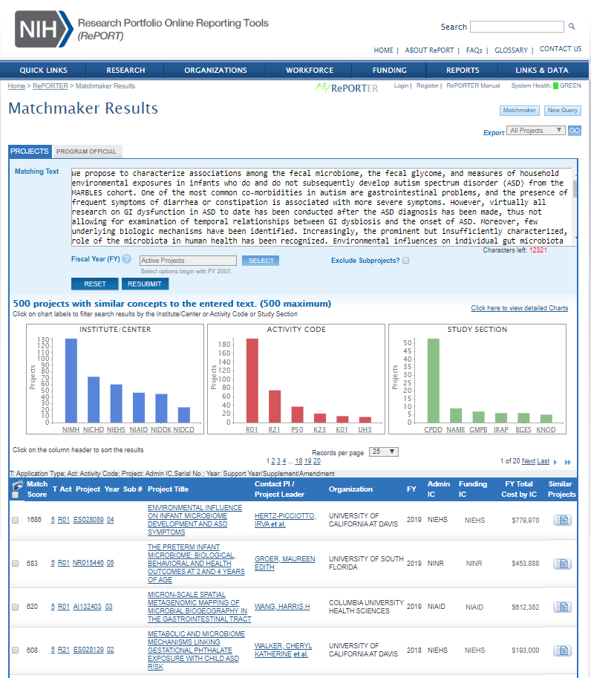
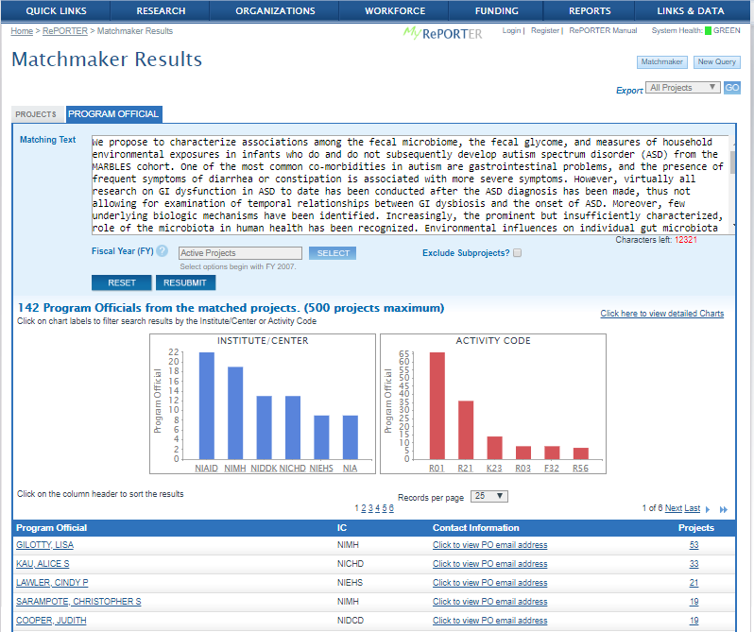
Before Writing Submission
Read FOA carefully
Write an abstract and sketch out some specific aims
Useful tool: Matchmaker of NIH Reporter (https://projectreporter.nih.gov/reporter_matchmaker.cfm)
Check the NIH Institute mission statement page
Talk to a Program Officer

Slide 22
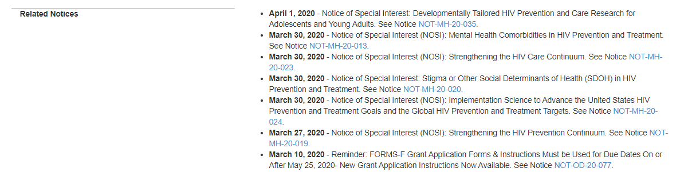
Before Writing Submission-check out ‘related notices’ section

Slide 23
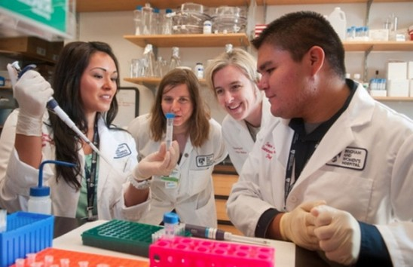
The Art of Crafting an R15 Application
Scientifically meaningful
  - Interesting questions & publishable data
Feasible
  Resources
  - Effort
  - Students
Appropriate scope
Describe your environment
Notes:
READ slide
The proposal needs to be strong scientifically; it is not just about undergraduate research experiences. Try to have good preliminary data for each specific aim in the proposal. This will clearly show that you can conduct the experiments proposed in the application.
At the very end of each specific aim, discuss outcomes, potential problems, and alternative strategies.

Slide 24
FOA has R15-specific instructions
Other Project Information: Facilities and Other Resources
Budget
Biographical sketch
Research Plan: Research Strategy
Include a resource sharing plan!
Notes:
There are also R15 specific instructions for describing… READ slide
Also…Make sure you include a resource sharing plan in the application. Several applications forget to include this.

Slide 25

Research Strategy
Should touch each review criteria & program goals
Preliminary data
  Reviewers can and will evaluate submitted data
Required to demonstrate appropriateness of project and group, including students
Description of involvement & oversight of students
Notes:
READ slide
Make sure that you discuss everything that is listed in the FOA scored criteria in your proposal. The reviewers of the application are asked to comment on these issues directly.
Remember that the research team described in your application must be primarily composed of undergraduate students for the AREA program.

Slide 26
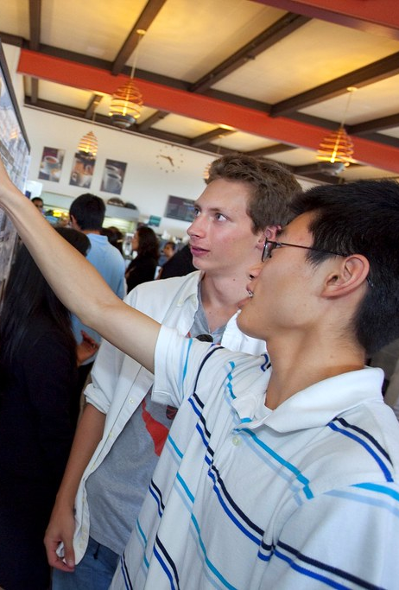
How Students Will Be Involved?
Examples provided in both FOAs
Perform & troubleshoot experiments
Present at (lab) meetings & (campus) conferences
(Help) design experiments
Collect & analyze data
Draft articles
Collaborative interactions
Notes:
READ slide

Slide 27

Student Involvement Should Be Meaningful
Quality of student involvement
  Not sufficient to say “there will also be a couple undergrads (with an unspecified or insignificant role)”
  Mention how students will be recruited and student level (freshman – senior) for AREA, or graduate students for REAP
Notes:
Read slide
Mention them as part of RS, but also in Biosketch. What is your history of mentoring students. Underline name of students that co-authored papers. Does your school offer programs for students (research office, scholar’s program, award or scholarship program)? Make the reviewer want to send his son or daughter to your school and your lab.

Slide 28

The Budget
R15 is multi-year award
Budget for all years must be requested in first budget year
Budget justification should align with program goals
Can support the following, for example:
- Student wages
- Collaborator salaries (subawards)
- Travel
Notes:
Include in your budget salary for students during the school year and the summer

Slide 29
Review criteria: Part 2, Section V, Part 1

Slide 30

R15 Application Review
Special Emphasis Panel for R15 applications
Clustered within standing study sections
Reviewers use review criteria as listed in the FOA

Slide 31

Institutions
Accredited public or non-profit private school conferring baccalaureate or advanced degrees in biomed and behavioral sciences
Confirm institutional eligibility for appropriate R15 FOA
Include Provost letter that confirms institutional eligibility
Activity codes C06, S10 and all codes that start with ‘G’ do not count against eligibility

Slide 32

Applicants
Be familiar with the FOA goals and review criteria
- address each question in your application
Pick a compelling research topic that aligns with institute of interest
State the significance – be articulate, avoid jargon, and write for the expert and non-expert
Propose a realistic scope
Propose clear hypotheses
Include meaningful student involvement, but not a training grant
Consider collaborators

Slide 33

Questions

