Slide 1
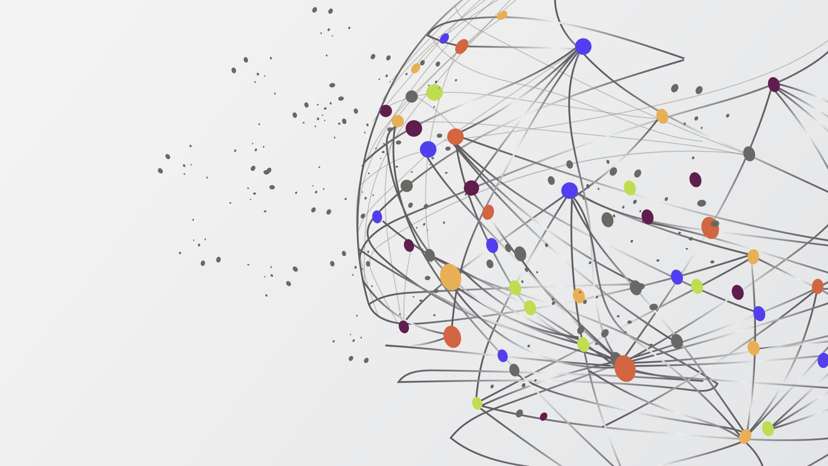
CLSS Training
A Registrar Perspective
*Not intended to replace department level training, this is only intended to answer common questions

Slide 2
Overview
Glossary
How does Seattle University schedule classes?
What is Colleague?
What is CLSS?
Production calendar
University timeline
Procedures
Creating a new section
Time-blocks
Capacities
Comments
Crosslists

Slide 3
Glossary
Colleague – The database of record for the university
CLSS – A tool used by departments to schedule classes
Scheduling – The process by which classes are created, edited and roomed
Course – The overarching subject; not related to a term
Section – The specific class associated with a term and course
Term – Quarter; 21FQ, 22WQ, 22SQ, 22RQ
Subterm – For summer only; 22RQ41, 22RQ42, 22RQI, 22RQ8
Production Calendar – The yearly timeline for scheduling, created in August for the next year
MySU – Online platform students use to plan academics and register
Acalog – System that manages the official course listings for the university

Slide 4
How Does SU Schedule Classes?
Acalog
Colleague
CLSS
Course
Course
CLSS Entry
You are here
MySU
CLSS Queue
Manual Entry

Slide 5
What is Colleague?
Colleague is the database of record for Seattle University – meaning it holds the master records for the majority of the university
Within Colleague, there are different modules for course, sections, registration, students etc
Most people access Colleague modules, but permissions are in place for privacy, data security and need
Colleague interacts with CLSS every night by sending data packets of the information it has and overriding most of the information CLSS has
Colleague updates mySU in real time for many things, but requires an overnight data packet transfer for others

Slide 6
What is CLSS?
CLSS (usually pronounced ‘class’) is the CourseLeaf program we use to enter, review and approve the class schedules for all departments across Seattle University
Access is granted based on individual needs – for example, if you are the administrative assistant for FILM, only you have the ability to make changes to FILM sections within CLSS
CLSS is separated into specific instances, which is the word CLSS uses for terms
Within each instance, you can create sections for courses and update the details for that section
Once you have made the updates, saving the changes puts those changes into workflow
Workflow refers to the review process – once you save changes, they are submitted to the lead scheduler for your college. They have the ability to roll the changes back to you for further edits, or approve the changes. If the changes are approved, the section comes to the Registrar’s scheduler for final approval and official entry into Colleague
The sections for each term and ‘rolled’ meaning the sections from the previous year and copied over

Slide 7
Production Calendar
The production calendar is the yearly outline of when schedule details can be added & changed in CLSS, as well as when rooming for each term will occur. Details for classes need to be finalized before rooming and absolutely must be complete by registration
The calendar runs from summer quarter through spring quarter, and is usually released in the late summer for the following year
Schedule Entry: Term opens for section creation and edits
UCOR Deadline: UCOR operates on a different schedule and therefore their entry period ends early
ADMN Lock: CLSS instance is locked for edits to everyone other than administrators
Pre-Rooming Review: Period for entering changes before rooming starts
Rooming: CLSS instance is completely locked for three weeks while rooming is completed
Schedule Audit: Final opportunity to make changes, but rooming/registrar are the real deadlines

Slide 8
University Timeline
In August, the Production Calendar for the next year is released.
Changes can be made to sections using CLSS until rooming is done for that term. After rooming, changes to day, time, or increases in section max caps are difficult but not impossible.
After registration, changes to day/time are extremely difficult for multiple departments & students and should not be made.
One the term has started, it will be archived in CLSS after 10th day.
During the term, audits will be sent out for missing instructors prior to grading. Instructors must be entered into the system prior to grading.

Slide 9
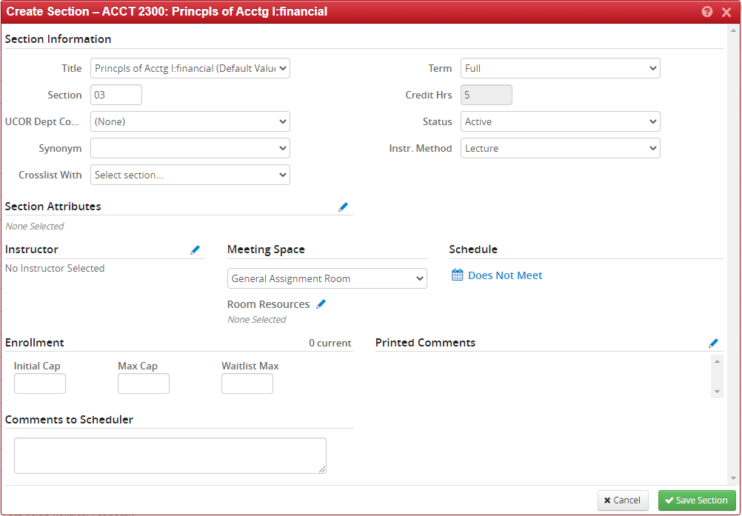
Creating A New Section
CLSS Procedures
Go to the term in CLSS, and select the course you want
On the right side, you will see a green + button (screenshot below)
Click the + button, and you will see a pop-up screen with all the options for creating a section
Fill out the details
Click ‘Save Section’ in the lower right corner
You should get a pop-up that says this section must be submitted to workflow for approval. All sections must go through workflow to be officially created
If you do not confirm it is in workflow, it has not really been created – only saved as a draft

Slide 10
Creating a Meeting Pattern
CLSS Procedures
Open the section in CLSS
Click into the schedule view of the section (where you can see the calendar with the green boxes)
In the bottom left corner, click Meetings (black button)
In the middle right of the screen, there will be a + button (left of the X, above the pencil)
Click the + and select the Type and Room as needed
Click Accept
The new meeting pattern will show up as the bottom row on the list
Click the new meeting pattern (the list will disappear, that’s OK – click the Meetings button to see it again)
Now you have the new meeting pattern select so you can tell CLSS what timeslot it should have
Click the Patterns dropdown on the top right of the schedule view
In the meeting pattern name box, enter the meeting pattern (TTh 1pm-3pm, for example)
Click Add
Click Accept
Click Save Section

Slide 11
Capacities
CLSS Procedures
Each section has two capacities (caps) that matter – minimum (min) cap and maximum (max) cap
Min cap is the number of students who can register themselves for the section using MySU
Max cap is the number of students the department can manually register for a section using Colleague
Sections are roomed based on the max cap, which is why it is important for departments to ensure that number is accurate and not to go above it

Slide 12
Crosslists (Xlists)
Both sections must be fully created
Comments to Scheduler should include the xlist max cap and designate one section as the Parent or Child
The xlist only has to be set-up on one of the sections
Prior to rooming each term, college schedulers can submit a spreadsheet of the xlists to the scheduler. After rooming start, xlists must be submitted through CLSS.
If a spreadsheet is submitted, it must include the sections in the xlist, the xlist max cap, and the Parent/Child designation

Slide 13
Comments
CLSS Procedures
There are two type of comments – Comments to the Scheduler and Printed Comments
Comments to the Scheduler are place to note context/background, clarify what the section needs, ask questions, and is where you ALWAYS note what you have updated on the section. These comments are not visible to students and never leave CLSS – they are not input into any other official system
Printed Comments are for student facing section details to be added. They will be put into Colleague and MySU.

Slide 14
Tips & Tricks
If a section has been submitted to workflow but not approved, CLSS will not allow any changes to it. Email the scheduler to roll back the section to you for edits.
More context and information in the Comments to Scheduler can’t hurt!
If there is no synonym listed on the Section in CLSS, it has not been created in Colleague yet
Without a max cap, a Section cannot be roomed
Discussing options or stressing wonky details via email is great, but please ensure that all changes come through the queue as well – it is a tool dedicated to accuracy and tracking

