Slide 1
FINANCIAL LITERACY FOR REDHAWKS

Slide 2
Agenda
Introduction
Student Loan Basics
Repaying Student Loans
Credit Cards
Credit Scores
Filing Taxes
Budgeting Tips and Tools
Resources
Notes:
A

Slide 3
Student Persistence Team
Joelle Pretty
Director of Student Persistence
Andrea Vargas
Advising Services Coordinator
Yvette Gutierrez-Morfin
Student Persistence Specialist
Notes:
A

Slide 4
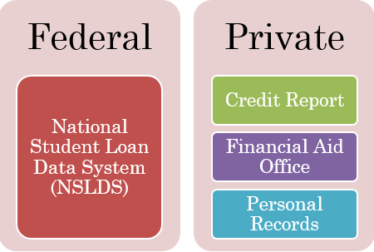
Identify Your Loans
Access NSLDS using your FSA ID at nslds.ed.gov
Notes:
Y
NSLDS can help you identify what loans you have
Private loans won’t show up in NSLDS
Important to know which type of loans you have (if any)
Different terms and conditions with federal vs private loans
Some loans accrue interest while in school, interest rates vary, repayment options vary

Slide 5
Types of Federal Student Loans
Federal Student Loan
Subsidized Stafford
Unsubsidized Stafford
Parent PLUS
Grad. PLUS
Perkins Loans
Consolidation Loans
Private Loan
Notes:
Y
Difference between subsidized and unsubsidized loans
Different interest rates
Repayment options may vary

Slide 6
Loan Servicer
It is your responsibility to ensure that your loan servicer always has your current billing address and phone number. If you have more than one loan, you may have more than one loan servicer.
Who is your loan servicer?
Find your loan servicer: www.nslds.ed.gov →click on "Financial Aid Review" or call Federal Student Aid at 1-800-433-3243.
Notes:
A
Loan servicer is the agency responsible for your loan, the main point of contact if you have questions about your loan.
Common Loan servicers: Nelnet, Navient, etc.
A loan servicer can change if your loan is bought or sold between servicers.

Slide 7
Repaying Loans
Grace Period: You usually do not have to start repaying your loans right away. This “waiting period” after graduation and before repayment begins is known as a “grace period”.
Unless you defer, Direct loan repayment begins 6 months after graduation (or dropping below half-time)
There is no grace period for PLUS loans or private loans.
Notes:
Y
You typically have six months to find a job before you need to start making payments
Depending on type of loan, interest may start accruing earlier
Not all loans have a grace period, some payments start immediately
You don’t have to wait for the grace period to end before beginning repayment

Slide 8
Exit Counseling
Exit counseling provides important information to prepare you to repay your federal student loan(s).
True or False: Exit counseling is optional.
True or False: Students who have received a loan under the Direct Loan Program must complete exit counseling each time they drop below half-time, graduate, or leave school.
Notes:
A
False: Exit counseling is required
True: Must complete exit counseling each time you drop below half-time, graduate, or leave school.

Slide 9
Repayment Plans
Must opt-in, otherwise you will be put on standard repayment plan
Options are:
Standard Repayment Plan
Graduated Repayment Plan
Extended Repayment Plan
Revised Pay As You Earn Repayment Plan
Pay As You Earn Repayment Plan
Income Based Repayment Plan
Income Contingent Repayment Plan
Income Sensitive Repayment
Consider:
Public Service Loan Forgiveness (PSLF)
https://studentaid.ed.gov/sa/repay-loans/understand/plans
Notes:
Y
There are many different options and they have different criteria and pros/cons
Main differences are time to repay (10 vs 25 years), and how much you pay monthly
Common ones are Standard and Income Based Repayment
PSLF – Portions of loans can be forgiven over time for certain jobs. This is not guaranteed and there are a lot of conditions.
Choose payment plan based on your current situation, can adjust plan as necessary but important to carefully read the details
Visit website to learn more

Slide 10
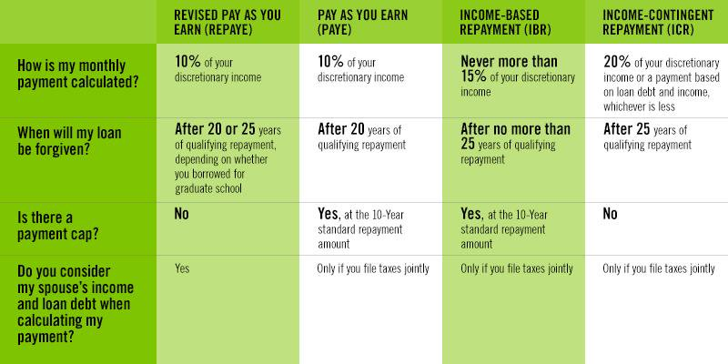
Income Based Repayment
Notes:
A
This is just an example of some differences between a few plans.

Slide 11
Example
Rudy Redhawk has $40,000 in Direct Loan debt, with a 6.00% interest rate. His income is $35,000, he is single, and lives in Colorado. His income increases 5% per year.
Repayment Plan | Initial Payment | Final Payment | Time to Repay | Total Paid
Standard | $444 | $444 | 10 years | $53,290
Graduated | $254 | $762 | 10 years | $56,848
Extended - Fixed | $258 | $258 | 25 years | $77,316
Extended - Graduated | $200 | $388 | 25 years | $84,115
Revised Pay As You Earn* | $143 | $507 | 20 years | $71,172
Pay As You Earn* | $143 | $444 | 20 years | $69,967
Income-Based* | $215 | $444 | 15 years, 6 mos. | $65,407
Income-Contingent* | $315 | $373 | 15 years | $61,484
Notes:
A
Note the differences in the amount paid monthly, in how long it would take to repay, and how much would be paid total over time.
More time to pay = more interest paid overall
Interest paid on student loans is tax deductible (your loan servicer will provide a tax form at the beginning of the next year)

Slide 12
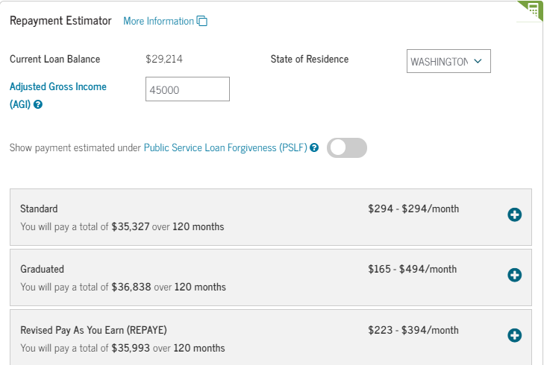
Repayment Estimator
Use the Repayment Estimator to see how much you might have to pay over time with the different repayment plans. If you login with your FSA ID, it will pull your federal loan information automatically.
Notes:
Y
Visit the website to use the repayment estimator. If you log in with FSA ID, it will pull your information.

Slide 13
Compound Interest
Student loan interest is typically “compounded” daily. Your interest rate is divided by the number of days in the year, and you are charged each day based on the outstanding balance.
Consider a $10k Direct loan with 4.45% interest rate:
Daily interest rate: Divide 4.45% by 365 to get 0.012%. For $10,000 = $1.20.
$1.20 is added to loan balance → $10,001.20 (new balance) When interest is compounded the next day, you’ll pay interest on new balance.
By end of the year, you pay $455.02 in interest, rather than $445 (if interest was compounded once a year instead of daily)
It’s better to pay a small amount rather than nothing to avoid accruing more compound interest!
https://studentloanhero.com/featured/how-student-loan-interest-works/
Notes:
A
It’s important to understand what compound interest is
Compound interest can have a big impact on total paid over many years, especially with larger loans.
It is possible to make an “overpayment” to lower how much interest accrues

Slide 14
Deferment and Forbearance
Deferment
Unemployment
Economic hardship
Forbearance
Medical/dental internship residency
Student loan debt burden
Graduate fellowship
Rehabilitation training program
Military
In-school
AmeriCorps
Teacher Loan Forgiveness
DOD Student Loan Repayment Program
National Guard
Medical/other acceptable reasons
Notes:
Y
In order to defer or be on forbearance, your loan can’t be in default
Deferment = postpone without accruing interest on subsidized loans, unsubsidized continues to accrue
Forbearance = interest accrues on both types of loans, accrued interest is added to total loan balance
Deferment and forbearance is better than defaulting, find out more about these options online

Slide 15
What Happens With Default?
For most federal loans, you will default if you have not made a payment in more than 270 days
Affects credit score, can go to collections
Loss of eligibility for future federal aid or repayment options
Loan becomes due in full immediately
Wages and tax refunds can be garnished
If you have a hardship or are concerned about making payments, contact your Loan Servicer as soon as possible!
Notes:
A
It is always better to contact your loan servicer and discuss options (which may include deferment or forbearance) rather than defaulting
Defaulting on a student loan can have a lot of major consequences
As of April 2019, student loans are not forgiven if you declare bankruptcy

Slide 16
Credit Cards
Student credit cards are designed for people ages 18 to 21 who have limited or no credit history.
If you’re not eligible or don’t think you’re ready for a credit card, see if you can become an authorized user on a family member’s card or consider a secured credit card.
Things to look for:
Low interest rate
No annual fee
No foreign transaction fee
Credit-monitoring tools
Bonuses or incentives
https://www.nerdwallet.com/blog/credit-cards/choose-student-credit-card/
Notes:
Y:
We understand that some students already have credit cards, some choose not to open any, but pointing out important information
The most important things to look for in a credit card is the interest/APR rate (the lower the better), and whether the card charges an annual fee or not
NerdWallet is a great resource with many articles and credit card comparisons

Slide 17
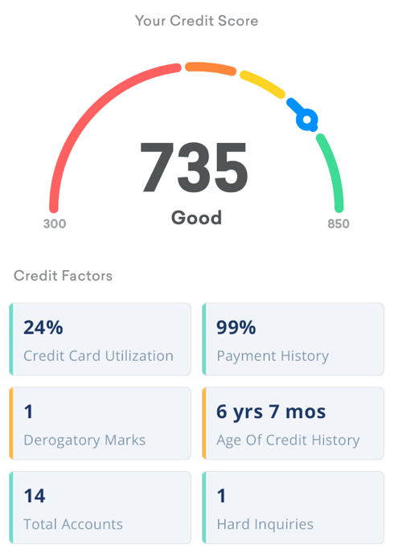
Credit Score
Measure of your likelihood to pay back borrowed funds
Factors affecting credit score include:
Payment history (35%)
Length of credit history (15%)
Balance to credit limit ratio (30%)
Types of credit used (10%)
New Credit (10%)
https://www.equifax.com/personal/understanding-credit/
Notes:
A
Three different credit reporting agencies: Experian, Equifax, and TransUnion
Most of the info is similar, but there are slight differences, just be aware that there are three different credit bureaus
The higher your credit score is, the lower your interest rate will be when you try to take out a credit card, home loan, car loan, etc.
Different factors have greater impacts on your overall credit score, see above list for percentage breakdown

Slide 18
Credit Score
Hard “pulls” vs Soft “pulls”
Hard inquiries (“hard pulls”) occur when a financial institution checks your credit when making a lending decision. (When applying for loan or credit card)
A hard inquiry could lower your score by a few points temporarily. Multiple hard inquiries in a short period could lead lenders to consider you a high-risk customer.
Soft inquiries (“soft pulls”) occur when a person or company checks your credit as part of a background check (During background check in housing application or hiring process)
Soft inquiries won’t affect your credit scores.
Stay informed: Use free tools such as Credit Karma to check your credit score!
https://www.moneyunder30.com/soft-pull-vs-hard-pull
https://www.creditkarma.com/advice/i/hard-credit-inquiries-and-soft-credit-inquiries/
Notes:
A
Credit Karma is free and has an app that is easy to use. Stay informed to help make good financial decisions.

Slide 19
Filing Taxes
Federal and State taxes (no income tax in WA)
Different filing tools
Free filing services if you fall below certain income
Due on April 15, but extensions are available
Commonly required info:
W2
1099s
SSN or tax ID number
Student loan interest form
State and local income taxes paid
Seattle U Albers offers free tax prep for households making less than $66k/year!
https://www.seattleu.edu/business/centers-and-programs/low-income-tax-prep/
Notes:
Y
You don’t have to file taxes if you make under a certain amount, but you still may want to since you may be eligible for a refund
Visit a tax prep center for more info, some services are free to households making less than a certain amount per year
Albers offers free tax prep for households under $66k/year
Save all of your documents in a secure location

Slide 20
Budgeting
Learn more about money basics
Map out a budget
Be mindful of new debt
Top priority: emergency fund
Tackle debt load as much as possible
Take advantage of your employer’s 401(k) or retirement plan
Start saving as soon as you can
https://www.nerdwallet.com/blog/loans/best-budgeting-apps-grads/
Notes:
A
Budgeting can be overwhelming, but it is important to stick to a budget
If you aren’t sure where to start, you can always begin by tracking your spending
Cash Course has info and tools

Slide 21
Draft a Budget
List income sources
Identify fixed expenses
Identify new expenses (for graduating students)
Set a savings “expense”
Identify variable expenses
Select your tools (Excel, app, etc.)
Budgeting Tools
Mint
Spending Tracker
BillGuard
YNAB
https://www.nerdwallet.com/blog/loans/best-budgeting-apps-grads/
Notes:
Y
Income sources: job income, interest income, etc.
Fixed expenses: rent, utilities, car payment, credit card payment, health insurance, student loan payments, etc.
Variable expenses: entertainment, subscriptions, restaurants, clothing, travel, etc.
Savings “expense”: Set an amount you’d like to save per month. If you prioritize it this way, it will be easier to save
Select a budgeting tool. Some people like to use apps that sync with your banking info, some like to use excel. If one doesn’t work for you, try another.

Slide 22
Resources
Federal Student Aid – Repaying Loans
Federal Student Aid – Types of Loans
National Student Loan Data System (NSLDS)
CashCourse
Credit Karma
NerdWallet
www.seattleu.edu/persistence

