Slide 1


Axiom –
Budget Transfers
Revised 9/14/22

Slide 2
What Should I Know About Budget Transfers?
How Do I Get Into Axiom And Navigate to Budget Transfers?
How Do I Create A Budget Transfer?
How Do I Submit My Budget Transfer?
What Happens Next?
How Will My Reconciled Budget Transfer Impact Data in Axiom?
Where Can I Get Help With Budget Transfers?
2
Revised 9/14/22

Slide 3
What Should I Know About Budget Transfers?
3
Revised 9/14/22

Slide 4
General Information About Budgets
A budget is a plan for earning revenue and/or expensing dollars within the coming or current fiscal year
Budgets do not reflect real dollars - they are revenue targets or spending thresholds recorded in the university’s general ledger
Budgets are placed in Account Strings in the general ledger, primarily in the operating funds (i.e., fund #s beginning with ‘1’)
  Some restricted cost centers (e.g., grants, sponsored projects, and gifts) budget their use of restricted funds over the course of a year
  See the ‘Finance: Chart of Accounts Overview’ video available on EngageSU for more information on the Chart of Accounts
4
Revised 9/14/22

Slide 5
Base vs. One-time Budget
Most revenue and expenditure budgets are set to an annually recurring amount – this is referred to as the Base Budget
Any budget can then be adjusted as follows:
  Base Budget adjustment
    a change to the revenue target or spending threshold that is meant to be in effect for the current fiscal year and every year thereafter
    processed from July 1 through the first Friday in October in the current fiscal year
  One-Time/Current-Year adjustment
    a change to the revenue target or spending threshold that is meant to be in effect for the current fiscal year only
    processed throughout the current fiscal year
5
Revised 9/14/22

Slide 6
Budget Transfer Overview
All budget transfers (base and one-time) are processed through Axiom
Submission of budget transfers depends on an individual’s role in Organizational Hierarchy (OH)
  Only an Axiom user within the span of financial oversight for the Activity reducing its budget can submit the budget transfer
  Within the budget transfer, the user may increase the budget of any Activity, even those outside their span of financial oversight, provided that other basic transfer controls are met
  See the ‘Axiom Orientation and Navigation’ slide deck available on EngageSU for more information about the Organizational Hierarchy and the ‘span of financial oversight’
6
Revised 9/14/22

Slide 7
Things To Know About Budget Transfers
Budget Transfers must be balanced (i.e. net neutral)
Budget Transfers are not allowed between funds
Fringe benefit transaction will be automatically processed for any transfer including faculty or staff Object Codes
Users will have ability to request transfers to new Activities or new Account Strings with oversight of UBO and Controller’s Office
A Mass Upload Utility with cut-and-paste functionality is available through the UBO for transfers with a large number of budget transactions (generally 10 or more rows of data)
7
Revised 9/14/22

Slide 8
What Is Required To Create a Budget Transfer?
An Axiom user in span of financial oversight of the Activity for which budget will be reduced
Reporting Unit code related to Activity being reduced
Account Strings (17 digits) for all transactions (to and from)
  Fund (2 digits), Function (1 digit), Activity (6 digits), Object (7 digits)
  Location (1 digit) is not required
Budget spread methodology and determinations for all transactions
Position Control Code (PCC) and Full-Time Equivalency (FTE) updates for budget adjustments impacting controlled faculty and/or staff positions
8
Revised 9/14/22

Slide 9
Launching and Navigating Axiom
9
Revised 9/14/22

Slide 10
Launching Axiom
Information about Accessing and Launching the Axiom software exists elsewhere:
  The ‘Axiom Orientation and Navigation’ slide deck available on EngageSU (refer to the ‘How Do I Launch Axiom?’ section)
  Installation Guides available on the UBO website
Axiom functions in both the Windows and Mac environments and can be accessed off-campus
  Mac users will access Axiom via the Virtual Desktop
  Off-campus users may also choose to access Axiom via the Virtual Desktop
  Information regarding the Virtual Desktop is available on the Information Technology Services website
10
Revised 9/14/22

Slide 11
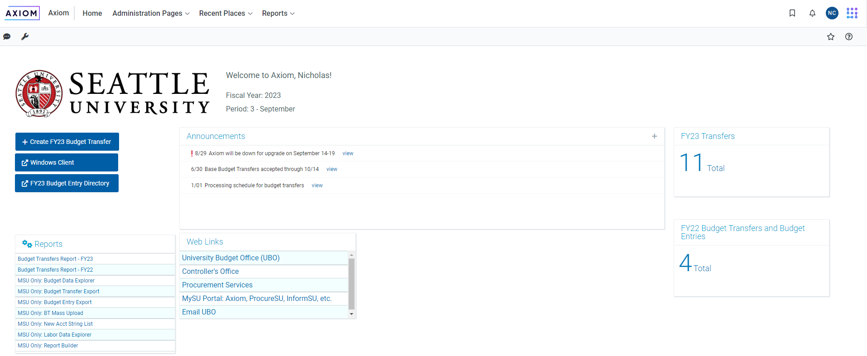
Web Client Landing Page
Axiom is initially accessed through a webpage portal
Quick
Links
11
Revised 9/14/22

Slide 12
How Do I Create A Budget Transfer?
→ Initial Data Required
12
Revised 9/14/22

Slide 13
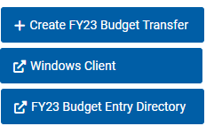
Landing Page
Select ‘+ Create Budget Transfer’ Quick Link on the Landing Page
Webpage will refresh to show the ‘Create a Budget Transfer’ page
If the page does not refresh, check to make sure you have allowed pop-ups on your browser
First option in the Quick Links List
13
Revised 9/14/22

Slide 14
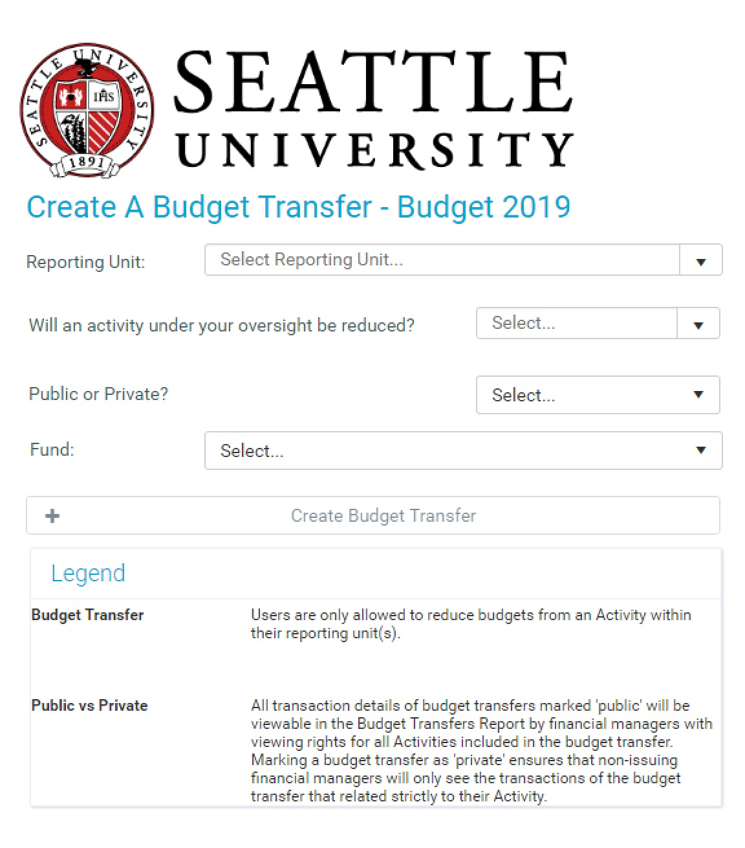
Initial Data Required
Reporting Unit
Will an activity under your oversight be?
Public vs Private?
Fund
Legend
Reclassification Warning
Notice that the ‘+ Create Budget Transfer’ button is inactive
14
Revised 9/14/22

Slide 15
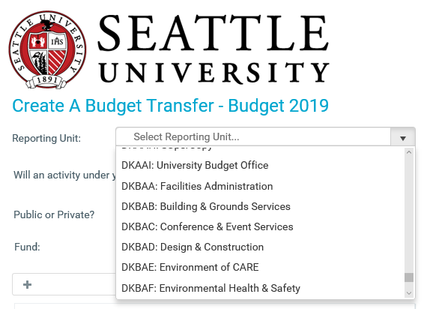
Selecting Reporting Unit
The ‘Reporting Unit’ field dropdown shows those Reporting Units in your span of financial oversight in the OH
If there are a number of options, you can type in the field to limit your search
Select the Reporting Unit that includes the Activity for which you will be reducing the budget
15
Revised 9/14/22

Slide 16
Reporting Unit Codes
All Activities in the GL are assigned to a Reporting Unit in the OH
Each Reporting Unit is assigned a unique five-digit, alphabetic designator that is smart-coded along four components
Letter Placement | Level Designation | Example: RU Code DKAAI
First | Senior Executive Area | D _ _ _ _ : CFO
Second | Division | _ K _ _ _ : Finance & Business Affairs
Third | School/College/Major Area | _ _ A _ _ : Finance Administration
Four & Five | Reporting Unit | _ _ _ A I : University Budget Office
More information about roles and relationships is available in the Organizational Hierarchy report folder available in InformSU
16
Revised 9/14/22

Slide 17
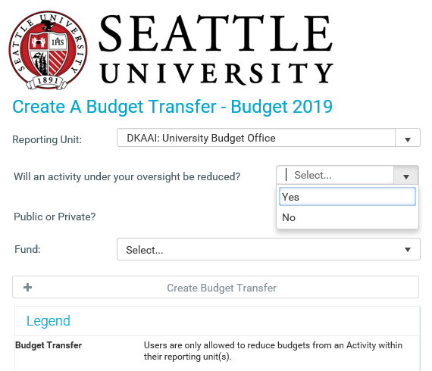
Will an activity under your oversight be reduced?
The options in this dropdown are ‘Yes’ and ‘No’
Notice that the Legend reiterates that “Users are only allowed to reduce budgets from an Activity within their Reporting Unit(s)”
17
Revised 9/14/22

Slide 18
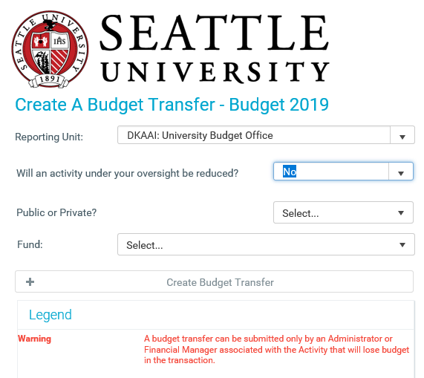
Selecting ‘No’
If you select ‘No’, notice that the Legend refreshes to provide you with a new Warning
Notice also that the ‘+ Create Budget Transfer’ button remains inactive
Exit the webpage and ask the appropriate Financial Manager to submit the budget transfer
What if the other Financial Manager refuses or neglects to submit the transfer? – Contact UBO
18
Revised 9/14/22

Slide 19
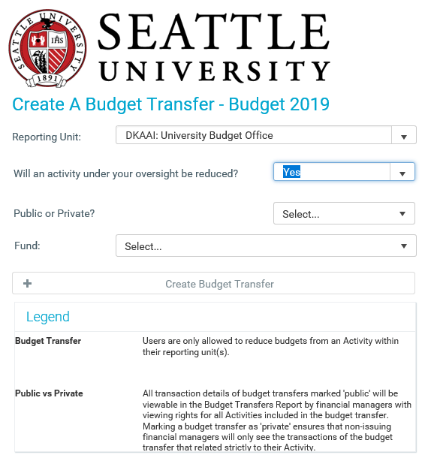
Selecting ‘Yes’
Select ‘Yes’ if the Activity for which you will be reducing budget is in your span of financial oversight
NOTE: If you select ‘Yes’ when the answer is really ‘No’, you will be able to move on now but you will lose all your work later
19
Revised 9/14/22

Slide 20
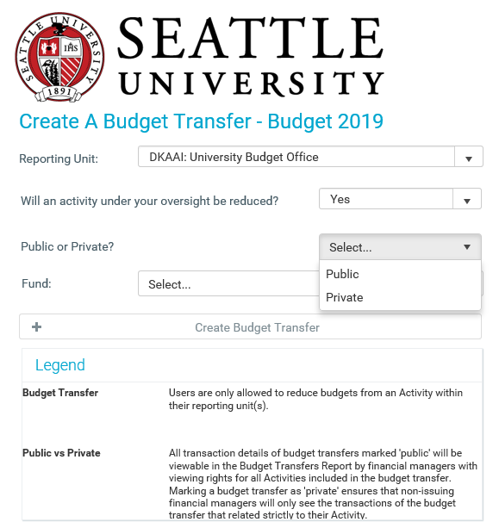
Public or Private?
The options in this dropdown are ‘Public’ and ‘Private’
Read the ‘Public vs Private’ note in the Legend
This designation determines:
  what information will show up in reports run by other financial managers
  who can open the budget transfer plan file at a later date to view the full transfer details
20
Revised 9/14/22

Slide 21
When Should the Transfer be ‘Public’?
Select ‘Public’ if the transfer does not include confidential or sensitive information
If marked ‘Public’, everyone in the span of financial oversight for every Activity included in the budget transfer will be able to:
  See all transaction rows in budget transfer reports
  Open the budget transfer plan file to review full details
Most transfers can and should be marked ‘Public’ to allow for ease of access and reconciliation of budgeted resources across campus
21
Revised 9/14/22

Slide 22
When Should the Transfer be ‘Private’?
Select ‘Private’ if the transfer includes confidential or sensitive information
  Any budget transfer with PCC or FTE information should be marked private
If marked ‘Private’, those in the span of financial oversight for every Activity included in the budget transfer:
  Will only be able to see data related to their specific adjustment in budget transfer reports (i.e., they won’t see all the budget transfer rows)
  Will not be able to open the budget transfer plan file to review full details
If the budget transfer is marked ‘Private’, full details and the plan file will still be available to the Transfer Requestor and everyone in the span of financial oversight for the Activity whose budget is reduced in the transfer
22
Revised 9/14/22

Slide 23
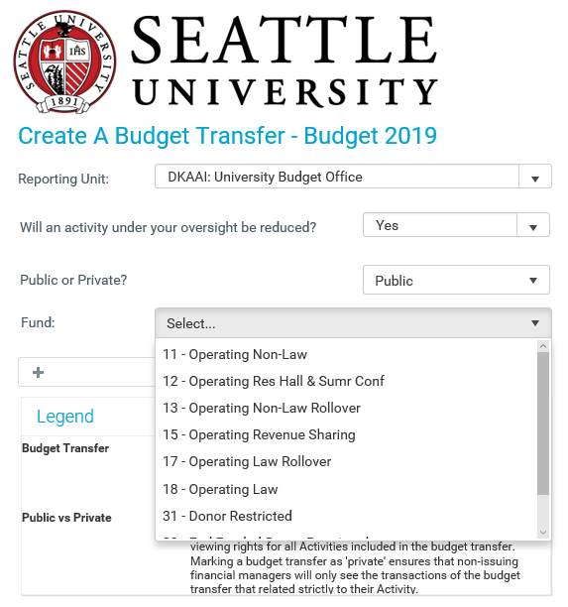
Selecting Reporting Unit
The ‘Fund’ field dropdown shows the those funds that are available for budget transfers:
  Operating Funds (i.e., ‘1X’)
  Some restricted funds (31, 32, and 33)
See the ‘Finance: Chart of Accounts Overview’ video available on EngageSU for more information on the Chart of Accounts
23
Revised 9/14/22

Slide 24
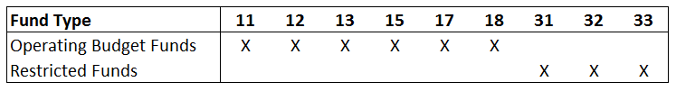
Selecting a Fund
Base budget transfers are permitted only in operating funds
One-time budget transfers are permitted in operating and some restricted funds
Remember that budget transfers cannot cross funds
  For example, you cannot input a budget transfer that reduces budget in Fund 11 and increases budget in Fund 31
Base and One-Time
One-Time Only
24
Revised 9/14/22

Slide 25
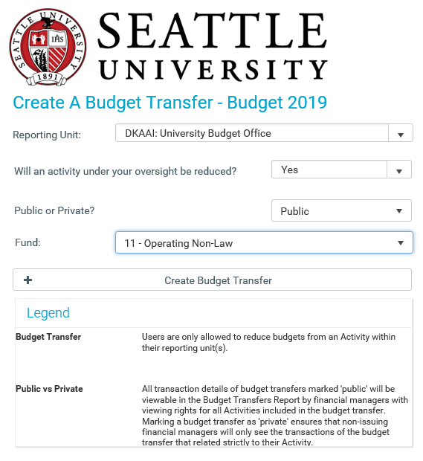
Create Budget Transfer
Once all required information has been provided, the ‘Create
Budget Transfer’ button
will become active
Click the button to move on
Create Budget Transfer
25
Revised 9/14/22

Slide 26
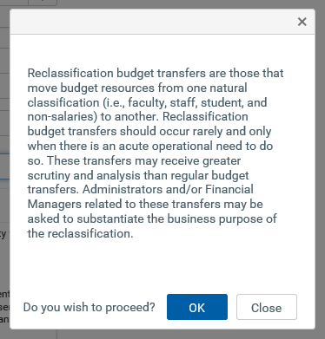
Reclassification Warning
This Reclassification Warning is displayed for every budget transfer
This warning is related to the ‘Policy on Transferring Salary Dollars’ available on the UBO website
If you select ‘Close’, the web form refreshes to the Landing Page
Select ‘OK’ to proceed – the webpage will refresh to the ‘Budget Transfer Header’ screen
26
Revised 9/14/22

Slide 27
How Do I Create A Budget Transfer?
→ Budget Transfer Header
27
Revised 9/14/22

Slide 28
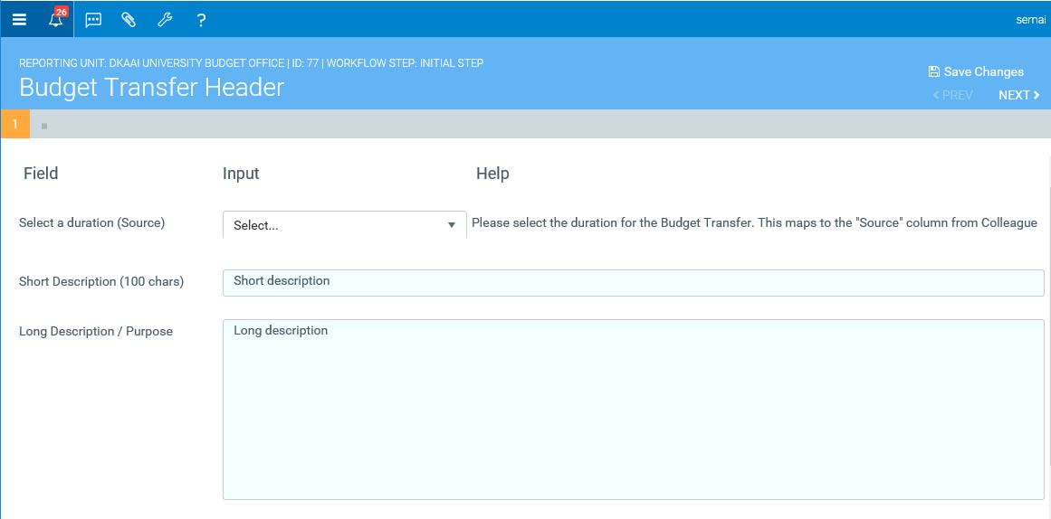
Budget Transfer Header Screen
4 Components
  Option Icons
  Identifying Data
  Navigation Options
  Data Fields
All data fields on the Budget Transfer Header Screen are required
Option Icons
Identifying Data
Navigation Options
28
Revised 9/14/22

Slide 29
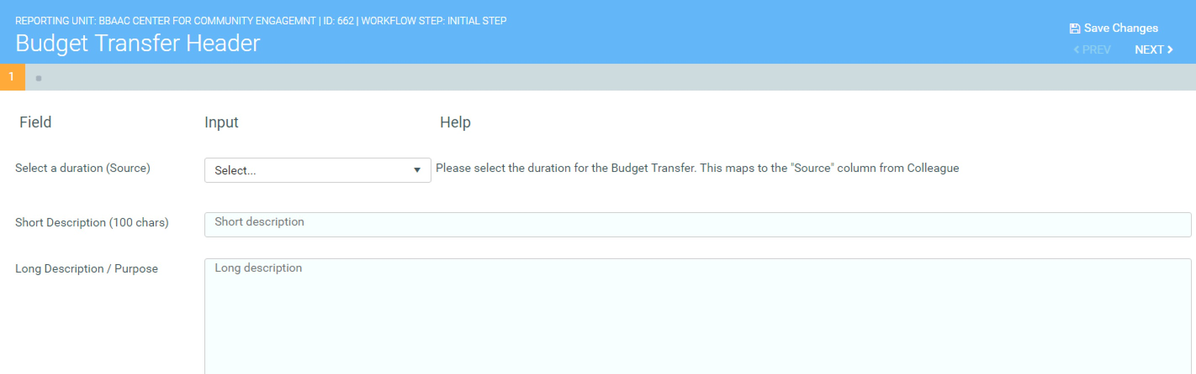
Budget Transfer Header: Identifying Data
The Reporting Unit Code and Description selected by the user
ID #: A unique numeric identifier assigned by Axiom
Workflow Step:
  Initial Step: Budget transfer has not yet been submitted
  Completed: Budget transfer has been submitted
29
Revised 9/14/22

Slide 30
Budget Transfer Header: Duration
Select a duration (source): The options are ‘Base’ and ‘One-Time’
  Base: the budget adjustments reflected in the transfer will alter the annually reoccurring budget
  One-Time: the budget adjustments reflected in the transfer are effective only in the current fiscal year
30
Revised 9/14/22

Slide 31
Budget Transfer Header: Short Description
Short Description:
  Limited to 100 characters
  Will be viewable in budget transfer reports
  Be clear enough to identify the transfer, but do not divulge sensitive info
31
Revised 9/14/22

Slide 32
Budget Transfer Header: Long Descriptions
Long Description:
  No character limit
  Is not currently viewable outside the plan file
  No need to write a novel – you can attach other documents
32
Revised 9/14/22

Slide 33




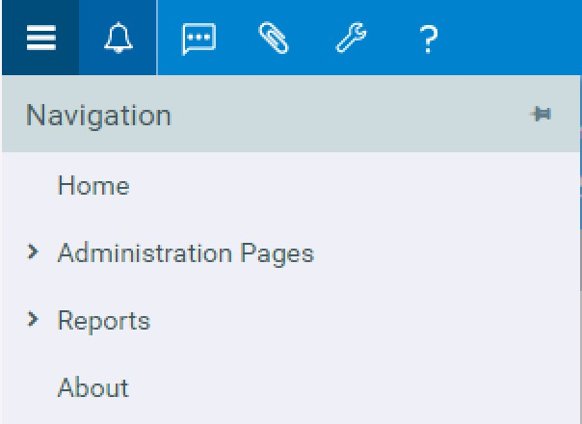


Budget Transfer Header: Option Icons
Triple Bar : Opens and closes
Navigation Pane
Bell : Axiom notifications
Conversation Bubble : Add message to plan file
Paper clip : Add attachment to plan file
Wrench : Other Tools
Question mark : System help
The Navigation Pane includes a link to the Landing Page
33
Revised 9/14/22

Slide 34
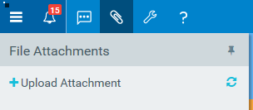
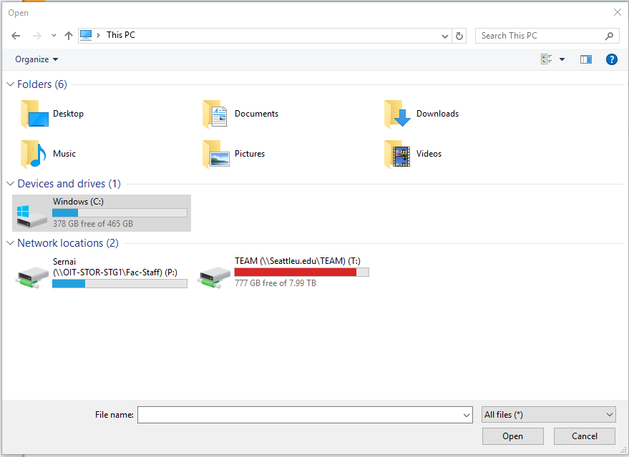
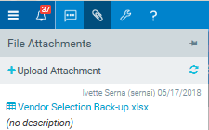
Budget Transfer Header: Adding an Attachment
Click on the paper clip : a new pane opens showing ‘+ Upload Attachment’
Click ‘+ Upload Attachment’ which will open an Explorer window
Find and select the file you want to attach
The file shows in the pane once uploaded
You can upload
multiple files
34
Revised 9/14/22

Slide 35
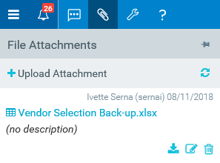
Budget Transfer Header: Deleting or Editing Attachment
Once the attachment is uploaded, hover over the white area in the pane to reveal attachment options
  Download attachment: Open and/or save document to computer or network
  Rename attachment: Change the attachment file name if necessary
  Delete attachment: Use this option if you uploaded the wrong attachment
35
Revised 9/14/22

Slide 36


Budget Transfer Header: Navigation Options
All data fields on the Budget Transfer Header screen are
required, but you have some options
  Complete all fields and click ‘Next’ in the Navigation Options
  to move on
  Click ‘Next’ to skip this screen for now and move on (you will
  need to complete these fields later)
  Click ‘Save Changes’ to save all you current work if you need
  to exit from the transfer
Navigation Options
36
Revised 9/14/22

Slide 37
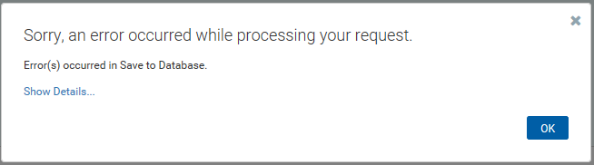
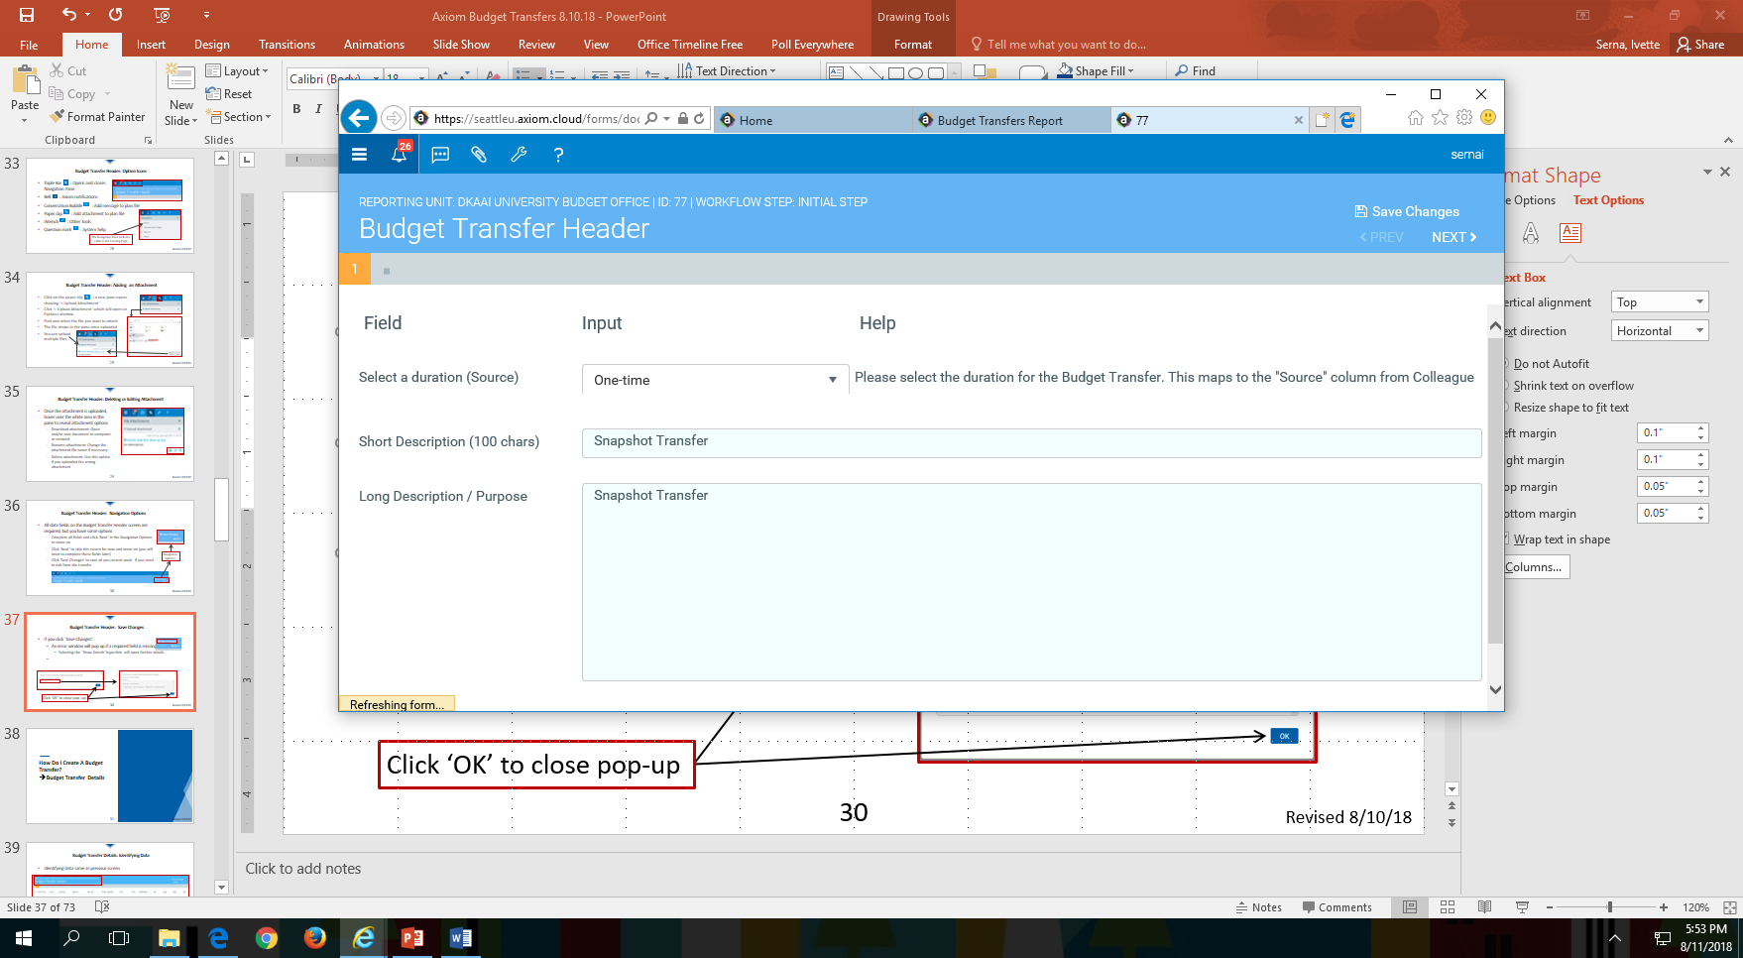
Budget Transfer Header: Save Changes
If you click ‘Save Changes’ either:
  The data will save, but nothing will happen on the screen
    There will be a small ‘Refreshing form…” message in the
    bottom-left corner of the screen. It will appear and disappear very quickly.
    If nothing else happens, then the data has been successfully saved and you can click on ‘Next >’ in the Navigation Options to move on or exit the budget transfer
  If there is something wrong with the data, then the transfer will not save
    The ‘Refreshing form…’ message will appear and disappear
    Then an error message will pop-up
37
Revised 9/14/22

Slide 38
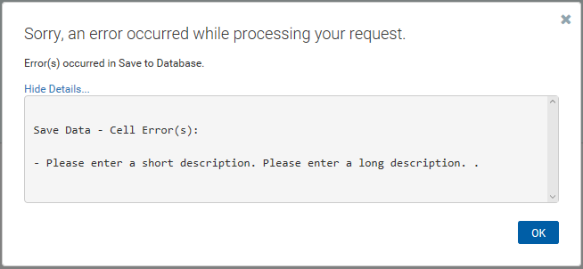
Budget Transfer Header: Fixing Data Errors
The error message means that the data did not successfully save
Click on the ‘Show Details…’ hyperlink to see further details about which data fields are missing or problematic
    Click ‘OK’ to close the error message
    Fix the data errors and click ‘Save Changes’ again to complete the save
    Click ‘Next >’ in the Navigation Options to move on
Click ‘OK’ to close pop-up
38
Revised 9/14/22

Slide 39
How Do I Create A Budget Transfer?
→ Budget Transfer Details
39
Revised 9/14/22

Slide 40
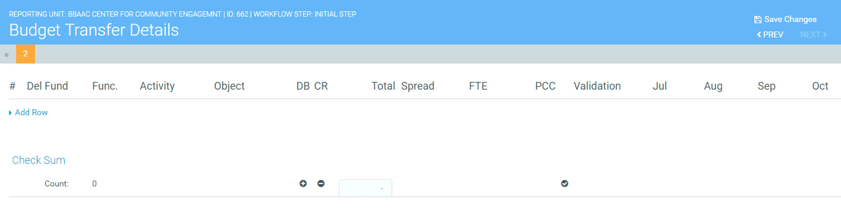
Budget Transfer Details: Identifying Data
Identifying Data same as previous screen
Scroll right to see months through June
40
Revised 9/14/22

Slide 41
Budget Transfer Details: Data Layout
The ‘Budget Transfer Details’ screen includes numerous columns that require scrolling to the right of the screen and will display data in rows based on user entry
The next five slides will explain the columns and rows of the ‘Budget Transfer Details’ screen in which data will be entered and/or displayed
  Columns are detailed from left to right
  Rows are detailed from top to bottom
Once you understand how the data will be displayed in the columns and rows, you will be instructed on entering budget transfer details beginning on slide #47
41
Revised 9/14/22

Slide 42
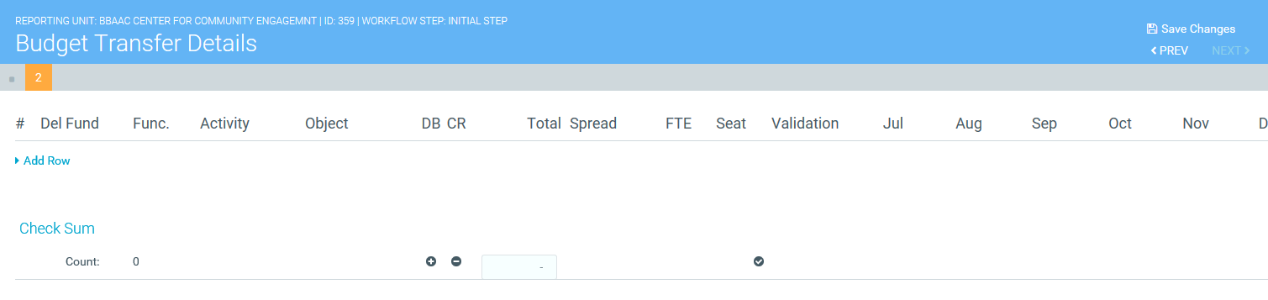
Budget Transfer Details: Columns
#: Each row added to the budget transfer will be identified with a row number to assist in implementation and reporting
Del: A delete checkbox is offered for every added row in the event an error is made and the row should not be saved
Fund: Will display the fund selected earlier on the ‘Create Budget Transfer’ screen
Func. / Activity / Object: Account String information to be selected by the user in each added row
42
Revised 9/14/22

Slide 43
Budget Transfer Details: Columns (cont.)
DB / CR: This column is informational only
  ‘DB’ stands for debit (+) / ‘CR’ stands for credit (-)
  Hover over the ‘+’ or ‘-’ and messages explain that:
    a budget increase will generally be entered as a positive number while a budget decrease will generally be entered as a negative number
    Contra-revenue (e.g., financial aid) and contra- expense (e.g., expense chargeback) items are considered budget decreases
Total: Total budget adjustment for the given row
Spread: An annual transaction amount can be spread across months using one of several budget spread methodologies
43
Revised 9/14/22

Slide 44
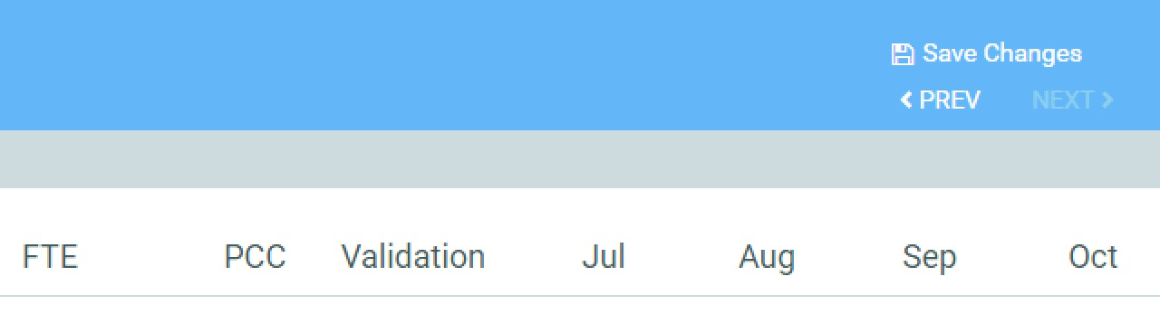
Budget Transfer Details: Columns (cont.)
FTE and PCC: Budget adjustments involving controlled positions should reference the underlying FTE and Position Control Code (PCC) adjustments
Validation: Axiom logic will validate the appropriateness of Account String and spread information and display error codes accordingly
Jul – Aug – Sep, etc.: The total budget adjustment for the row will be applied to months in the fiscal year based on the budget spread methodology
44
Revised 9/14/22

Slide 45
Budget Transfer Details: Rows
Add Row: Each transaction included in the budget transfer will require a distinct row
Check Sum: As rows are added to the budget transfer details, the ‘Check Sum’ row will maintain a transfer Total
  The budget transfer Total must ultimately be $0 (budget transfers must balance)
  The Check Sum total will include any fringe benefit adjustments
Count: The ‘Count’ will increase with each new row added to the budget transfer
45
Revised 9/14/22

Slide 46
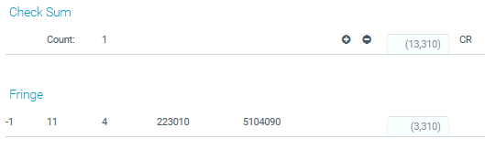
Budget Transfer Details: Fringe Benefits
If you select a faculty or staff Object Code, a Fringe row will be calculated at the bottom of the Budget Transfer Details page
Row # will always populate as ‘-1’
Account String will always be provided as shown
‘Check Sum’ Total includes
net budget adjustments
including fringe benefits
Fringe spread will match
spread on salary row(s)
46
Revised 9/14/22

Slide 47
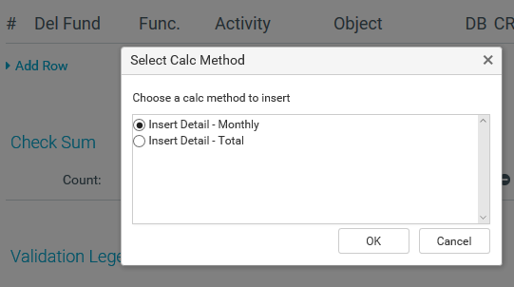
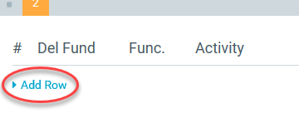
Budget Transfer Details: Adding a Row
Click ‘Add Row’
  There is no upper limit to number of rows you can add
  Contact the UBO if the transfer will need more than ten rows
The ‘Select Calc Method’ pop-up appears
47
Revised 9/14/22

Slide 48
Budget Transfer Details: Select Calc Method
Insert Detail – Monthly:
  Default option
  Allows user to enter budget adjustments in specific months that are added up to a row Total
Insert Detail – Total:
  Allows user to enter the total annual budget adjustment in the row
  Budget spread methodologies are then used to allocate the annual budget adjustment to individual months
Select option and
then click ‘OK’
48
Revised 9/14/22

Slide 49
A Word about Spreading Budgets
Allocating annual budget figures to individual months is a very new exercise for the university
It will take some time for this skill develop, so the only expectation is that financial managers do their best with the information available
Budget can be spread “backwards”
  Current practice can sometimes require the expenditure of resources with a budget transfer performed after the fact or at year-end
  While this practice is expected to decline, some resources will always require a year-end transfer
  Users may allocate budget to months that have already passed (e.g., a budget transfer submitted in February that spreads budget evenly over all 12 months)
49
Revised 9/14/22

Slide 50
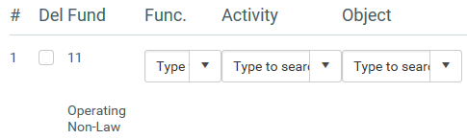
Budget Transfer Details: Adding Account String Information
The # is assigned when a new row is added
Fund: Displays the fund selected on the ‘Create Budget Transfer’ screen
Select Account String data from dropdown lists
  Axiom shows only 50 options at a time, so you should type words or numbers in the fields rather than scrolling
  The GL component description is provided below the selections
50
Revised 9/14/22

Slide 51
Budget Transfer Details: Account String Selections
You may only reduce budget in Activities belonging to the Reporting Unit you selected on the ‘Create Budget Transfer’ screen
You may increase budget in any Activity
There is a ‘TBD’ Activity available in the dropdown selections if you want to increase budget in a new Activity that has not yet been set-up
If you select ‘TBD’ for the Activity or if you select an Object Code in the Activity that has not been used before, you may get a ‘NEW’ code in the Validation column
  This means that the Account String is not yet set-up in the general ledger
  The UBO will contact you or the Controller’s Office to facilitate set-up
51
Revised 9/14/22

Slide 52
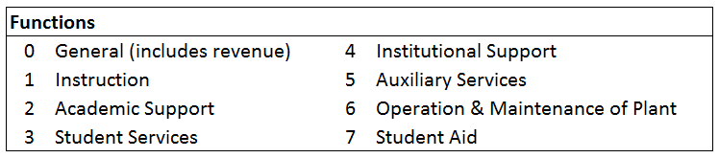
Budget Transfer Details: Common Errors
Remember to select an Activity for budget reduction that is part of the Reporting Unit you selected on the ‘Create Budget Transfer’ screen
If the ‘NEW’ code is showing in validation, make sure that you have selected the correct ‘Func.”
  Revenue adjustments will occur in function ‘0’
  Expense adjustments will occur in functions ‘1-6’ depending on the operational purpose of the Activity
  Financial aid adjustments will occur in function 7
52
Revised 9/14/22

Slide 53

Budget Transfer Details: Remaining Data Input
The remaining fields in the row will be completed based on the Calc Method you selected earlier
  Insert Detail – Monthly: this method requires the user to enter budget adjustments in specific months that are then summed into a row Total
  Insert Detail – Total: this method requires the user to enter a total annual budget adjustment amount that is then allocated to individual months using a selected spread methodology
53
Revised 9/14/22

Slide 54
Budget Transfer Details: Insert Detail - Monthly
Spread methodology is Manual
Cells below months become active for user input
Total is populated as details are added to months
Budget reductions are entered as negative numbers (e.g., -300), while budget increases are entered as positive numbers (e.g., 300)
Axiom calculates this amount
This is the user entered data
54
Revised 9/14/22

Slide 55

Budget Transfer Details: Insert Detail - Total
Spread methodology is selected from dropdown list
‘Total’ cell is active and ready for user input
Month cells are populated based on Total and Spread
Budget reductions are entered as negative numbers (e.g., -300), while budget increases are entered as positive numbers (e.g., 300)
This is the user entered/selected data
Axiom calculates this amount
55
Revised 9/14/22

Slide 56
Budget Transfer Details: Spread Options
For ‘Insert Detail – Total’, Axiom calculates monthly budget allocations based on the selected spread methodology
Spread Options
  Even: ‘Total’ is divided by twelve and result is assigned to each month
    Rounding may result in a slight discrepancy that you can disregard
  History – Actual:
    Calculated based on the actuals recorded in the most recent closed fiscal year
    Prior year’s actuals are proportionalized by month (e.g., 2% in July, 8% in August, 23% in September, etc.)
    Monthly proportions are assigned to the ‘Total’ amount entered for current fiscal year to calculate new monthly allocations
56
Revised 9/14/22

Slide 57

Budget Transfer Details: FTE and PCC
FTE and PCC fields will only become active if a faculty or staff Object Code is selected
FTE and PCC are related to the Labor Planning Plan Files available to SCMA Financial Managers
These fields are not required, though they might be very helpful to your SCMA Financial Manager
Consult with your SCMA Financial Manager about whether these fields should be utilized
57
Revised 9/14/22

Slide 58
Budget Transfer Details: Validation Legend
Axiom checks Account String and spread information
for any logic flaws and displays error codes accordingly
Errors will show on screen until details are adjusted
  MIS.: One or more Account String items are missing
  INV.: The Object Code specified (or not yet specified) is not yet “turned on” for this Activity in the GL
  HIS.: The spread methodology is ‘History – Actual’, but the figures are missing in the prior fiscal year (easiest fix is to change spread to ‘Even’)
  NEW: You have entered an Account String that is not yet active in the GL
58
Revised 9/14/22

Slide 59
Budget Transfer Details: Using the ‘Del’ Option
Data inputs/selections can be changed until the transfer is submitted
If you selected the wrong fund # on the ‘Create Budget Transfer’ screen, you must exit the plan file and start a new budget transfer
If you selected the wrong ‘Calc Method’ when you added a row, click the ‘Del’ box in the row and then add a new row
  The ‘Del’ row stays on the screen, but the data will not save and thus the row adjustment will not be processed
  Adjustments in ‘Del’ rows are not included in the ‘Check Sum’ Total
  Make sure you have made selections (you can pick anything) in the Func.’, ‘Activity’, and ‘Object’ fields so that you are able to save the transfer without errors later
59
Revised 9/14/22

Slide 60
Budget Transfer Details: Finish Data Input
As you add data to rows, the ‘Validation’ column will either become blank or will display error codes more fully described in the ‘Validation Legend’ at the bottom of the screen
As you add rows, the ‘Check Sum’ Total will refresh to show the total net adjustment for all the rows entered so far (the budget transfer must ultimately net to $0)
Adjustments in faculty or staff Object Codes will generate a fringe benefit adjustment that will be included in the ‘Check Sum’ Total
If the budget transfer is balanced and all required data has been provided, you are ready to submit the budget transfer
60
Revised 9/14/22

Slide 61
How Do I Submit My Budget Transfer?
61
Revised 9/14/22

Slide 62

Submitting: Save Changes
Click ‘Save Changes’ in the Navigation Options
An error window will pop up if a required field is missing
  Selecting the hyperlink will “Show Details”
You cannot submit the budget transfer until all errors are resolved
Use ‘< Prev’ and ‘Next >’ options to move between pages
Click ‘OK’ to close pop-up
62
Revised 9/14/22

Slide 63
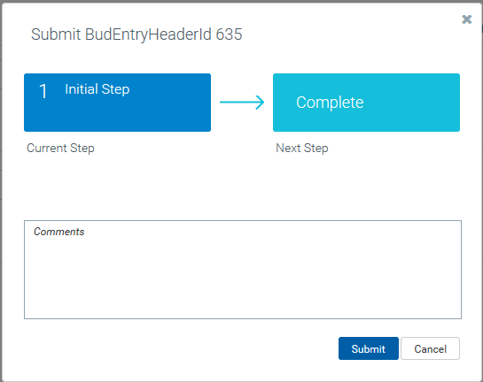

Submitting: Submit Entry
You cannot submit a budget transfer until all errors are resolved
Once all errors are resolved, click ‘Submit Entry’
A pop-up window will appear: ‘Submit BudEntryHeaderId XXX’
63
Revised 9/14/22

Slide 64
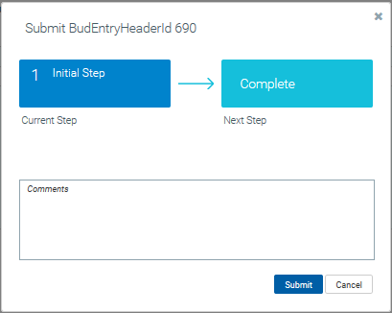
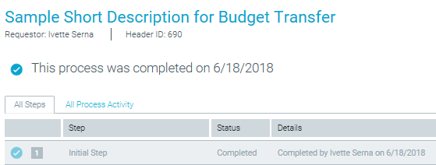
Submitting: Process Completed
Add comment if desired
Click ‘Submit’
Webpage refreshes to Status page that
tells you that “This process was completed …”
64
Revised 9/14/22

Slide 65
What Happens Next?
65
Revised 9/14/22

Slide 66
Workflow for Budget Transfers
User Submits Completed Budget Transfer
UBO Exports Submitted Budget Transfers from Axiom
UBO Uploads Budget Transfers To Colleague XE
Budget Transfers Are Posted To Colleague XE
Nightly Integration Brings Colleague XE Data Into Axiom
Reconciled Budget Transfer Data is Reflected in Axiom
66
Revised 9/14/22

Slide 67
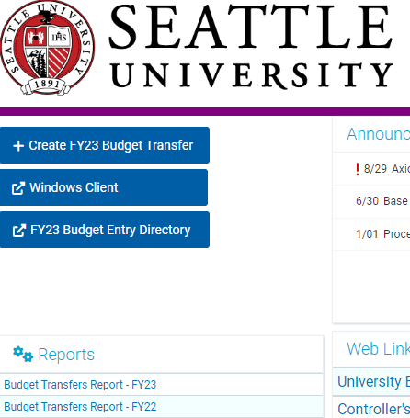
Landing Page – Budget Transfers Report
  The ‘Budget Transfer
  Report’ link is available
  on the Landing Page
  Users can access this
  report at any time
  A new webpage will open
67
Revised 9/14/22

Slide 68
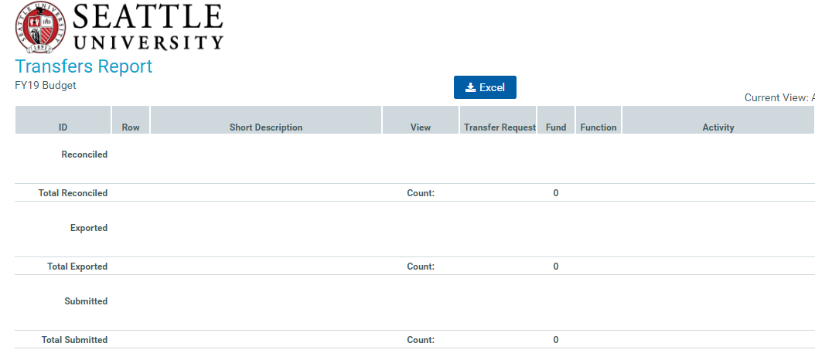
Budget Transfers Report
68
Revised 9/14/22

Slide 69
Using the Report
Status Sections
  Reconciled: Budget transfer is fully reconciled in Colleague XE and Axiom
  Exported: Budget transfer was exported from Axiom but is not yet posted to and reconciled with Colleague XE
  Submitted: Budget transfer was submitted in Axiom but has not yet been exported to Colleague XE
What can you see?
  Transfer Requestor sees all their transfers
  Others see transfers depending on ‘Public’ or ‘Private’ designation
  Hyperlinks allow you to open available Budget Transfer plan files
69
Revised 9/14/22

Slide 70
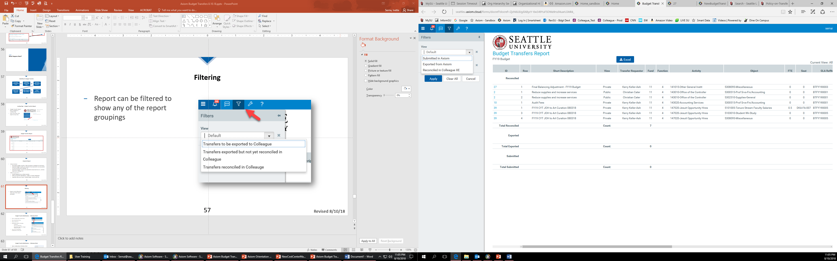
Filtering the Report
  Report can be filtered to show any of the report groupings
  Click on the filter icon in the upper-left corner of the screen to open the ‘Filters’ pane
  Use the dropdown function in the ‘View’ field to make a selection
  Click ‘Apply’ to refresh the report
70
Revised 9/14/22

Slide 71

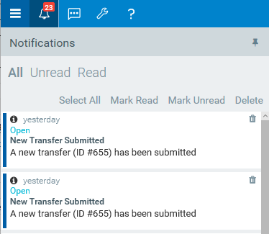
Budget Transfer Notifications – Web Client
    Open or return to Landing Page and check the Notification Icon in the
    upper-left corner
    If there is a red number hovering over the bell, you have Notifications waiting
    Click the bell icon to open the Notifications pane
71
Revised 9/14/22

Slide 72
Budget Transfer Notifications (cont.)
    The following data is available for all notifications:
      HeaderID
      Indication of age of notification (e.g., New, yesterday, 2 days ago)
      Hyperlink to open the Budget Transfer Plan File
    You can sort and delete notifications in this pane
72
Revised 9/14/22

Slide 73
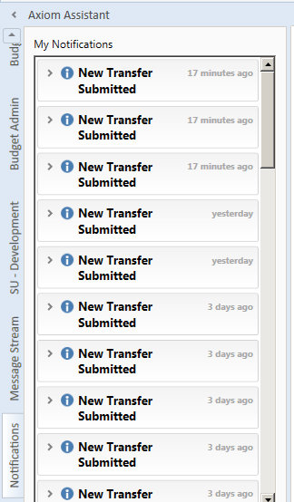
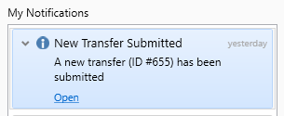
Budget Transfer Notifications – Windows Client
    Open Landing Page in Windows Client
    If you have recent notifications, the ‘Notifications’ tab of the Axiom Assistant will be open
    Click on ‘>’ to expand
    Notifications appear
    showing:
      HeaderID
      Age of notification
      Hyperlink to open the transfer
73
Revised 9/14/22

Slide 74
Budget Transfer Notifications – E-mails
    Axiom does provide e-mail notification capabilities for most activities
    E-mail protocol is still in development
    Need to balance sharing data with e-mail fatigue
    The UBO will be working with the Major Financial Managers to determine:
      Which actions warrant an e-mail
      Which people should receive e-mails
      Timing of e-mails
74
Revised 9/14/22

Slide 75
Where Can I Get Help with Budget Transfers?
75
Revised 9/14/22

Slide 76
Resources
EngageSU Curricula:
  Access EngageSU through the MySU portal
  Curricula include training slide decks, handouts, videos, etc. for the various Axiom modules and processes
  The UBO will use EngageSU to schedule Open Labs and/or In-Person Training Sessions
Contact the UBO
  Axiom General Questions: ubo@seattleu.edu
  Axiom Labor Planning: Brent Hanada, hanadab@seattleu.edu
  Org Hierarchy and Axiom Permissions: Nick Conte, nconte@seattleu.edu
76
Revised 9/14/22

