Slide 1
Axiom -
Labor Planning
Revised 9/14/22

Slide 2
What Should I Know About The Labor Planning Plan File?
How Do I Get Into Axiom?
How Do I Open My Labor Planning Plan File?
What Information Is Available In The Labor Planning Plan File?
Summary Report
FacultyPlan & StaffPlan
LaborPlan Categories
LaborPlan Sections: General and Foundational
Labor Sections: Current HR System Information
Labor Sections: Plan for [Upcoming Fiscal Year] Base Budget
How Do I Save My Labor Planning Plan File?
Where Can I Get Help With My Labor Planning Plan File?
2
Revised 9/14/22

Slide 3
1. What Should I Know About The Labor Planning Plan File?
3
Revised 9/14/22

Slide 4
What is an Axiom Plan File?
Users interact with the Axiom budget tool via Reports and Plan Files
Reports:
Reports are accessed through either the Axiom Web Client or Windows Client
Users access and review information available in Axiom via reports
Users interact with reports by changing view options and/or exporting data
Plan Files:
Plan Files can only be accessed through the Axiom Windows Client
Users access information, input data, and initiate processes via Plan Files
Users have the option of saving information back to Axiom tables via Plan Files
4
Revised 9/14/22

Slide 5
What is the Labor Planning Plan File?
The Labor Planning Plan File:
Is accessible to those at the SCMA and Divisional levels of the Org Hierarchy
Presents data to users based on their span of financial oversight
Displays information for faculty and staff Object Codes
Provides an itemization of the position-based budget details
Provides current, Object Code level operating budget data for all Activities across all Reporting Units within the SCMA
Provides data from the HR module of Colleague for all faculty and staff position records across all funds
Allows for itemization of non-position-specific budget resources
Does not provide payroll information nor student employee information
5
Revised 9/14/22

Slide 6
What is the Purpose of the Labor Planning Plan File?
The Labor Planning Plan File is a self-contained module in Axiom
It does not pull from or push data into other Axiom modules
It does not trigger any processes within or beyond Axiom
The primary purpose of the Labor Planning Plan File is to aid financial managers at the SCMA level and above in reviewing, reconciling, and planning for faculty and staff salary resources
The Labor Planning Plan File will often highlight the need for direct action
Budget Transfers (base and/or one-time)
Payroll change requests (change to GL or distribution)
New funding budget entries (address funding shortfalls)
6
Revised 9/14/22

Slide 7
Where Does the Data Come From?
Nightly data integrations
GL and Object-level budget information pulled from Colleague XE
Org Hierarchy data pulled from Enterprise Data Warehouse (EDW)
Person and position data is pulled from the HR module of Colleague XE
User Input
In certain sections of the Labor Plan Files, users are able to record information regarding the use of labor resources in the current fiscal year and planning details for upcoming fiscal years
The UBO will work with users to ensure the Plan File equates with budget data in Colleague: at the beginning of the fiscal year and once the Budget Update has been implemented in the fall
7
Revised 9/14/22

Slide 8
2. How Do I Get Into Axiom?
8
Revised 9/14/22

Slide 9
Launching Axiom
Labor Plan Files can only be accessed via the Axiom Windows Client that is launched from the Axiom web homepage
Information about Accessing and Launching the Axiom software exists elsewhere:
The ‘Axiom Orientation and Navigation’ slide deck available on the UBO website
Installation Guides available on the UBO website
Axiom functions in both the Windows and Mac environments and can be accessed off-campus
Mac users will access Axiom via the Virtual Desktop
Information regarding the Virtual Desktop is available on the Information Technology Services website
9
Revised 9/14/22

Slide 10
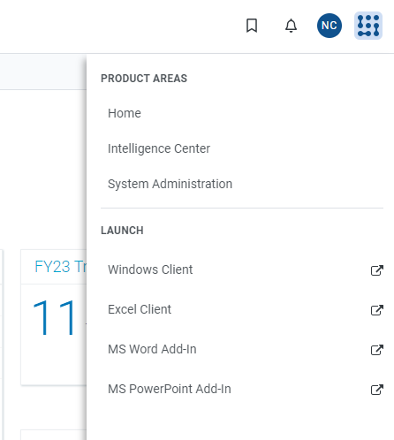
Launching the Windows Client
Access and login to Axiom via the MySU portal
Click the Syntellis logo in the upper right corner of the homepage to open the product areas and launch menu options
Select ‘Windows Client’ in the launch menu
Refer to the ‘Axiom Orientation and Navigation’ slide deck available on the UBO website for more information
10
Revised 9/14/22

Slide 11
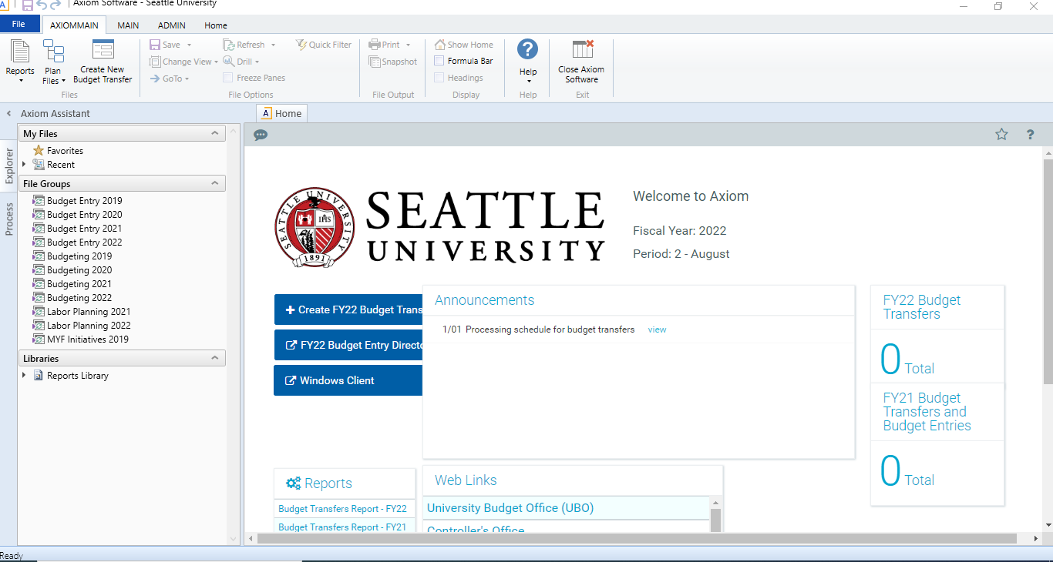
Windows Client
The Windows Client will open in a new window once the launch is complete
The Axiom Windows Client icon in the your computer’s task bar
11
Revised 9/14/22

Slide 12
3. How Do I Open My Labor Planning Plan File?
12
Revised 9/14/22

Slide 13
Landing Page – Windows Client
Axiom Identifiers (1)
Announcements (2)
Quick links (3)
Reports (4)
Process Summaries (5)
Axiom Assistant (6)
File Groups (7)
Plan Files in File Groups (7)
13
Revised 9/14/22

Slide 14
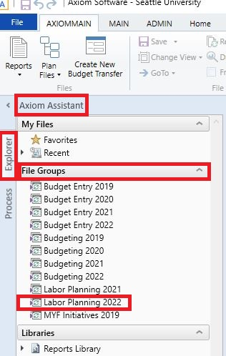
Axiom Assistant
Notice the ‘Axiom Assistant’ to the left of Landing Page
The caret icon (<) allows you to open and close the Axiom Assistant
The ‘Tab List’ offers various options. The Explorer Tab includes:
My Files
File Groups
Libraries
Double-click on ‘Labor Planning 2021’ in the ‘File Groups’ section to open the most current Labor Planning Plan File
14
Revised 9/14/22

Slide 15
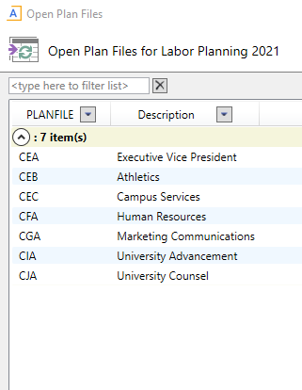
Opening Your Labor Planning Plan File
A pop-up window will appear
The number of School/College/Major Area (SCMA) units in your span of financial authority will be shown
Click the caret next to the ‘# items’ to open (˅) or close (˄) the dropdown
SCMA codes and descriptions will appear
Double-click on your selection to open the Plan File
SCMA Units
15
Revised 9/14/22

Slide 16
Plan File Opens
The Labor Planning Plan File will open as a new window in the Windows Client
The Plan File opens with three worksheets (look to the bottom of the screen):
16
Revised 9/14/22

Slide 17
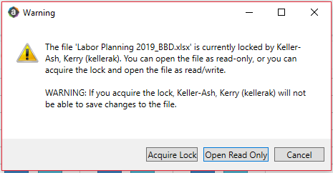
‘Open Read Only’
Note that all members of the SCMA’s span of financial oversight can open the Labor Planning Plan File, so you may occasionally get a “locked” error message
‘Open Read Only’ - you will not be able to save changes
‘Acquire Lock’ - you can save your changes, but the other person cannot
When you open a plan file as ‘Read Only’ the tab will be marked with an ‘(R/O)’
17
Revised 9/14/22

Slide 18
‘Acquire Lock’
If you ‘acquire lock’ from someone else, they are not notified until they attempt to save their changes
There is no auto-save or auto-recover in Axiom
If your lock gets taken, you will lose all the work you have not yet saved
The golden rules of Plan Files:
Save regularly – you cannot lose what has already been saved
Remember to close your files – There is no “time-out” feature in Axiom, so others may be waiting for you to exit
Do not ‘acquire lock’ without alerting the other user
If you know you have to work in a plan file, warn others that you will acquire all locks at a certain day and time
18
Revised 9/14/22

Slide 19
4.a. What Information Is Available in the Labor Planning Plan File?
→ Summary Report
19
Revised 9/14/22

Slide 20
Summary Report – Identifying Information
The Labor Planning Plan File opens on the Summary tab
The page header identifies the fiscal year covered by the plan file
Remember that the Labor Planning Plan File starts with data from the current fiscal year and will eventually end with foundational data for the upcoming year
Includes reminder of SCMA selected and current Labor Phase
20
Revised 9/14/22

Slide 21
Summary Report - Rows
Each pink row is a distinct Activity
Within the Activity data are Faculty and Staff Object Codes:
Every Object Code with budget and/or HR data gets its own section
Each Object Code has the following detail rows:
Base
Current Year
Total: Base plus Current Year
21
Revised 9/14/22

Slide 22
Summary Report – Starting Budget in Plan File
Starting Budget In Plan File:
Itemizes the foundational information included in the Plan File as of 7/1 (or when the implementation was completed) of the current fiscal year
This data is provided to highlight the progression of budgeted salary resources over the course of the fiscal year
The data in this column will not change over the course of the fiscal year
22
Revised 9/14/22

Slide 23
Summary Report – HR Wage Records in Colleague
HR Wage Records in Colleague:
Reflects summarized data pulled from the HR module in Colleague XE
The information is current as of the day before access date
* For 8/17/21, the data is current as of 8/16/21
The HR data reflects person and position information - not payroll
HR data is placed in the Base row just to save screen room
23
Revised 9/14/22

Slide 24
Summary Report – Budget in Colleague
Budget in Colleague:
Reflects summarized data pulled from the Finance module in Colleague XE
The information is current as of the day before access date
Budget transfers are reflected in appropriate row
24
Revised 9/14/22

Slide 25
Summary Report – Data Reconciliation
This Summary Report allows you to compare the current budget and HR data
There are sometimes good reasons for a difference, but the data should generally agree
Divergent data could signal the need for a budget adjustment or Payroll Change Notice to adjust HR data
25
Revised 9/14/22

Slide 26
Summary Report – → GoTo
For larger SCMA units, the Summary Report is very long
The ‘GoTo options’ allow users to navigate to specific areas of their Labor Planning Plan File
Change View:
Step 1: Scroll to ‘File Options’ in AxiomMain ribbon
Step 2: Click on ‘→ GoTo’
Click on dropdown arrow
26
Revised 9/14/22

Slide 27
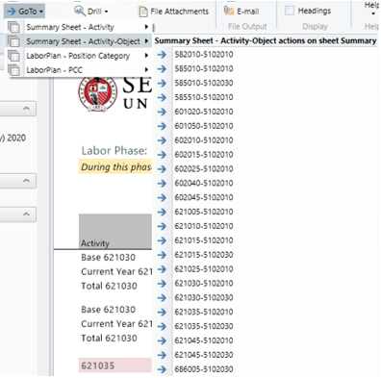
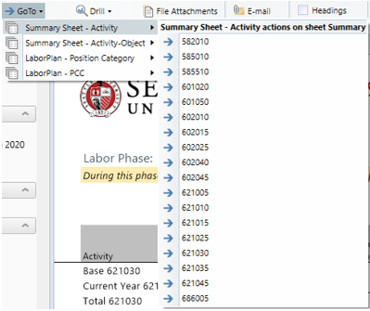
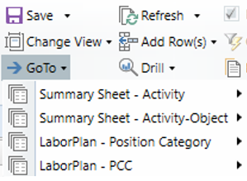
Summary Report – → GoTo (cont.)
‘→ GoTo’ dropdown offers navigation tools for both the Summary and LaborPlan worksheets
Select an area, then click on your selection
Area
Make Selection
27
Revised 9/14/22

Slide 28
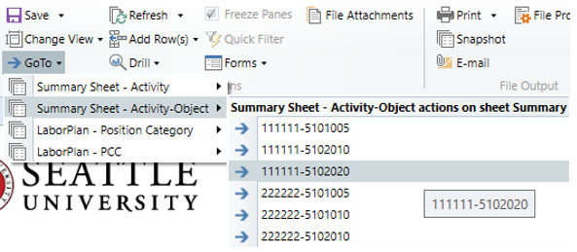
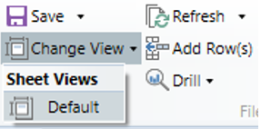
Summary Report – → GoTo (cont.)
Selecting an item in either Summary Report option causes the report to scroll so that your selection is shown in the first row of the Summary Report
Click on ‘Default View’ under ‘Change View’ to undo selections
28
Revised 9/14/22

Slide 29
4.b What Information Is Available in the Labor Planning Plan File?
→ FacultyPlan & StaffPlan
29
Revised 9/14/22

Slide 30
LaborPlan – Identifying Information
The FacultyPlan and StaffPlan worksheets detail information for the named population
The Labor Planning Plan File starts with data from the current fiscal year and will eventually end with foundational data for the upcoming year
30
Revised 9/14/22

Slide 31
4.c. What Information Is Available in the Labor Planning Plan File?
→ LaborPlan Categories
31
Revised 9/14/22

Slide 32
LaborPlan Categories – Layout of Rows
The FacultyPlan and StaffPlan have the same categories of data
Controlled Positions
Individual Position Control Code (PCC) lines and distributions
This category of data will include budget and HR data
Other Personnel Records – Non-Stipend
Records from the HR data load that could not be matched to a current PCC
This category of data will include only HR data
New employee records will show in this category until the user assigns them to a PCC
32
Revised 9/14/22

Slide 33
LaborPlan Categories – Layout of Rows (cont.)
Other Resources – Non-Stipend
Non-position specific budget items listed by Account Code
Examples: Salary savings, overtime, temp employee, etc.
This category of data will include only budget data
Stipends Only:
Records from the HR data load that include an employee name, but not a position code (All records not entered in Colleague’s Annual Wage screen)
Stipend specified budget items listed by Account String
This category of data can include both budget and HR data
33
Revised 9/14/22

Slide 34
LaborPlan Categories – Position Control Codes (PCCs)
PCCs are used to link Annual Pay to base funded positions in the budget
Only the UBO can assign PCCs
Plan File data will populate using a three-sided key combination of:
Position Control Codes (PCCs in Axiom)
PerPos (SU ID and Position ID from HR module of Colleague)
Activity String (GL data from Axiom)
Reported FTE for each SCMA (and thus Division) will be based on FTE associated with PCCs in Axiom
34
Revised 9/14/22

Slide 35
LaborPlan Categories – PCC Coding Convention
The PCC coding convention includes the SCMA code, the employee type, and the numeric identifier for the PCC (ex. DKA – ST – 015)
SCMA: Three-digit alphabetic code as defined in the Organizational Hierarchy
Employee Type: as defined in the HR Module of Colleague
FA: Faculty
ST: Staff (Non-union)
SU: Staff (Union)
Numeric Sequence: The UBO will assign a three-digit numeric figure to each distinct PCC
In the few instances where a PCC spans SCMA units, the numeric figure will include a decimal followed by an additional figure (ex. DKA – ST – 015.2)
35
Revised 9/14/22

Slide 36
LaborPlan Categories – Non-Positional Salary Resources
Other Resources
Non-position specific budget items listed by Account Code
Will include items such as:
Since there is no position associated with these resources, there is no way to align HR wage record data to these resources
Stipends Only
UBO budget records designated as stipends
Not included with ‘Other Resources’ since there may be HR wage record data to align with these resources
Salary Savings | Overtime
Temporary Employee | Other
36
Revised 9/14/22

Slide 37
LaborPlan Sections – → GoTo
For larger SCMA units, the LaborPlan worksheet is very long
The ‘GoTo options’ allow users to navigate to specific areas of their Labor Planning Plan File
Change View:
Step 1: Scroll to ‘File Options’ in AxiomMain ribbon
Step 2: Click on ‘→ GoTo’
Click on dropdown arrow
37
Revised 9/14/22

Slide 38
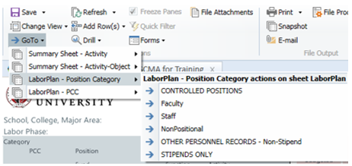
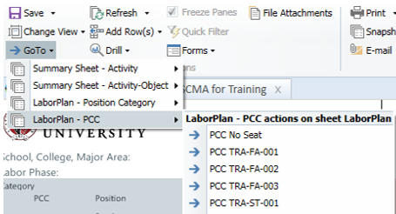
LaborPlan Sections – → GoTo (cont.)
‘→ GoTo’ dropdown offers navigation tools for both the Summary and LaborPlan worksheets
Select an area, then click on your selection
Make Selection
Area
38
Revised 9/14/22

Slide 39
LaborPlan Sections → GoTo (cont.)
Selecting an item in either LaborPlan option causes the report to scroll so that your selection is shown in the first row of the LaborPlan
Click on ‘Default View’ under ‘Change View’ to undo selections
39
Revised 9/14/22

Slide 40
4.d What Information Is Available in the Labor Planning Plan File?
→ LaborPlan Sections: General & Foundational
40
Revised 9/14/22

Slide 41
LaborPlan Sections: Initial Data Review
The Initial Data Review has multiple columns that are split into two sections named:
General – Highlighted in grey
Foundational – Highlighted in pink
41
Revised 9/14/22

Slide 42
LaborPlan Sections: General
Freeze Pane
Section is color-coded dark grey with inactive cells that cannot be edited
Portions of the General section are included in a frozen pane so data remains visible as you scrolls right in the LaborPlan
Header Data is shown in two rows:
Upper Row: PCC and PerPos Data
Lower Row: Account String Data
42
Revised 9/14/22

Slide 43
LaborPlan Sections: PCC and PerPos Data
PCC: Eight-digit code assigned by UBO and held in Axiom
Position: Position ID code as held in the PerPos record in Colleague
Job Title: the formal job title held in Colleague
Rank: the Faculty rank associated as indicated by the Position ID
EmpID: Employee ID code as held in the PerPos record in Colleague
Employee Name: The name attached to the EmpID in Colleague
43
Revised 9/14/22

Slide 44
LaborPlan Sections: Account String Data
PCC: Eight-digit code assigned by UBO and held in Axiom
Account String
Location is always ‘0’ so it is not required in Axiom
PCCs are only created for operating funds, so budget records for PCCs will only ever exist in Account Strings within the operating funds (11, 12, 15, 18)
44
Revised 9/14/22

Slide 45
LaborPlan Sections: Foundational
This section reflects data provided in the prior year’s Labor Plan File as foundational for the current fiscal year
Foundational Year Comments: as recorded in the prior year’s Labor Plan File
Budgeted Amount:
Budgeted annual amount for the given PCC
BUDGET DATA IN THE FOUNDATIONAL SECTION INCLUDES ONLY BASE BUDGET RESOURCES
45
Revised 9/14/22

Slide 46
LaborPlan Sections: Foundational (cont.)
FTE: the budgeted FTE associated with the Budget Amount
Budget Dist Pct (Distribution Percentage):
These metrics allow Axiom to calculate budget distributions for any future changes to the PCC
Every PCC, no matter its total FTE, has a total Budget Dist Pct of 100%
Example: .8 FTE split between Account String A (.5 FTE) and Account String B (.3 FTE) has a Budgeted Dist Pct of 62.5% (.6 rounded) in Account String A and 37.5% (.4 rounded) in Account String B
Assigned Work Units and Total Work Units: Faculty metric as provided
46
Revised 9/14/22

Slide 47
LaborPlan Sections: Example of Split Distribution
PCC and PerPos (Person ID & Position (ID)
But Account Strings are different: Activity 111111 and Activity 222222
FTE is 1.0 total but FTE (and thus budget) is split:
.29 FTE in Activity 111111 → Budgeted Dist Pct of 29% (0.3 rounded)
.71 FTE in Activity 222222 → Budgeted Dist Pct of 71% (0.7 rounded)
47
Revised 9/14/22

Slide 48
4.e What Information Is Available in the Labor Planning Plan File?
LaborPlan Sections: Current HR System Information
LaborPlan Sections: Current Year Resource Management
48
Revised 9/14/22

Slide 49
LaborPlan Sections: Current HR System Information
Section is color-coded orange with inactive cells that cannot be edited
This data reflects HR record information current as of the last nightly data import
Very occasionally, this section will be notated to indicate that HR records are historic rather than current
This section of data cannot be updated by the user
49
Revised 9/14/22

Slide 50
LaborPlan Sections: Current HR System Information (cont.)
Start and End:
Each HR record will indicate the start and end date for the record
Any start date after 7/1 of the current fiscal year indicates one of the following:
New employee that started within the fiscal year
HR record adjustment such as MRR review or stipend record
An end date before 6/30 of the current fiscal year indicates one of the following:
An employee has left the university (the position may now be open)
HR record adjustment such as MRR review or stipend record
50
Revised 9/14/22

Slide 51
LaborPlan Sections: Current HR System Information (cont.)
Amount: indicated the Annual Salary, Wage, or Contract for the record
FTE: Calculation of the number of work hours expected in the fiscal year divided by an annual load of 1,950 hours (52 weeks X 37.5 hrs/wk)
No. Pay Per: Number of pay periods expected in the fiscal year:
Regular staff and faculty records in the PCC section will have 24
Stipends will have 1
Dist. Pct: Every HR record has a total Dist Pct of 100%
51
Revised 9/14/22

Slide 52
LaborPlan Sections: Current Year Resource Management
Section is color-coded light blue with inactive cells that cannot be edited
This section was added by the UBO in March 2021 to capture the Final FY21 Base snapshot.
Snapshot was taken from the “Upcoming Budget Year” as of March and reconciliations against PowerBI was completed before snapshot was made.
This section of data cannot be updated by the user. Please reach out to UBO (ubo@seattleu.edu) if you have any questions.
52
Revised 9/14/22

Slide 53
4.f What Information Is Available in the Labor Planning Plan File?
→ LaborPlan Sections: Plan for [Upcoming Fiscal Year] Base Budget
53
Revised 9/14/22

Slide 54
LaborPlan Sections: Plan for [Next Fiscal Year] Base Budget
[Next Fiscal Year] in this example is FY22
This section can be edited by users as indicated by the blue highlighted cells in the line items
When Labor Plan Files are rolled forward in a new fiscal year, this Plan data becomes the Foundational data in the new files
The UBO will work with SCMA Financial Managers at the beginning of the fiscal year and in the fall to ensure this section of data is updated to align with base budget data available in Colleague
54
Revised 9/14/22

Slide 55
LaborPlan Sections: Planning Data for PCCs
1
2
3
NOTE: Line 3 + Line 3 = Line 2 + Line 2 = Line 1
Grey Line: The total of all Employee-Position record data available for the individual PCC (not available for user edit)
Light Grey Line: The Total of all distribution data available for the Employee-Position Record (not available for user edit)
Lines with Blue and Green cells: Users can input GL and budget specific data for each GL distribution line of an Employee Position Record
55
Revised 9/14/22

Slide 56
7. How Do I Save My Labor Planning Plan File?
56
Revised 9/14/22

Slide 57
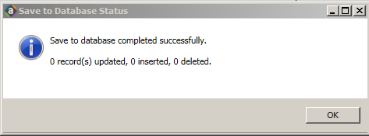
Saving Your Data
To Save:
Step 1: Scroll to ‘File Options’ in AxiomMain ribbon
Step 2: Click on ‘Save’ (Do not open dropdown)
Step 3: ‘Save to Database Status’ window will appear
Step 4: Click ‘OK’
57
Revised 9/14/22

Slide 58
Saved Data
Once your Labor Planning Plan File is saved, all your changes will be present when you next open the Plan File
Remember - The Labor Planning Plan File is a self-contained module in Axiom
It does not pull from or push data into other Axiom modules
It does not trigger any processes within or beyond Axiom
The Labor Planning Plan File will often highlight the need for direct action
Budget Transfers (base and/or one-time)
Payroll change requests (change to GL or distribution)
New funding budget entries (address funding shortfalls)
58
Revised 9/14/22

Slide 59
8. Where Can I Get Help With My Labor Planning Plan File?
59
Revised 9/14/22

Slide 60
Resources
UBO Website:
Current training materials for the Axiom System, modules, and processes are available on the UBO website.
Contact the UBO
Axiom General Questions: ubo@seattleu.edu
Axiom Labor Planning: Brent Hanada (hanadab@seattleu.edu)
Org Hierarchy and Axiom Permissions: Nick Conte (nconte@seattleu.edu)
60
Revised 9/14/22

