Slide 1

Axiom -
Labor Planning -
Updating the Plan File
Revised 9/15/22

Slide 2
What Information Is Available In The Labor Planning Plan File? (Slide 3)
How Do I Update PCC Records in the Labor Planning Plan File? (Slide 12)
Adding a PCC Record to the Labor Planning Plan File (Slide 13)
Adjusting the Employee attached to a PCC Record in the Labor Planning Plan File (Slide 15)
Adjusting the GL Distribution data for a PCC Record in the Labor Planning Plan File (Slide 20)
How Do I Update OTHER RESOURCES – Non-Stipend records in the Labor Planning Plan File? (Slide 24)
How Do I Update STIPENDS – ONLY records in the Labor Planning Plan File? (Slide 31)
How Do I Update the ‘Plan for [Upcoming Fiscal Year] Base Budget’ Section? (Slide 36)
Updating PCC Records (Slide 37)
Updating Other Records (Slide 44)
How Do I Save My Labor Planning Plan File? (Slide 46)
Where Can I Get Help With My Labor Planning Plan File? (Slide 49)
2
Revised 9/15/22

Slide 3
1. What Information Is
Available in the Labor Planning
Plan File?
NOTE: See the ‘Axiom – Labor Planning – Orientation’
slide deck on the UBO website for more on navigating
and understanding Plan File information.
3
Revised 9/15/22

Slide 4
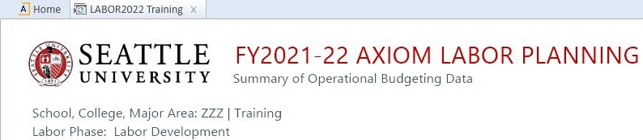

Summary Report – Identifying Information
The Labor Planning Plan File opens on the Summary tab
The page header identifies the fiscal year covered by the plan file
The Summary tab provide summaries of foundational budget data, current HR information, and current budget data from Colleague
4
Revised 9/15/22

Slide 5


LaborPlan – Identifying Information
The FacultyPlan and StaffPlan worksheets detail information for the named population
  The Labor Planning Plan File starts with data from the current fiscal year and will eventually end with foundational data for the upcoming year
5
Revised 9/15/22

Slide 6
LaborPlan Categories – Layout of Rows
The FacultyPlan and StaffPlan have the same categories of data
Controlled Positions
  Individual Position Control Code (PCC) lines and
  distributions
  This category of data will include budget and HR data
Other Personnel Records – Non-Stipend
  Records from the HR data load that could
  not be matched to a current PCC
  This category of data will include only HR data
  New employee records will show in this category until the user assigns them to a PCC
6
Revised 9/15/22

Slide 7
LaborPlan Categories – Layout of Rows (cont.)
Other Resources – Non-Stipend
  Non-position specific budget items listed by
  Account Code
  Examples: Salary savings, overtime, temp employee, etc.
  This category of data will include only budget data
Stipends Only:
  Records from the HR data load that include an employee name, but not a position code (All records not entered in Colleague’s Annual Wage screen)
  Stipend specified budget items listed by Account String
  This category of data can include both budget and HR data
7
Revised 9/15/22

Slide 8
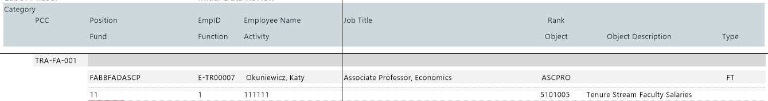
LaborPlan Sections: General
First Row: Position Control Code (PCC) information
  PCC: Eight-digit code assigned by UBO and held in Axiom
  Position: Position ID code as held in the PerPos record in Colleague
  EmpID: Employee ID code as held in the PerPos record in Colleague
Second Row: GL Information
This section is not available for user edit
8
Revised 9/15/22

Slide 9

LaborPlan Sections: Foundational
This section reflects data provided in the prior year’s Labor Plan File as foundational for the current fiscal year
BUDGET DATA IN THE FOUNDATIONAL SECTION INCLUDES ONLY BASE BUDGET RESOURCES
This section is not available for user edit
9
Revised 9/15/22

Slide 10

LaborPlan Sections: Current HR System Information
Section is color-coded orange with inactive cells that cannot be edited
This data reflects HR record information current as of the last nightly data import
  Very occasionally, this section will be notated to indicate that HR records are historic rather than current
  This section of data cannot be updated by the user
10
Revised 9/15/22

Slide 11

LaborPlan Sections: Plan for [Next Fiscal Year] Base Budget
[Next Fiscal Year] in this example is FY22
This section can be edited by users as indicated by the blue highlighted cells in the line items
When Labor Plan Files are rolled forward in a new fiscal year, this Plan data becomes the Foundational data in the new files
The UBO will work with SCMA Financial Managers at the beginning of the fiscal year and in the fall to ensure this section of data is updated to align with base budget data available in Colleague
11
Revised 9/15/22

Slide 12
2. How Do I Update PCC
Records in the Labor Planning
Plan File?
12
Revised 9/15/22

Slide 13
2.a Adding a PCC Record to the
Labor Planning Plan File
13
Revised 9/15/22

Slide 14


LaborPlan Sections: Requesting a New PCC
Only the UBO can create a new Position Control Code (PCC), but users can create a new-PCC placeholder record in the Labor Planning Plan File
To request a new PCC, select the ‘Add new PCC to [Faculty / Staff] section’
  Located directly above ‘Total Faculty’ and ‘Total Staff’
  Axiom will ask for a PCC Description or position title
A temporary PCC line item will be created in the Labor Plan File to which the user can add an employee-position and distribution (GL).
14
Revised 9/15/22

Slide 15
2.b Adjusting the Employee
attached to a PCC Record in
the Labor Planning Plan File
15
Revised 9/15/22

Slide 16
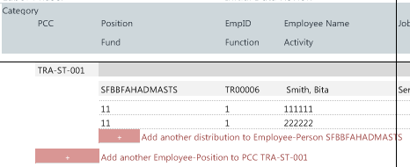
PCC Record Updates : Add Another Employee-Position to PCC …
Click on this selection to update the
PCC record for the following:
  Attach a new employee’s data
  to the PCC record
  Add an employee placeholder to
  the PCC record when an employee has left and a new employee has not yet been hired
Generally, updating an Employee-Position brings the Labor Plan File into line with the HR data section
  If a variance occurs between the budget and HR data for the new employee, this could signal the need for a Budget Transfer
16
Revised 9/15/22

Slide 17
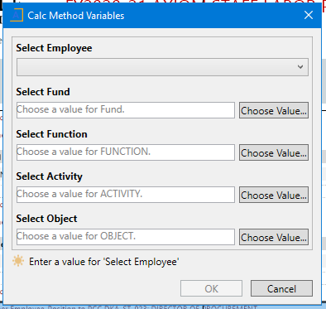
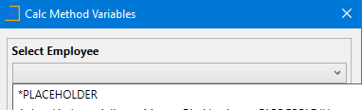
PCC Record Updates : Add Another Employee-Position to PCC … (cont.)
Clicking on the ‘Add Another Employee-Position to
PCC …’ option causes a Calc Method Variables popup
menu to open
Click on the drop-down field under ‘Select Employee’
to open a popup window of potential selections
  This is a long list of current employee-position
  records – start typing the employee’s
  last name to jump to that area of the
  selections
  If a new employee has not been hired or
  an HR record is not yet available for the new employee, select the first “*Placeholder” option
17
Revised 9/15/22

Slide 18
PCC Record Updates : Add Another Employee-Position to PCC … (cont.)
Once an Employee record has been selected,
enter a Value for each additional field by double-
clicking in the empty field box or the ‘Choose
Value’ button to open a window of potential
selections for each field.
  Click on an item to select it for the field
  The Activity Field will be limited to those
  Activities belonging to the current SCMA Labor Plan File
  Once the fields have been completed, click ‘OK’.
18
Revised 9/15/22

Slide 19
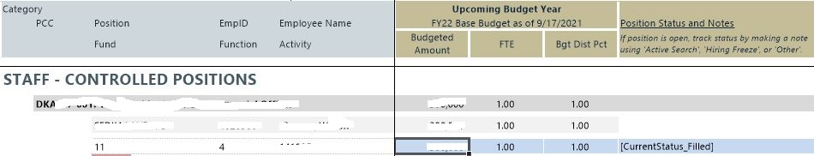
PCC Record Updates : Add Another Employee-Position to PCC … (cont.)
Once you have approved the ‘Calc Method Variables’ selections, a new line of information will be added to the PCC record in the Labor Plan File
Only cells highlighted in blue in the new GL distribution line can be altered by the user:
  Users cannot make updates to the General, Foundation, or HR sections of the PCC record
  Depending on the budget cycle, users can make updates to the ‘Current Year’ and ‘Plan for [Upcoming Fiscal Year] Base Budget’ sections of the PCC Record
Plan for … section: Blue cells are open for edit
General section: Not open for edit
19
Revised 9/15/22

Slide 20
2.c Adjusting the GL
Distribution data for a PCC
Record in the Labor Planning
Plan File
20
Revised 9/15/22

Slide 21
PCC Record Updates : Add Another Distribution to Employee-Person
Click on this selection to update the
PCC record for the following:
  Change the GL Account Code for
  the PCC record
  Add a GL Account Code to the PCC record to indicate split funding
Remember that adding or changing a GL distribution may require updates in other systems:
  Budget Transfers: input in Axiom to update the funding available to Account Codes
  Payroll Change Notice (PCN): HR/Payroll request to update an employee’s record in the HR module
21
Revised 9/15/22

Slide 22
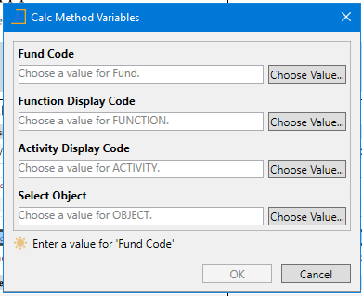
PCC Record Updates : Add Another Distribution (cont.)
Clicking on the ‘Add Another Distribution …’
option causes a Calc Method Variables popup
menu to open
Enter a Value for each field by double-clicking
in the empty field box or the ‘Choose Value’
button to open a window of potential
selections for each field.
  Click on an item to select it for the field
  The Activity Field will be limited to those Activities belonging to the current SCMA Labor Plan File
  Once the fields have been completed, click ‘OK’.
22
Revised 9/15/22

Slide 23
PCC Record Updates : Add Another Distribution (cont.)
Once you have approved the ‘Calc Method Variables’ selections, a new line of information will be added to the PCC record in the Labor Plan File
Only cells highlighted in blue in the new GL distribution line can be altered by the user:
  Users cannot make updates to the General, Foundation, or HR sections of the PCC record
  Depending on the budget cycle, users can make updates to the ‘Current Year’ and ‘Plan for [Upcoming Fiscal Year] Base Budget’ sections of the PCC Record
Plan for … section: Blue cells are open for edit
General section: Not open for edit
23
Revised 9/15/22

Slide 24
3. How Do I Update OTHER
RESOURCES – Non-Stipend
records in the Labor Planning
Plan File?
24
Revised 9/15/22

Slide 25
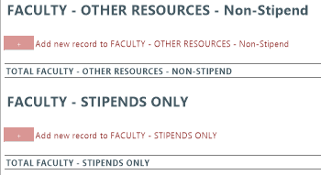
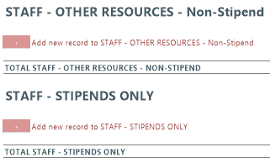
Updating OTHER RESOURCES – Non-Stipend
Other Resources
  Non-position specific budget items listed by Account Code including:
  Since there is no position associated with these resources, these line items are for budget information only
  Click on the ‘Add new record …’ button to add a line item
Salary Savings | Overtime
Temporary Employee | Other
25
Revised 9/15/22

Slide 26
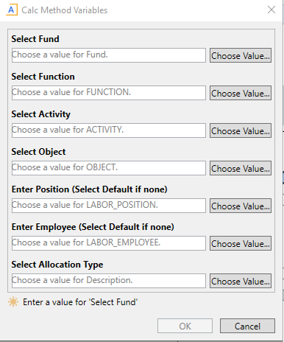
Updating OTHER RESOURCES: Warning
Clicking on the ‘Add new record …’ button causes
a Calc Method Variables popup menu to open
BEFORE ADDING A NEW RECORD:
  Review the records that already exist in the
  Labor Plan File
  Entering two or more line items with the
  exact same Variables will eventually cause
  a reporting error
    Note that the Plan File will allow you to save
    the duplicate record without a warning
  If you suspect this error has occurred, contact the UBO
26
Revised 9/15/22

Slide 27
Updating OTHER RESOURCES: GL Fields
Enter a Value for each of the GL fields by double-
clicking in the empty field box or the ‘Choose
Value’ button to open a window of options
  GL Fields include: Fund, Function, Activity,
  and Object
  Click on an item to select it for the field
  The Activity Field will be limited to those
  Activities belonging to the current SCMA
  Labor Plan File
27
Revised 9/15/22

Slide 28
Updating OTHER RESOURCES: Position and Employee
Selecting the open field or ‘Choose Value’
button under ‘Enter Position’ and ‘Enter
Employee’ opens a popup window of options
  Selecting these fields will open a list of
  either current Labor_Position Codes or
  Labor_Employee Codes
  If you do not want to select a particular option, you can select the first “Default” option in the list
  Remember that creating duplicate line items will cause an error in the Labor Plan File – make sure you are entering a unique combination of Variables
28
Revised 9/15/22

Slide 29
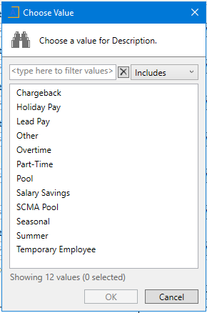
Updating OTHER RESOURCES: Allocation Type
The selection options for ‘Allocation Type’
include various non-position specific funding
pools that users may need to include in their
Labor Plan Files
  Remember that creating duplicate line items
  will cause an error in the Labor Plan File –
  make sure you are entering a unique
  combination of Variables
  If a new, unique record cannot be created,
  users should instead use the Comment fields
  in the Labor Plan File to document any
  necessary information
29
Revised 9/15/22

Slide 30
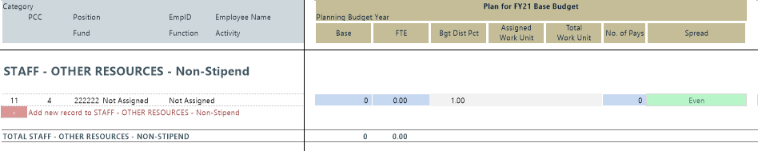
Updating OTHER RESOURCES – Non-Stipend (cont.)
Once you have approved the ‘Calc Method Variables’ selections, a new line of information will be added to the OTHER RESOURCES – Non-Stipend section of the Labor Plan File
Only cells highlighted in blue in the record can be altered by the user:
  Users cannot make updates to the General, Foundation, or HR sections of the PCC record
  Depending on the budget cycle, users can make updates to the ‘Current Year’ and ‘Plan for [Upcoming Fiscal Year] Base Budget’ sections of the PCC Record
Plan for … section: Blue cells are open for edit
General section: Not open for edit
30
Revised 9/15/22

Slide 31
4. How Do I Update STIPENDS –
ONLY records in the Labor
Planning Plan File?
31
Revised 9/15/22

Slide 32
Updating STIPENDS - ONLY
Often, stipend budget resources are known long before an employee is assigned the stipend
Stipend records may eventually have HR wage record data connected to them, but they should not be budgeted along with the regular base pay included in the PCC records
  WARNING: As you add a record to this section, keep in mind creating duplicate line items will cause an error in the Labor Plan File – make sure you are entering a unique combination of Variables
32
Revised 9/15/22

Slide 33
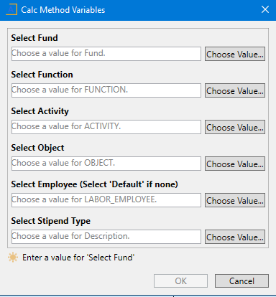
Updating STIPENDS-ONLY: GL Fields
Clicking on the ‘Add new record …’ button causes
a Calc Method Variables popup menu to open
Enter a Value for each of the GL fields by double-
clicking in the empty field box or the ‘Choose
Value’ button to open a window of options
  GL Fields include: Fund, Function, Activity,
  and Object
  Click on an item to select it for the field
  The Activity Field will be limited to those
  Activities belonging to the current SCMA
  Labor Plan File
33
Revised 9/15/22

Slide 34
Updating STIPENDS-ONLY: Employee and Stipend Type
Select the open field or ‘Choose Value’ button
under the remaining fields to opens a popup
window of options
  Select Employee:
    Select from the list of current Labor_Employee Codes
    If you do not want to select a particular option, you can select the first “Default” option in the list
  Stipend Type: Select either ‘Stipend’ or ‘Supplemental’
Remember that creating duplicate line items will cause an error in the Labor Plan File – make sure you are entering a unique combination of Variables
34
Revised 9/15/22

Slide 35
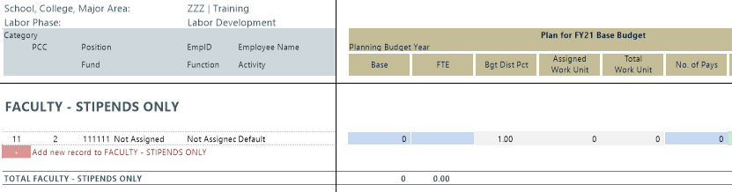
Updating STIPENDS-ONLY (cont.)
Once you have approved the ‘Calc Method Variables’ selections, a new line of information will be added to the STIPENDS ONLY section of the Labor Plan File
Only cells highlighted in blue in the record can be altered by the user:
  Users cannot make updates to the General, Foundation, or HR sections of the PCC record
  Depending on the budget cycle, users can make updates to the ‘Current Year’ and ‘Plan for [Upcoming Fiscal Year] Base Budget’ sections of the PCC Record
Plan for … section: Blue cells are open for edit
General section: Not open for edit
35
Revised 9/15/22

Slide 36
5. How Do I Update the ‘Plan
for [Upcoming Fiscal Year]
Base Budget’ Section?
36
Revised 9/15/22

Slide 37
5.a How Do I Update the ‘Plan
for [Upcoming Fiscal Year]
Base Budget’ Section?
→ Updating PCC Records
37
Revised 9/15/22

Slide 38
Plan for [Next Fiscal Year] Base Budget
[Next Fiscal Year] in this example is FY21
This section can be edited by users as indicated by the blue highlighted cells in the line items
When Labor Plan Files are rolled forward in a new fiscal year, this Plan data becomes the Foundational data in the new files
The UBO will work with SCMA Financial Managers at the beginning of the fiscal year and in the fall to ensure this section of data is updated to align with base budget data available in Colleague
38
Revised 9/15/22

Slide 39
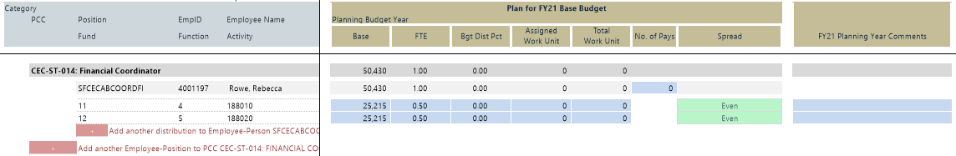
Editing Planning Data for PCCs
1
2
3
NOTE: Line 3 + Line 3 = Line 2 + Line 2 = Line 1
Grey Line: The total of all Employee-Position record data available for the individual PCC (not available for user edit)
Light Grey Line: The Total of all distribution data available for the Employee-Position Record (not available for user edit)
Lines with Blue and Green cells: Users can input GL and budget specific data for each GL distribution line of an Employee Position Record
39
Revised 9/15/22

Slide 40
Editing Planning Data for PCCs (cont.)
Refer to the “How Do I Add Records to the Labor Planning Plan File” section of the slide deck for instructions on adding data rows
For each GL Distribution line, enter the following in the Plan section:
  Base: Enter the base funding necessary to fund this item, in this GL distribution line, for a full fiscal year
  FTE: For each GL Distribution line, calculate the expected in the fiscal year divided by an annual load of 1,950 hours (52 weeks X 37.5 hrs/wk)
40
Revised 9/15/22

Slide 41
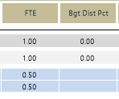
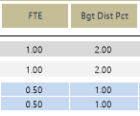
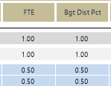
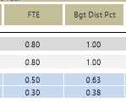
Editing the Planning Data for PCCs (cont.)
Budget Dist Pct (Distribution Percentage):
  Every PCC, no matter its total FTE, has a total Budget Dist Pct of 1.0
  Divide the FTE indicated for each GL Distribution line by the total FTE for the Employee-Position Record calculated in the light gray line
WRONG
Bdg Dist Pct must be 1.0
CORRECT
Bdg Dist Pct must be 1.0
41
Revised 9/15/22

Slide 42
Editing the Planning Data for PCCs (cont.)
For each GL Distribution line, enter the following in the Plan section:
Assigned Work Units and Total Work Units:
  These are faculty metrics only
  As calculated by School and College SCMA Financial Managers
No. of Pays: Calculate the number of pay periods for the Employee-Position record and enter that in the only blue cell included in the light grey total line
42
Revised 9/15/22

Slide 43
Editing the Planning Data for PCCs (cont.)
Spread:
  Select the green cell in each GL Distribution line
  Select a budget spread from among the options provided
Planning Year Comments: Include any notations for the line that should be kept when the Plan Files are rolled forward to the next fiscal year
43
Revised 9/15/22

Slide 44
5.b How Do I Update the ‘Plan
for [Upcoming Fiscal Year]
Base Budget’ Section?
→ Updating Other Records
44
Revised 9/15/22

Slide 45
LaborPlan Sections: Editing Planning Data in Other Sections
Users can edit fewer columns of Planning Data in the non-PCC sections of the Plan File:
  OTHER PERSONNEL RECORDS – Non-Stipend: Users can only edit cells in the ‘Planning Year Comments’ columns
  OTHER RESOURCES – Non-Stipend: Since these records are for budget information, users can enter data in the ‘Base’, ‘FTE’, ‘Spread’, and Planning Year Comments’ columns
  STIPENDS ONLY: Since these records may include budget information, users can enter data in the ‘Base’, ‘FTE’, ‘Spread’, and Planning Year Comments’ column
45
Revised 9/15/22

Slide 46
6. How Do I Save My Labor
Planning Plan File?
46
Revised 9/15/22

Slide 47
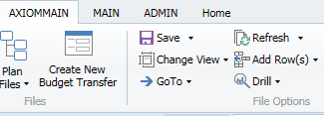
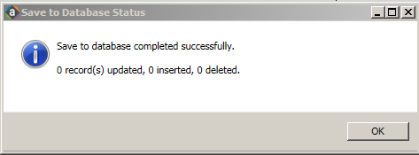
Saving Your Data
Save your work regularly!
To Save:
  Step 1: Scroll to ‘File Options’ in
  AxiomMain ribbon
  Step 2: Click on ‘Save’ (Do not open
  dropdown)
  Step 3: ‘Save to Database Status’
  window will appear
  Step 4: Click ‘OK’
47
Revised 9/15/22

Slide 48
Saved Data
Once your Labor Planning Plan File is saved, all your changes will be present when you next open the Plan File
Remember - The Labor Planning Plan File is a self-contained module in Axiom
  It does not pull from or push data into other Axiom modules
  It does not trigger any processes within or beyond Axiom
The Labor Planning Plan File will often highlight the need for direct action
  Budget Transfers (base and/or one-time)
  Payroll change requests (change to GL or distribution)
  New funding budget entries (address funding shortfalls)
48
Revised 9/15/22

Slide 49
7. Where Can I Get Help With My Labor Planning Plan File?
49
Revised 9/15/22

Slide 50
Resources
UBO Website:
  Current training materials for the Axiom System, modules, and processes are available on the UBO website.
Contact the UBO
  Axiom General Questions: ubo@seattleu.edu
  Axiom Labor Planning: Brent Hanada (hanadab@seattleu.edu) Org Hierarchy and Axiom Permissions: Nick Conte (nconte@seattleu.edu)
50
Revised 9/15/22

