Slide 1


Axiom – Orientation &
Navigation
Revised 9/14/22

Slide 2
What Is Axiom?
Who Can Use Axiom?
How Do I Launch Axiom?
How Do I Navigate Within Axiom?
Where Can I Get Help With Axiom?
2
Revised 9/14/22

Slide 3
1. What Is Axiom?
3
Revised 9/14/22

Slide 4
What is Axiom?
Axiom is a third-party financial management software supported by Syntellis
Axiom is a platform product consisting of many modules that incorporate various facets of financial management into a single integrated solution
Seattle University has deployed components of the Axiom’s Operating Budget module
4
Revised 9/14/22

Slide 5
What Does Axiom Include?
Budget entry development and revision/approval workflow
  New funding requests
  Reallocations and reductions
  Revenue updates
Self-service budget transfers
Labor planning data review and scenario development
Data reporting with export capabilities
5
Revised 9/14/22

Slide 6
How Does Axiom Work?
Axiom is build upon an extensive framework of connected data tables that include different types of information:
  Structural: Organizational Hierarchy and General Ledger
  Financial: Budget, Actual, and Encumbrance transactions
  Employment: Position and Employee Data
  Dimensional: Workflows, Roles, Assigned Personnel
Tables are populated through:
  Nightly integrations
  User input
Data queries are used to create reports and interactive files
6
Revised 9/14/22

Slide 7
Nightly Data Integrations
General Ledger information
  Financial transactions: budgets, actuals, encumbrances
  Structural data: Chart of Accounts
  From Colleague XE, Finance Module
Human Resources information
  Person/position specific information (e.g., annualized salary, GL distribution, FTE, etc.)
  From Colleague XE, HR Module
Organizational Hierarchy (OH) information
  OH levels, nodes, roles, assignees
  From Enterprise Data Warehouse (EDW)
7
Revised 9/14/22

Slide 8
User Inputs Saved in Axiom
Labor planning inputs and scenarios
Monthly operating budget spreads
Workflow determinations (approve, revise, return, deny)
Attached messages and documents
8
Revised 9/14/22

Slide 9
2. Who Can Use Axiom?
9
Revised 9/14/22

Slide 10
User Groups in Axiom
Master System Users (MSUs):
  Administrators of system with full access to all files and data
  All members of the University Budget Office (UBO)
Institutional Stewards:
  Some offices have a designated individual with full access to Axiom to validate data and/or assist users with questions or concerns
  Offices: Controller’s Office, Faculty Services, Human Resources, Information Technology Services, Institutional Effectiveness
Organizational Hierarchy (OH) Users assigned at the Reporting Unit level or higher
10
Revised 9/14/22

Slide 11
What is the Organizational Hierarchy (OH)
The OH is a structural framework used to assign, review, and report resource information across the span of the university’s activities
  Revenues and expenditures
  Faculty and staff positions
The OH allows the university to provision access to regularly available and ad hoc information for individuals based on their standing in the OH
The OH has multiple levels that are governed and managed by:
  An Administrator: the individual holding a position whose accountabilities include oversight and authorization of resources for an area
  A Financial Manager: the individual designated by the Administrator to provide day-to-day strategic and/or tactical management of resources
11
Revised 9/14/22

Slide 12
Organizational Hierarchy: Levels and Administrators
1
3
4
5
2
*
Institution
Division
School/College/Major Area
(SCMA)
Reporting Unit (RU)
Senior Executive Area
(SEA)
Activity
Seattle University
University President, Provost, Executive Vice President, and Chief Financial Office
Four Senior Executives and nine Vice Presidents
Academic Areas: Deans, Associate Provosts, Univ. Librarian
Non-Academic Areas: Associate VPs & equivalent positions
Often Department Chair, Director, or Supervisor
Not an official part of the Organizational Hierarchy but every Activity is linked to a Reporting Unit
12
Revised 9/14/22

Slide 13
Span of Financial Oversight
Levels 2-5 of the OH have multiple nodes and each node is assigned a single Administrator and single Financial Manager
The assignment of roles from the Activity up through the Senior Executive Area (SEA) level defines the span of financial oversight
Anyone assigned to an OH role has explicit permissions to the lower levels of the OH within their span of financial oversight
Axiom OH Users will only be able to access reports, files, and processes for units within the span of their financial oversight
More information about roles and relationships is available in the Security Role Assignments report available in InformSU
13
Revised 9/14/22

Slide 14
Organizational Hierarchy Coding
All Activities in the General Ledger are assigned to one Reporting Unit (RU)
Each Reporting Unit (RU) is assigned a unique five-digit, alphabetic designator that is smart-coded along four components that serve to identify the RUs place within the OH structure
Letter Placement | Level Designation | Example: RU Code DKAAI
First | Senior Executive Area | D _ _ _ _ : CFO
Second | Division | _ K _ _ _ : Finance & Business Affairs
Third | School/College/Major Area | _ _ A _ _ : Finance Administration
Four & Five | Reporting Unit | _ _ _ A I : University Budget Office
Axiom reports and files will utilize School/College/Major Area (SCMA) codes (e.g., DKA) and Reporting Unit codes (e.g., DKAAI)
14
Revised 9/14/22

Slide 15
3. How Do I Launch Axiom?
15
Revised 9/14/22

Slide 16
Things to Know
Axiom is initially accessed through a webpage portal
Axiom functions in both a Windows and Mac environment and can be accessed off-campus
  Mac users will access Axiom via the Virtual Desktop
  Information regarding the Virtual Desktop is available on the Information Technology Services website
Installation Guides are available on the UBO website
16
Revised 9/14/22

Slide 17
Navigating to Axiom
Axiom supported browsers:
  Google Chrome
  Microsoft Edge
Users access Axiom through the MySU portal
  The MySU portal Axiom link leads users to the Production instance of Axiom which integrates with the Production instance of Colleague XE, the university’s primary data system
  Users can also access the Sandbox instance of Axiom in which tests and practice files can be created without impacting live systems using the Sandbox URL: https://seattleu-sandbox.axiom.cloud
17
Revised 9/14/22

Slide 18
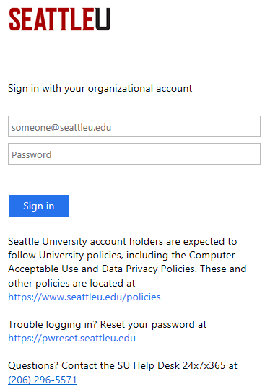
Authentication
Clicking on the Axiom button in MySU will take users to the SU login page
Enter your standard SU credentials
  The MySU portal provides web access to a number of university systems
  If you completed authentication earlier in your browser session to visit a different MySU system, you will skip the login page and Axiom will open immediately
The screen will refresh to show the Axiom Landing Page
18
Revised 9/14/22

Slide 19
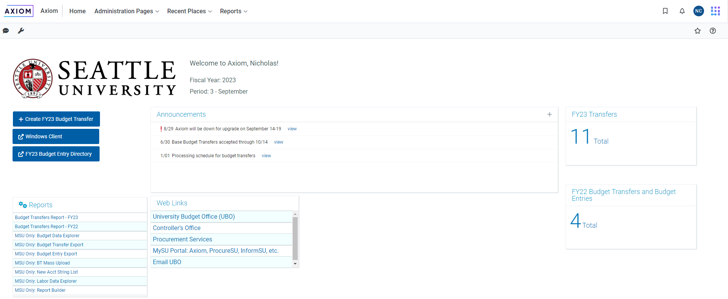
Web-Based Landing Page
19
Revised 9/14/22

Slide 20
Client Views
Users will access different Client Views for different functionalities
Web Client
  The initial Landing Page view is in Web Client
  The Web Client is well suited for web-form actions like submitting Budget Transfers and Budget Entries
  Some reports can be accessed and run on Web Client
Windows Client:
  Large scale data views and data input require a stronger environment
  The Windows Client is well suited for managing Plan Files (Operational Budgeting and Labor Planning)
20
Revised 9/14/22

Slide 21
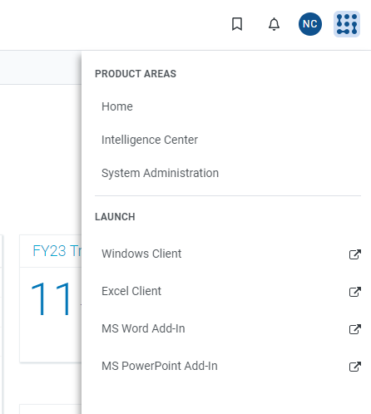
Launching the Windows Client
Click the Syntellis logo in the upper right corner of the homepage to open the product areas and launch menu options
Select ‘Windows Client’ in the launch menu
Note: the ‘Excel Client’ is only available to Master System Users
21
Revised 9/14/22

Slide 22
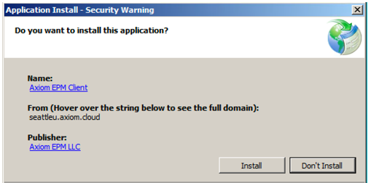
Axiom EMP Client
When you select the ‘Windows Client’ icon, an Application Install – Security Warning will open
The Axiom EPM Client application must be installed on your computer to access the Windows Client for the first time
Click ‘Install’
NOTE: The Virtual Desktop does not allow a permanent save, so you will have to install the Axiom EPM Client for every new session
22
Revised 9/14/22

Slide 23
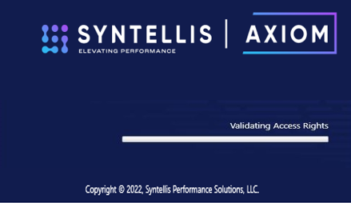
Successful Launch
The Axiom EPM Client will load
Once the Axiom EPM Client has been installed, the ‘Syntellis’ launch window will appear and show a series of actions
NOTE: If you are prompted to login to Axiom, this means that your browser set-up is not compatible with Axiom. If you are using Google Chrome, you must download a OneClick extension.
23
Revised 9/14/22

Slide 24
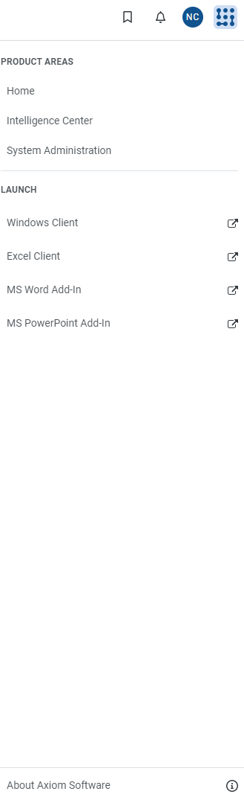
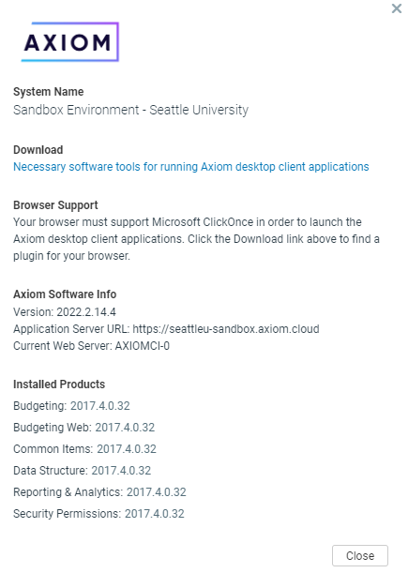
Google Chrome and Mozilla Firefox Extensions
To download the necessary browser extension, click the Syntellis logo
When the Navigation Pane opens, click on ‘About Axiom Software’
In the pop-up window that opens, click on the text link that reads “Necessary software tools for running Axiom desktop client applications”
24
Revised 9/14/22

Slide 25
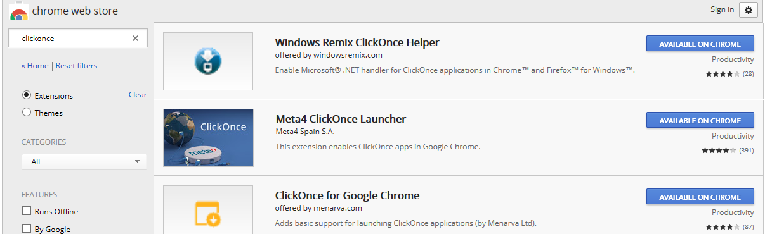
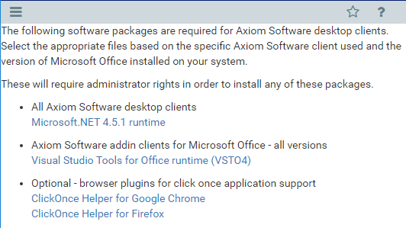
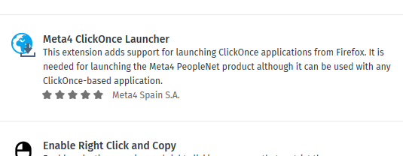
Axiom Software
Double-click the ‘ClickOnce Helper’ link to open a new webpage
25
Revised 9/14/22

Slide 26
ClickOnce Software
Current users have successfully downloaded and used the ‘Meta4 ClickOnce Launcher’ available for both Google Chrome and Mozilla Firefox
Select the ClickOnce extension of your choice and follow the directions for installation
Navigate back to the ‘Quick Launch’ menu and select the Windows Client icon
The Axiom EPM Client will launch with an “Application Install – Security Warning”
Click Install and allow the load process to run
26
Revised 9/14/22

Slide 27
4. How Do I Navigate Within Axiom?
27
Revised 9/14/22

Slide 28
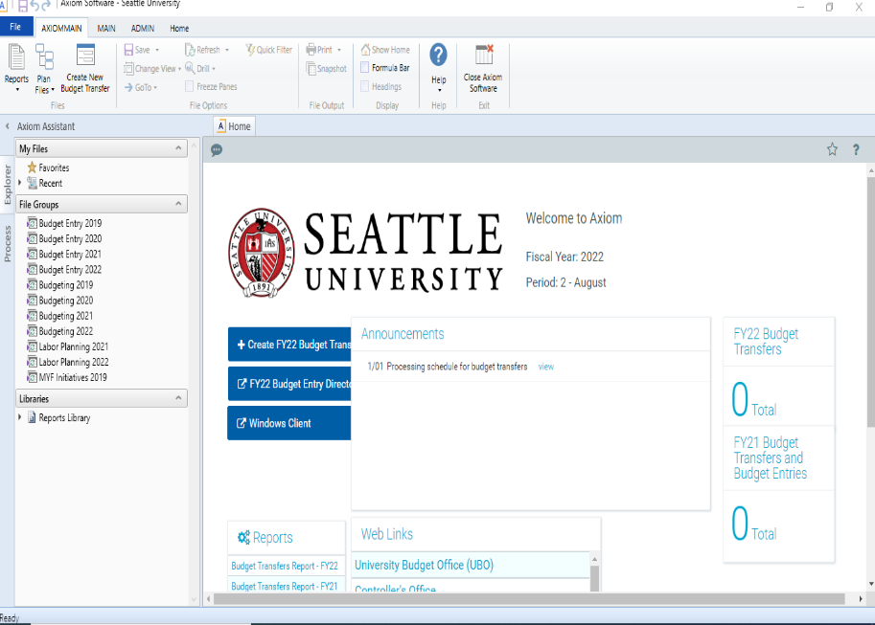
Windows Client
The Windows Client will open in a new window once the launch is complete
The Axiom Windows Client icon in the your computer’s task bar
28
Revised 9/14/22

Slide 29
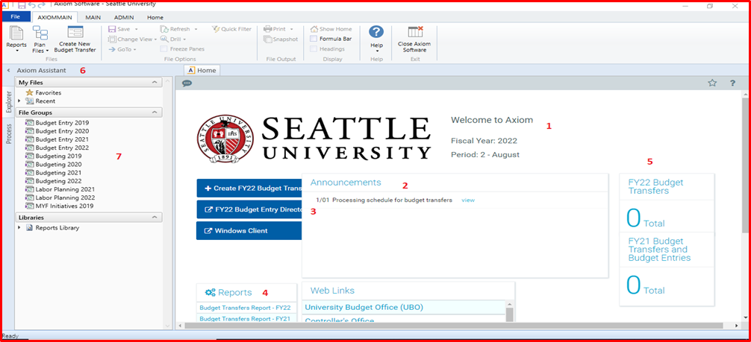
Landing Page – Windows Client
Axiom Identifiers (1)
Announcements (2)
Quick links (3)
Reports (4)
Process Summaries (5)
Axiom Assistant (6)
File Groups (7)
Plan Files in File Groups (7)
29
Revised 9/14/22

Slide 30
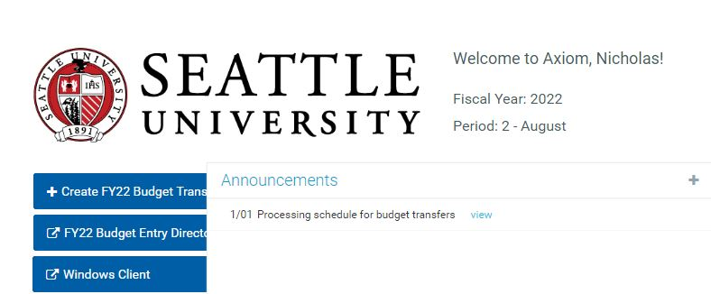
Landing Page Components: Axiom Identifiers
User name as recorded in Colleague XE
  The UBO cannot change this name
Identifiers
Fiscal Year: fiscal year for date of access
Period: by month as indicated by date of access
The red SANDBOX rectangle is an indication that you have access the sandbox instance of Axiom
If there is no red Sandbox rectangle, you have are in Production Axiom
30
Revised 9/14/22

Slide 31
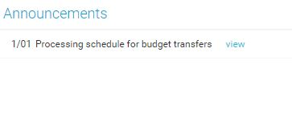
Landing Page Components: Announcements
Allows UBO to communicate instructions and updates to all Axiom users
When announcement(s) are added:
  They have a start and end date associated with the announcement
  Announcements are short with option to View more details
Example:
31
Revised 9/14/22

Slide 32
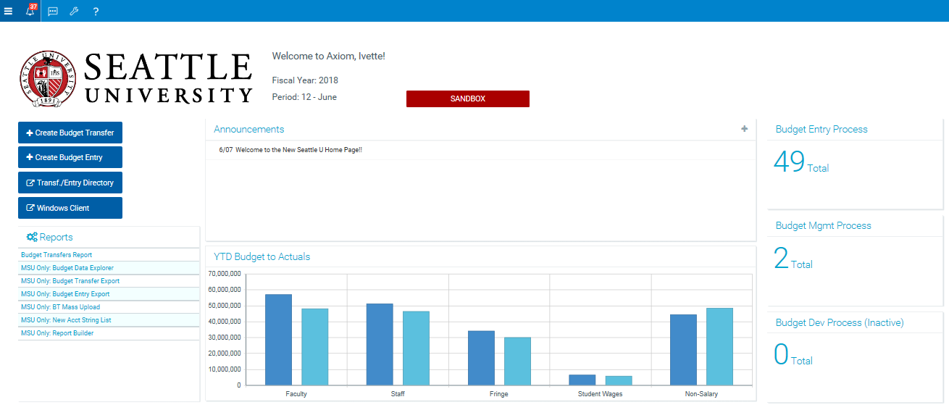
Landing Page Components: YTD Budget to Actuals
Monthly budget spread data is used to calculate the YTD Budget
  July 1 through end of access period
  Monthly spreads as recorded in Axiom from:
    Saved Operational Budgeting Plan File
    Reconciled Budget Transfers
    Approved Budget Entries
Nightly GL information provides YTD Actuals
32
Revised 9/14/22

Slide 33
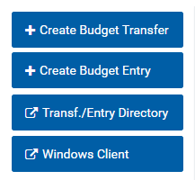
Landing Page Components: Quick Links
Quick Link buttons are available on the Landing Page in either the Web or Windows Client
Depending on which client you are in, the Create links (Budget Transfer and Budget Entry) will open in either a new webpage or new window
33
Revised 9/14/22

Slide 34

Landing Page Components: Reports
Reports can be accessed via the homepage or the Axiom Assistant
Reports available to all users will be accessed via a link in the Reports section of the homepage
34
Revised 9/14/22

Slide 35
Landing Page Components: Process Summaries
Provides users with updated information relevant to their budget or labor workflow
Numbers (even ‘0’) are hyperlinks that will open approval processes or reports
See “Axiom – Budget Transfers” and “Axiom – Budget Entries” on the UBO website for more information
35
Revised 9/14/22

Slide 36
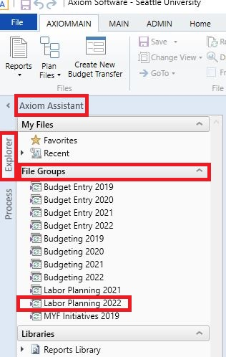
Landing Page Components: Axiom Assistant
Axiom Assistant to left of Landing Page
Several tabs are available in the Axiom Assistant
  Explorer: primary tab
  Notifications: will be primary tab if budget transfer notifications are available for you
36
Revised 9/14/22

Slide 37

Landing Page Components: File Groups
Available in Explorer tab of Axiom Assistant
File groups organize the essential Plan Files used in:
  Budget Entry
  Operational Budgeting
  Labor Planning
37
Revised 9/14/22

Slide 38
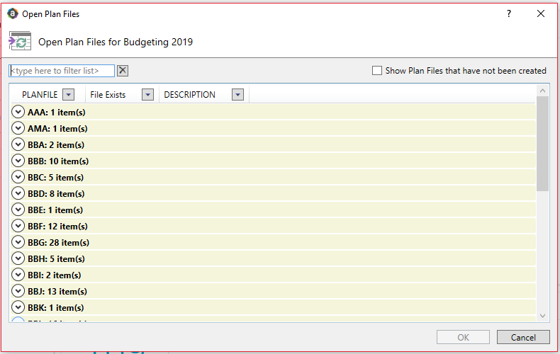
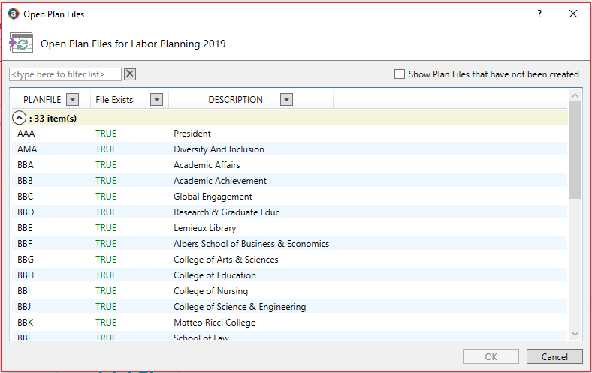
Landing Page Components: Plan Files
Plan Files are Reporting Unit- or SCMA-specific files that allow users to access and input data
Users can only access Plan Files within their span of financial authority
38
Revised 9/14/22

Slide 39
5. How Do I Get Help With Axiom?
39
Revised 9/14/22

Slide 40
Resources
UBO Website:
  Current training materials for the Axiom System, modules, and processes are available on the UBO website.
Contact the UBO
  Axiom General Questions: ubo@seattleu.edu
  Axiom Labor Planning: Brent Hanada (hanadab@seattleu.edu)
  Org Hierarchy and Axiom Permissions: Nick Conte (nconte@seattleu.edu)
40
Revised 9/14/22

